Slide 1
Minnesota Prairie Conservation Plan
Greg Hoch| DNR Prairie Habitat Supervisor
Judy Schulte | DNR SNA Prairie Biologist
Angie Miner | TNC Prairie Recovery Specialist

Slide 2
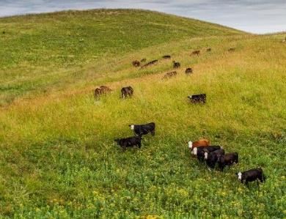
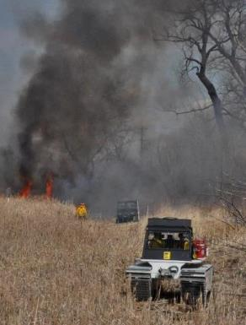
Goals and Objectives of the Plan
Protect last remaining tracts of prairie (protect)
Build a grassland habitat base for many species of wildlife (restoration)
Make sure grasslands are in best possible condition (enhance)
Use a working lands approach to integrate conservation and economics
Functioning grassland landscapes

Slide 3
Changing Landscape
Fluctuations in commodity prices
Numerous factors
Land prices and interest in conservation programs
Loss of CRP (~1M acres since 2007)
Ecosystem services of grasslands
Carbon and grasslands
Societal focus on pollinators
Data on declines in grassland birds

Slide 4
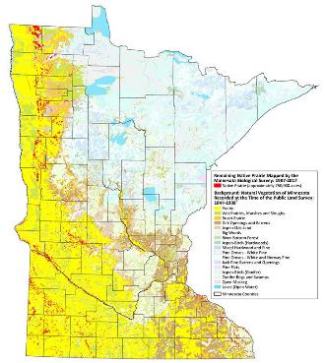
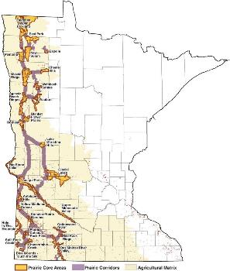
Protect, Restore, and Enhance
Clustered around state
Soils and topography
Need to protect and connect
Restore
Fee title
Easements (multiple)
Temporary programs (CRP, etc)
Notes:
I usually hide the footers. They’re great if you need them, but I find they add visual clutter

Slide 5
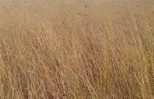
2010 Plan, Learn, 2017 Plan
2010 – Original Prairie Plan
We’ve learned a lot since then
Mechanics of conservation on the ground
Science always changing informing us how we do our work
2017 – Version 2 Plan and maps
Incorporate what we’ve learned
Still a lot to learn!!

Slide 6
Partnerships and Working Together
6

Slide 7
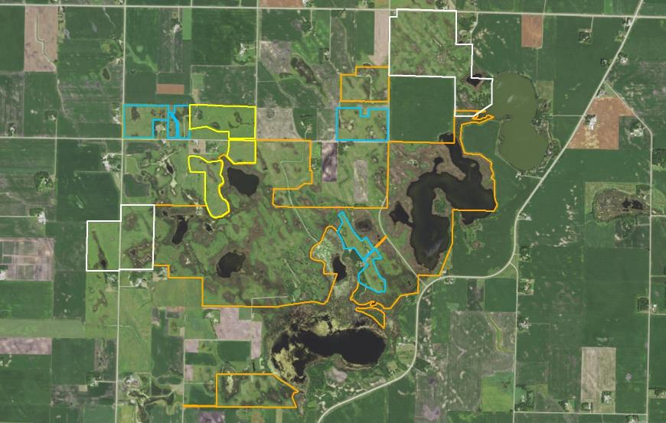
Partnership Landscape WMAs / WPAs / CREP / WIA

Slide 8
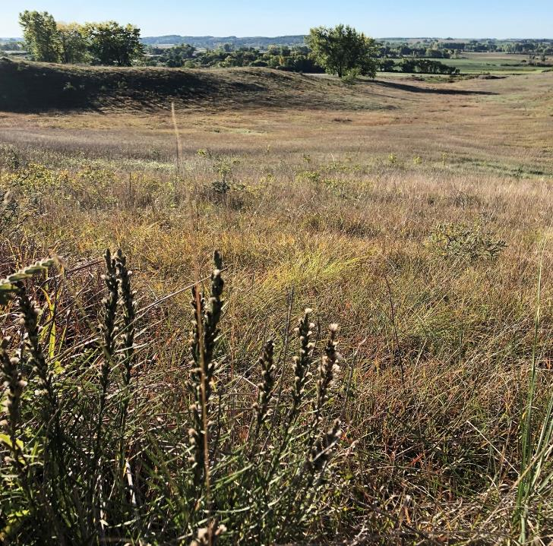
Minnesota Prairie Conservation Plan
LANDOWNER ENGAGEMENT

Slide 9
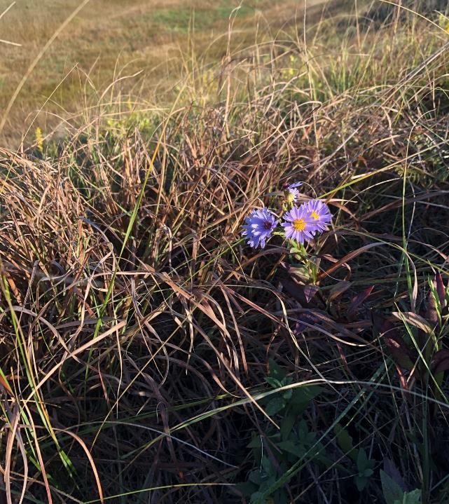
BACKGROUND
½ of the states native prairie is privately owned making landowner engagement a vital component of the Prairie Plan
LCCMR has recognized this and allocated ENRTF funding to the Native Prairie Bank Program for 15+ years
Prairie Plan Partners across the state are helping us significantly expand our efforts

Slide 10
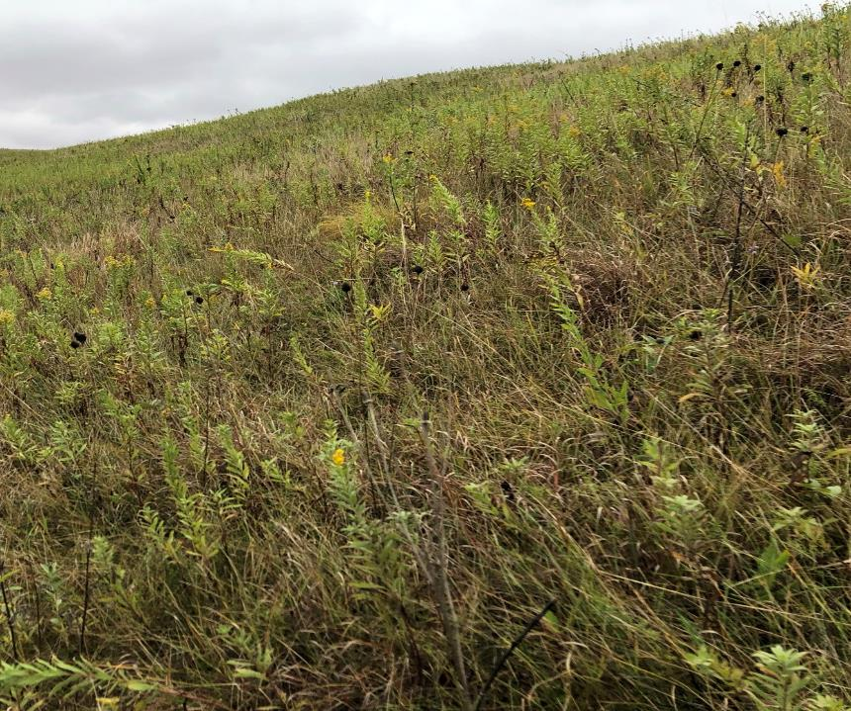
RECENT HIGHLIGHTS

Slide 11
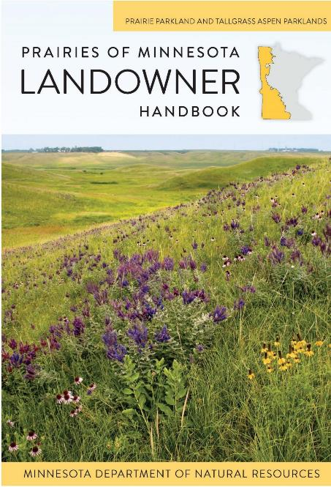
PRAIRIES OF MINNESOTA LANDOWNER HANDBOOK

Slide 12
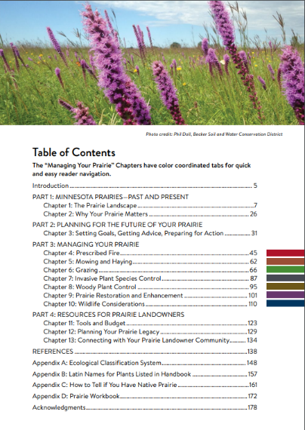
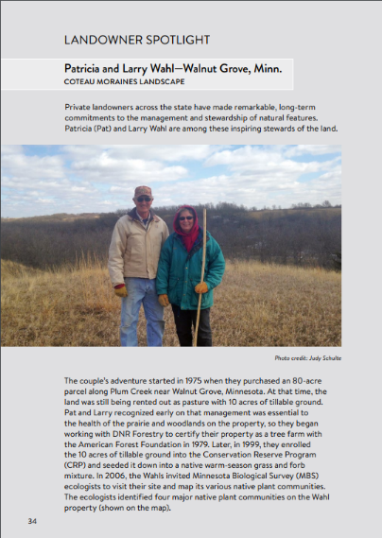
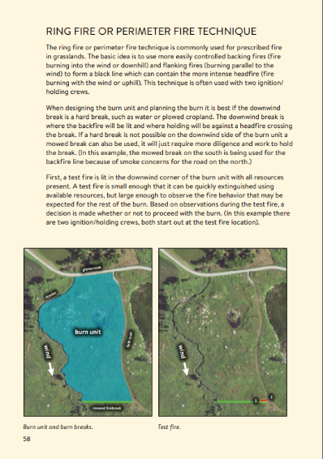
HANDBOOK: EXAMPLE PAGES

Slide 13
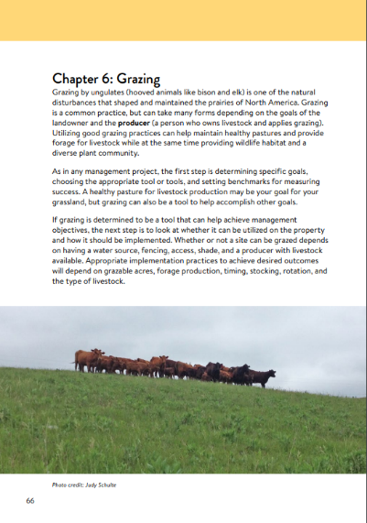
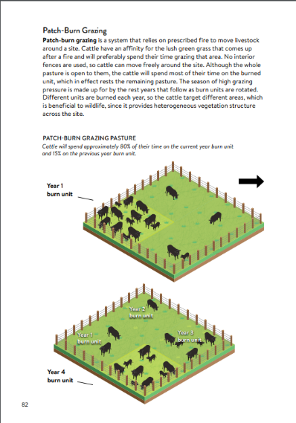
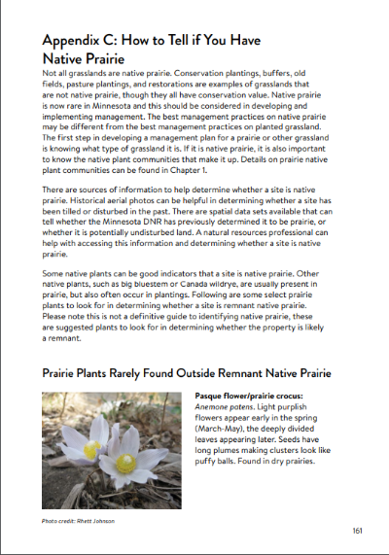
HANDBOOK: EXAMPLE PAGES CONT.

Slide 14
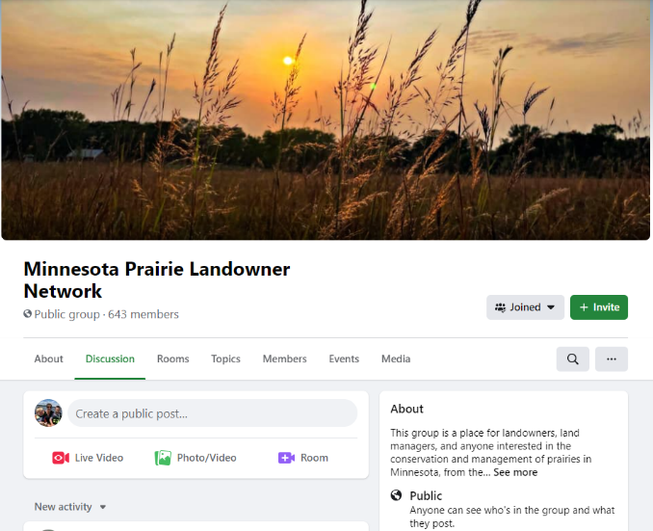
MINNESOTA PRAIRIE LANDOWNER NETWORK

Slide 15
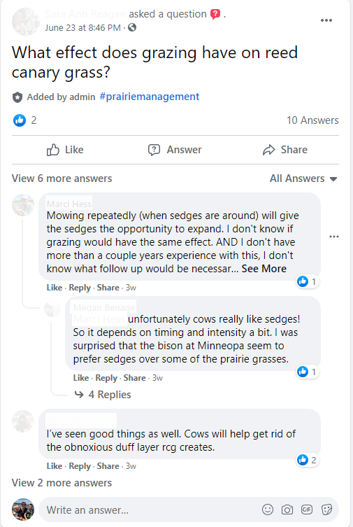
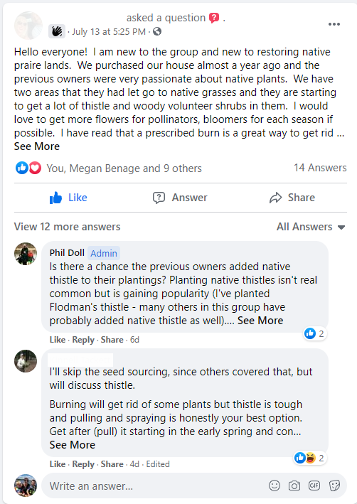
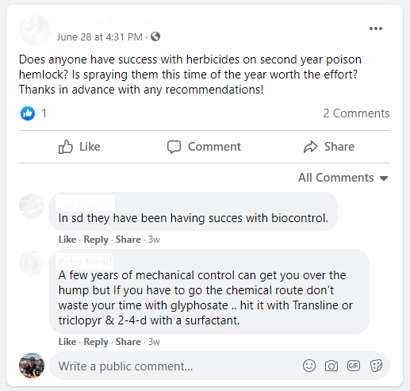
NETWORK: EXAMPLE POSTS

Slide 16
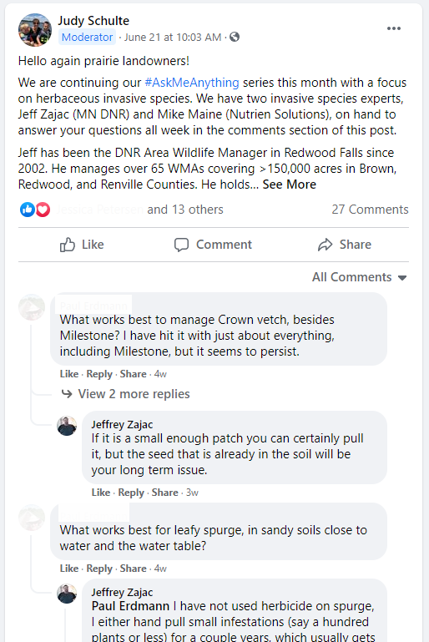
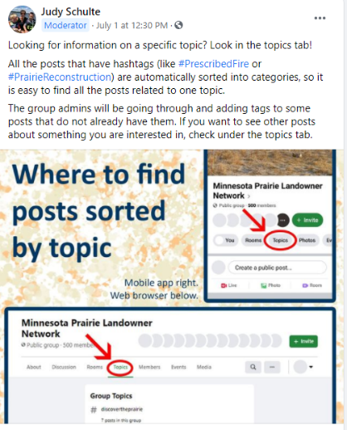
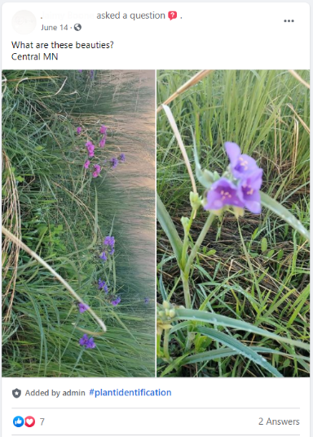
NETWORK: EXAMPLE POSTS CONT.

Slide 17
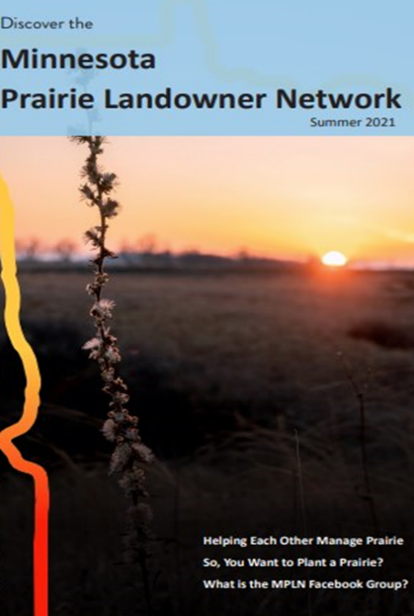
Online, Offline & In-Person
June 2021: First newsletter mailed to 6,000+ landowners and distributed at many SWCD and partner offices
June 2022: Next newsletter scheduled to be released
June-August 2022: First in-person events to be scheduled (pandemic pending)

Slide 18
Glacial Lakes Prairie Core

Slide 19
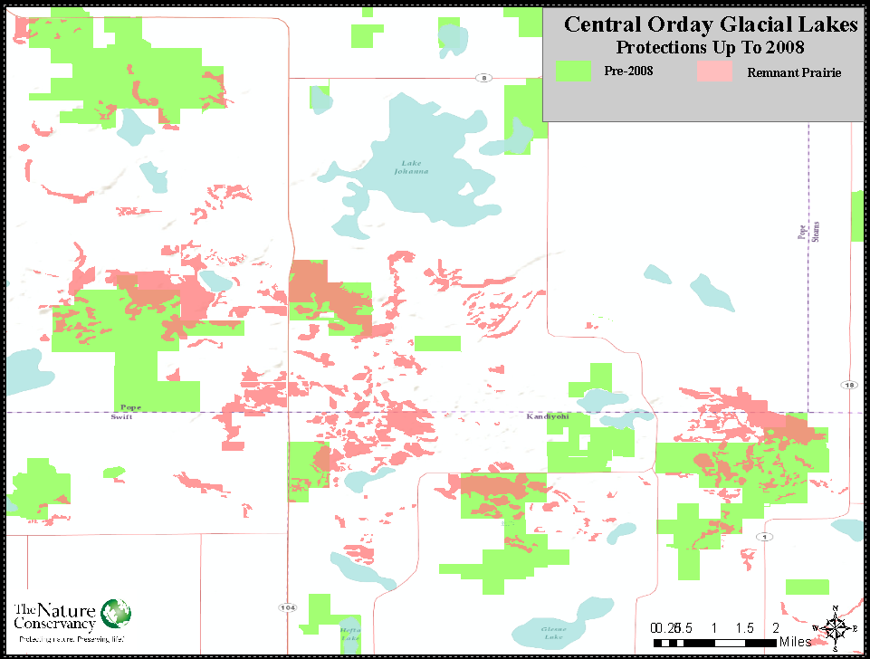
Central Orday Glacial Lakes

Slide 20
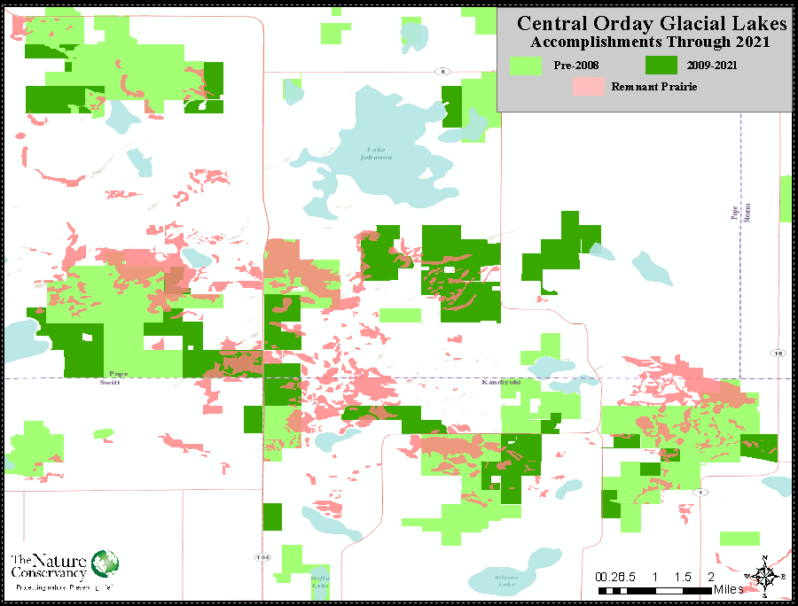
Central Orday Glacial Lakes 2

Slide 21
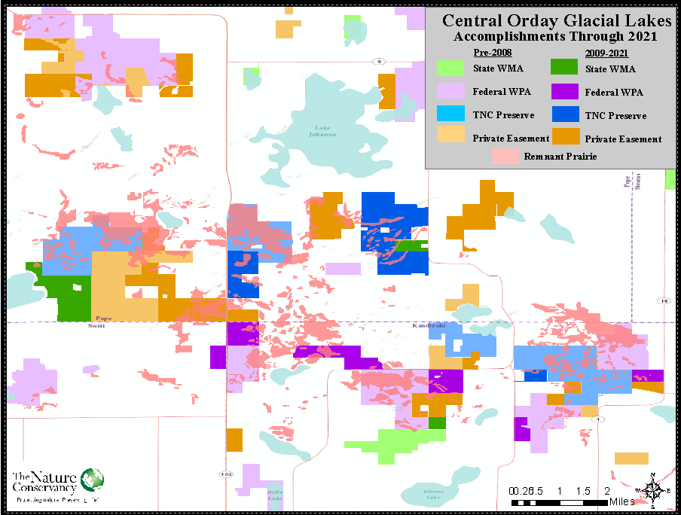
Central Orday Glacial Lakes 3

Slide 22
Conservation Over Time

Slide 23
Partnered Work

Slide 24
Conclusion For the future of the Prairie…
TNC Glacial Lakes Fire Crew 2021

