Slide 1

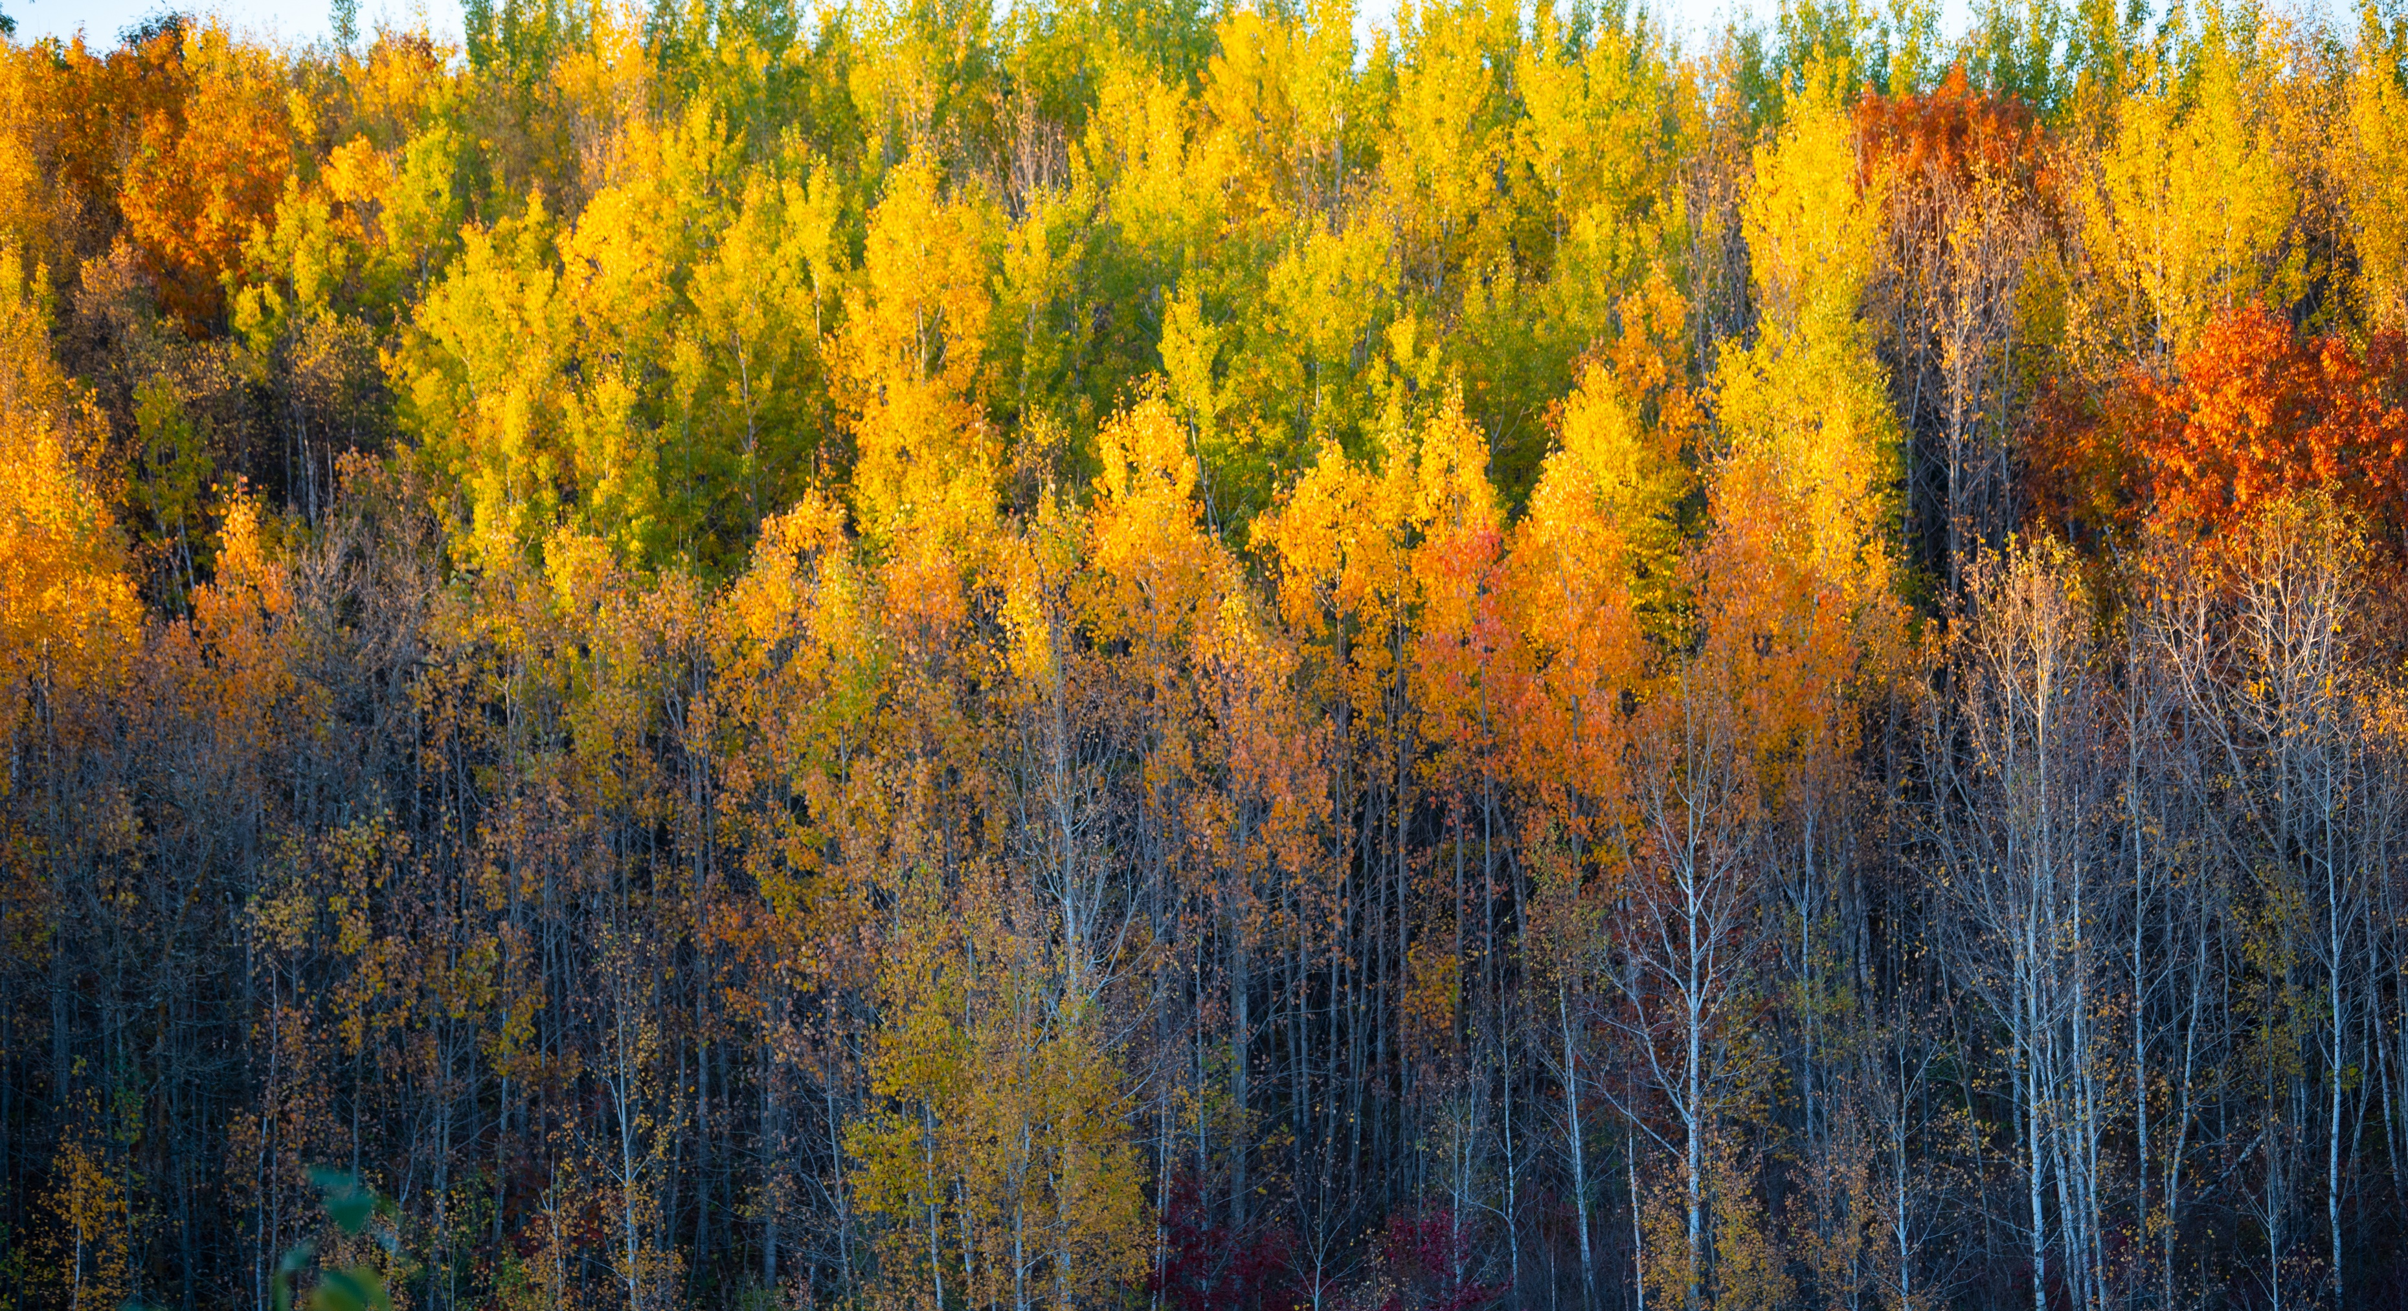
Minnesota’s Heritage Forest
Kim Berns-Melhus, Minnesota State Director
Emilee Nelson, Associate Minnesota State Director

Slide 2

Who We Are
At the Conservation Fund, we make conservation work for America.
By creating solutions that make environmental and economic sense, we are redefining conservation to demonstrate its essential role in our future prosperity.
Top-ranked for efficiency and effectiveness, we have worked in all 50 states to protect over 8.5 million acres of land since 1985.
More than 95% of annual spending goes to conservation programs.
Our Ratings
Date

Slide 3
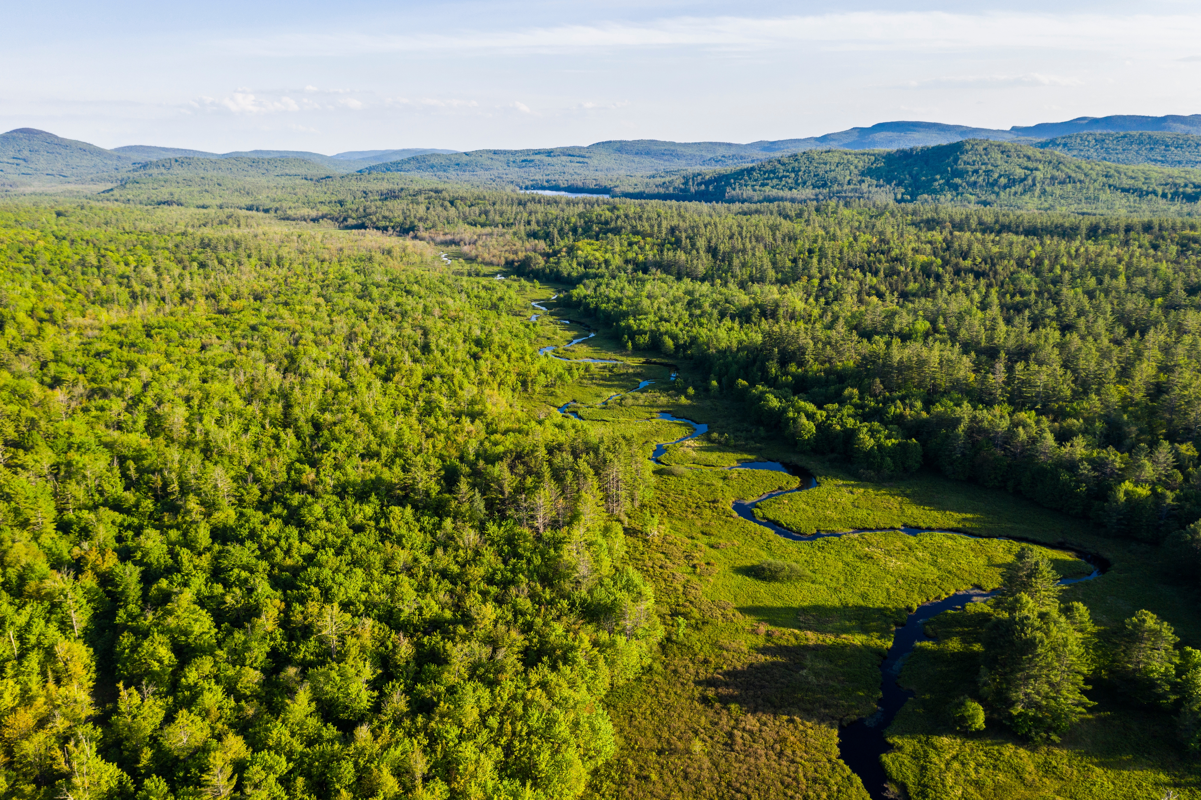
TCF Working Forest Fund®
Past 30 years, our country has lost 36 million acres of forests and projected to lose another 37 million acres in the coming decades.
Over the next 10 – 15 years we have a goal to save 5 million acres
The Conservation Fund successfully issued $150 million bond in 2019 (https://www.conservationfund.org/green-bonds)
Our goal is to invest all proceeds from bond into the Working Forest Fund®
The bond funds and a private loan were used for the purchase of the MN Heritage Forest Project

Slide 4
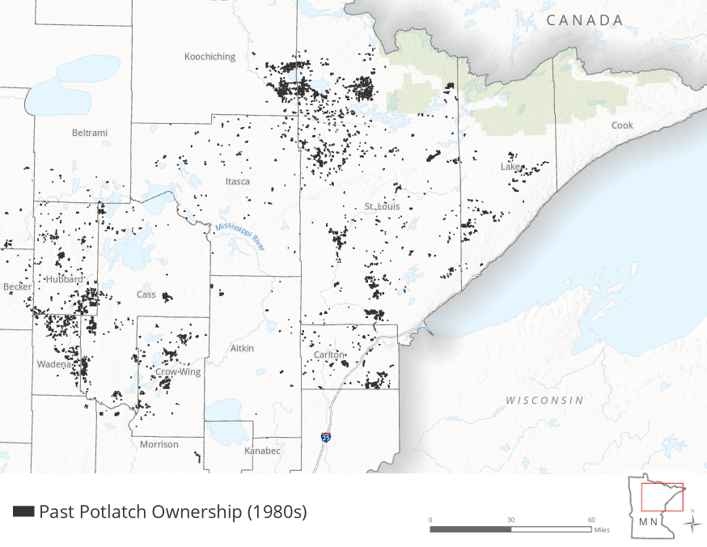
Past Potlatch Ownership

Slide 5
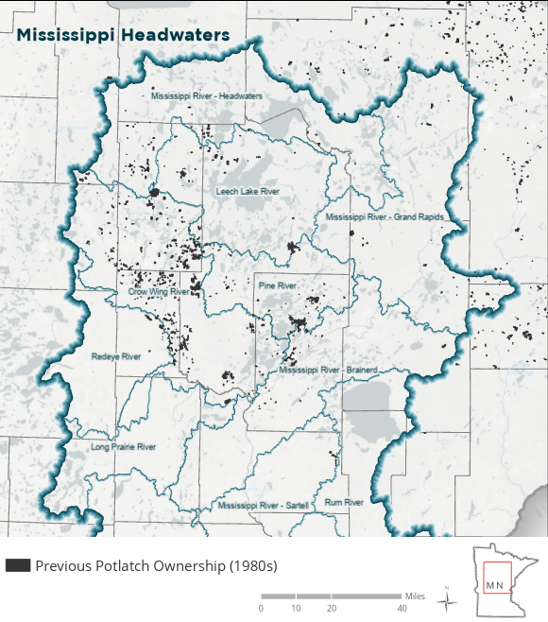
Mississippi Headwaters Past Potlatch Ownership

Slide 6
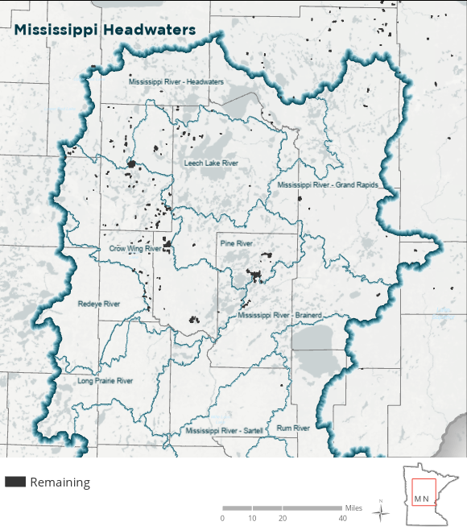
Mississippi Headwaters Remaining Ownership

Slide 7
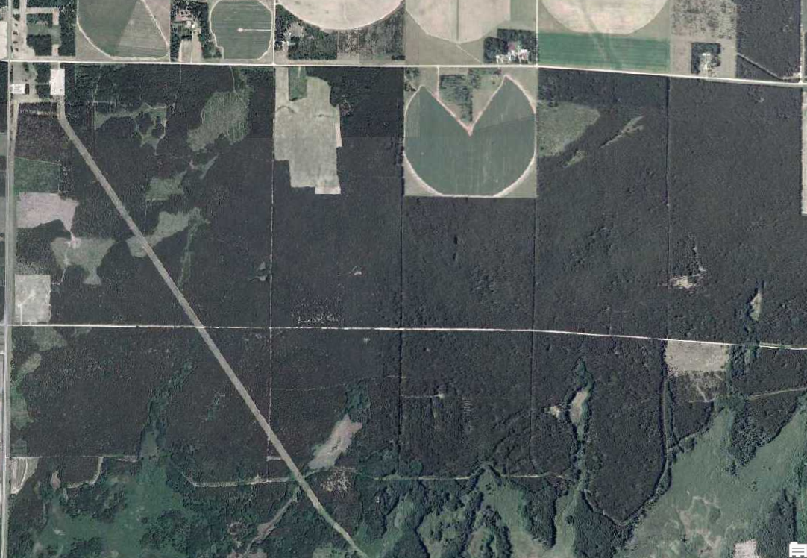
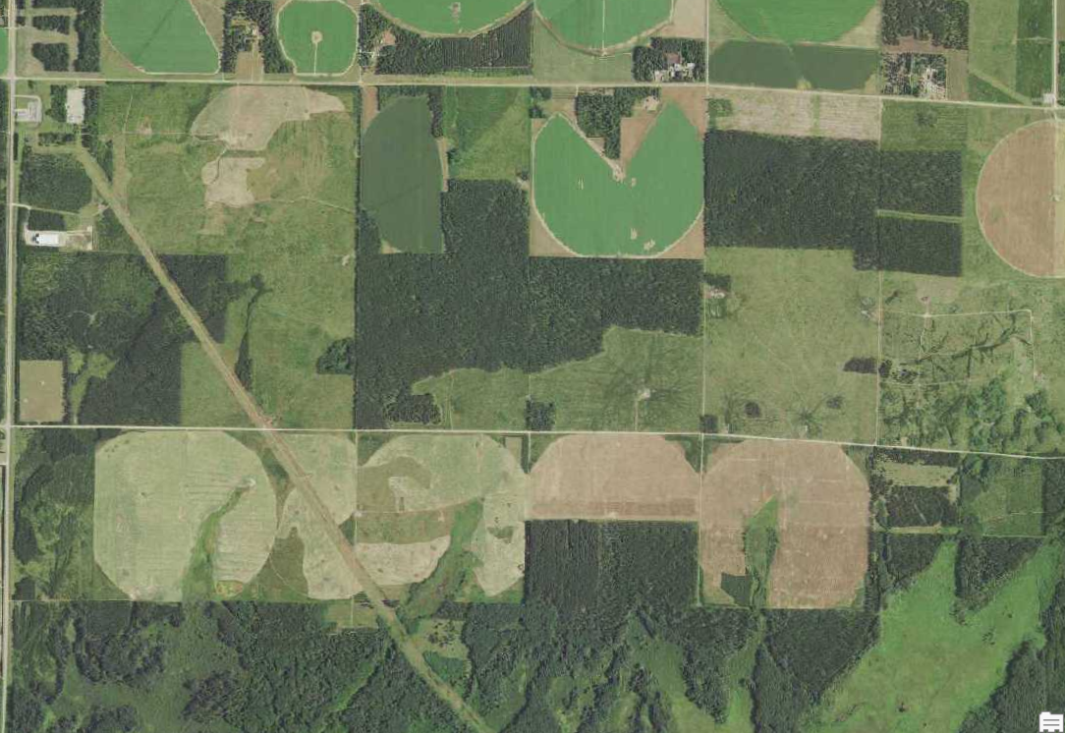
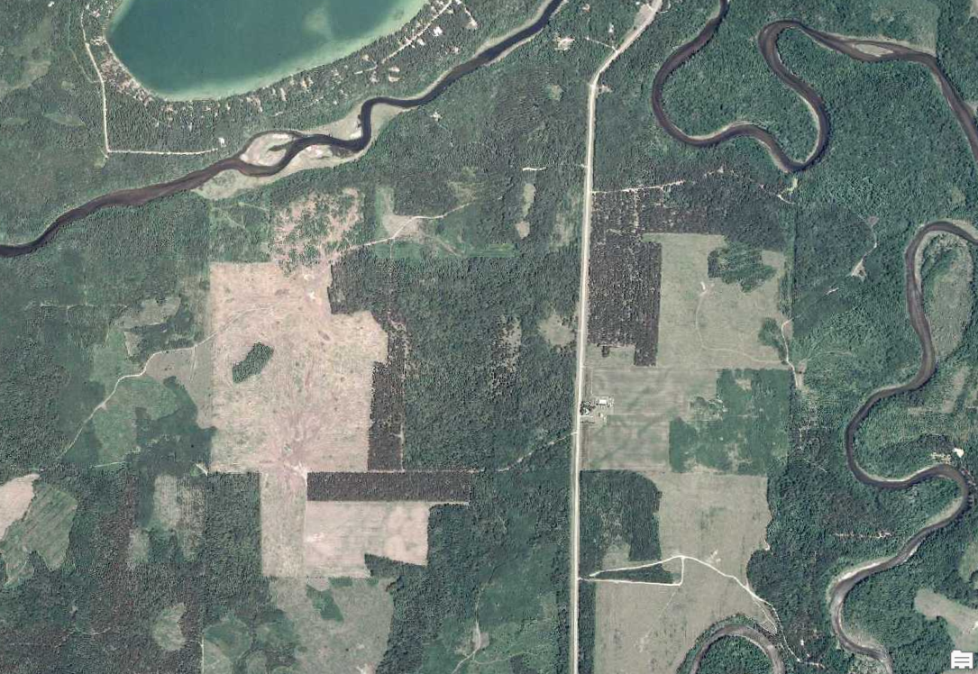
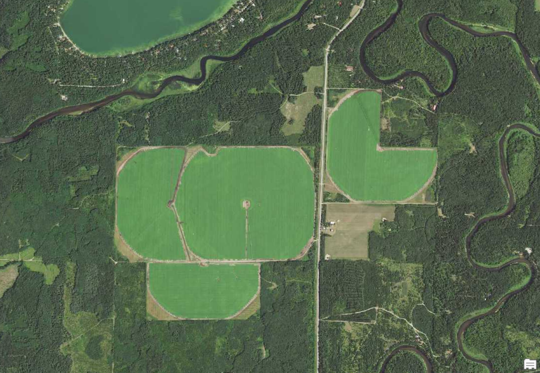
2006 to 2017 Land Comparison
2006
2017

Slide 8
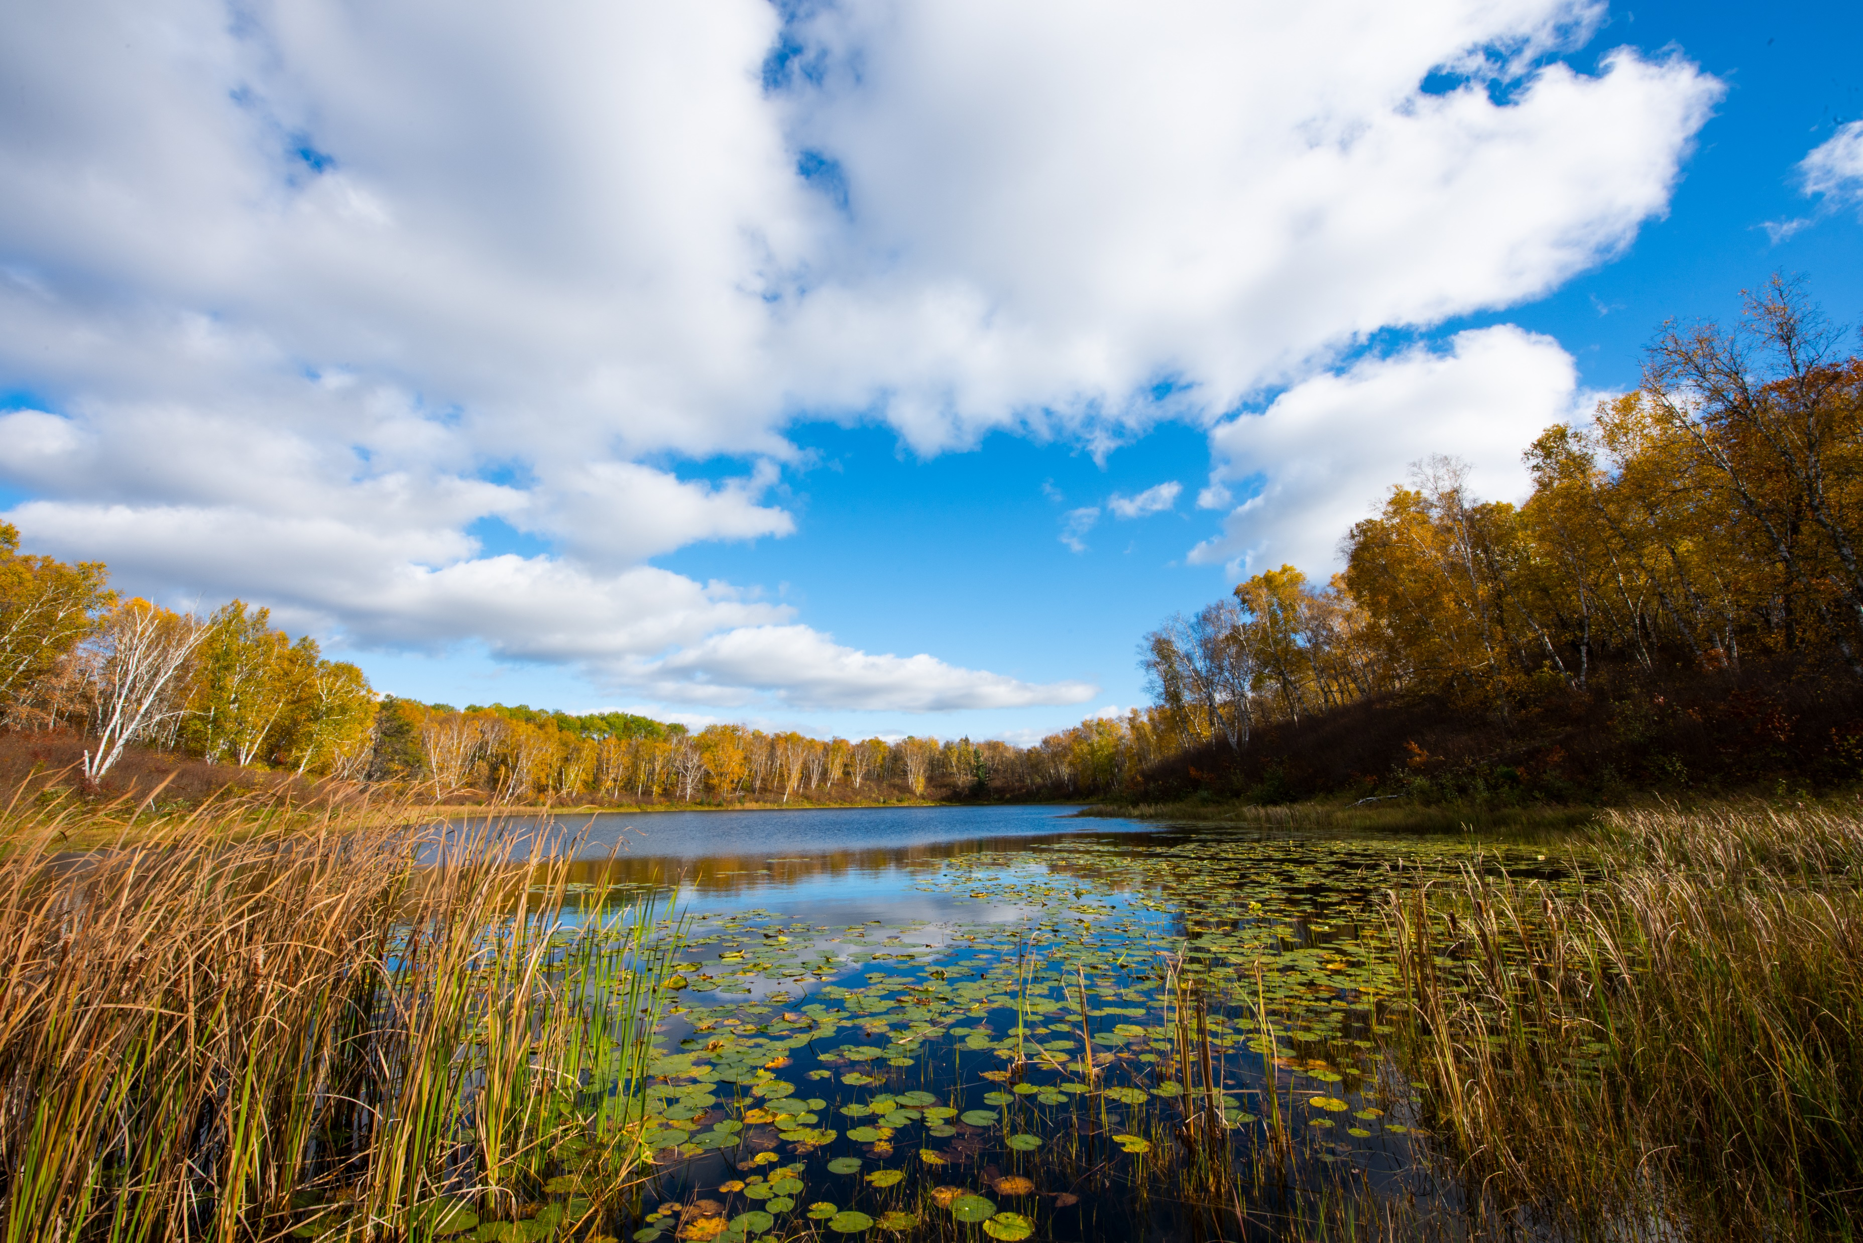
Looking back…
9 years of projects with Potlatch since 2012
Purchased 63,000 acres
Exchanged 73,000 acres benefitting counties and State of MN
Resulted in 136,000+ acres of protected forests

Slide 9
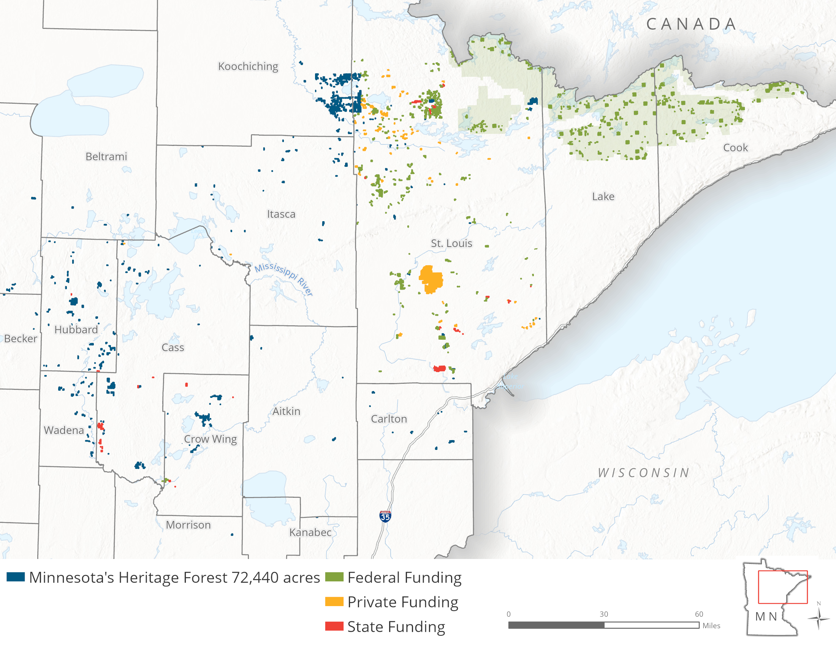
Funding Sources 2012-present
State
$12M
Private
$13M
Federal
$52M

Slide 10
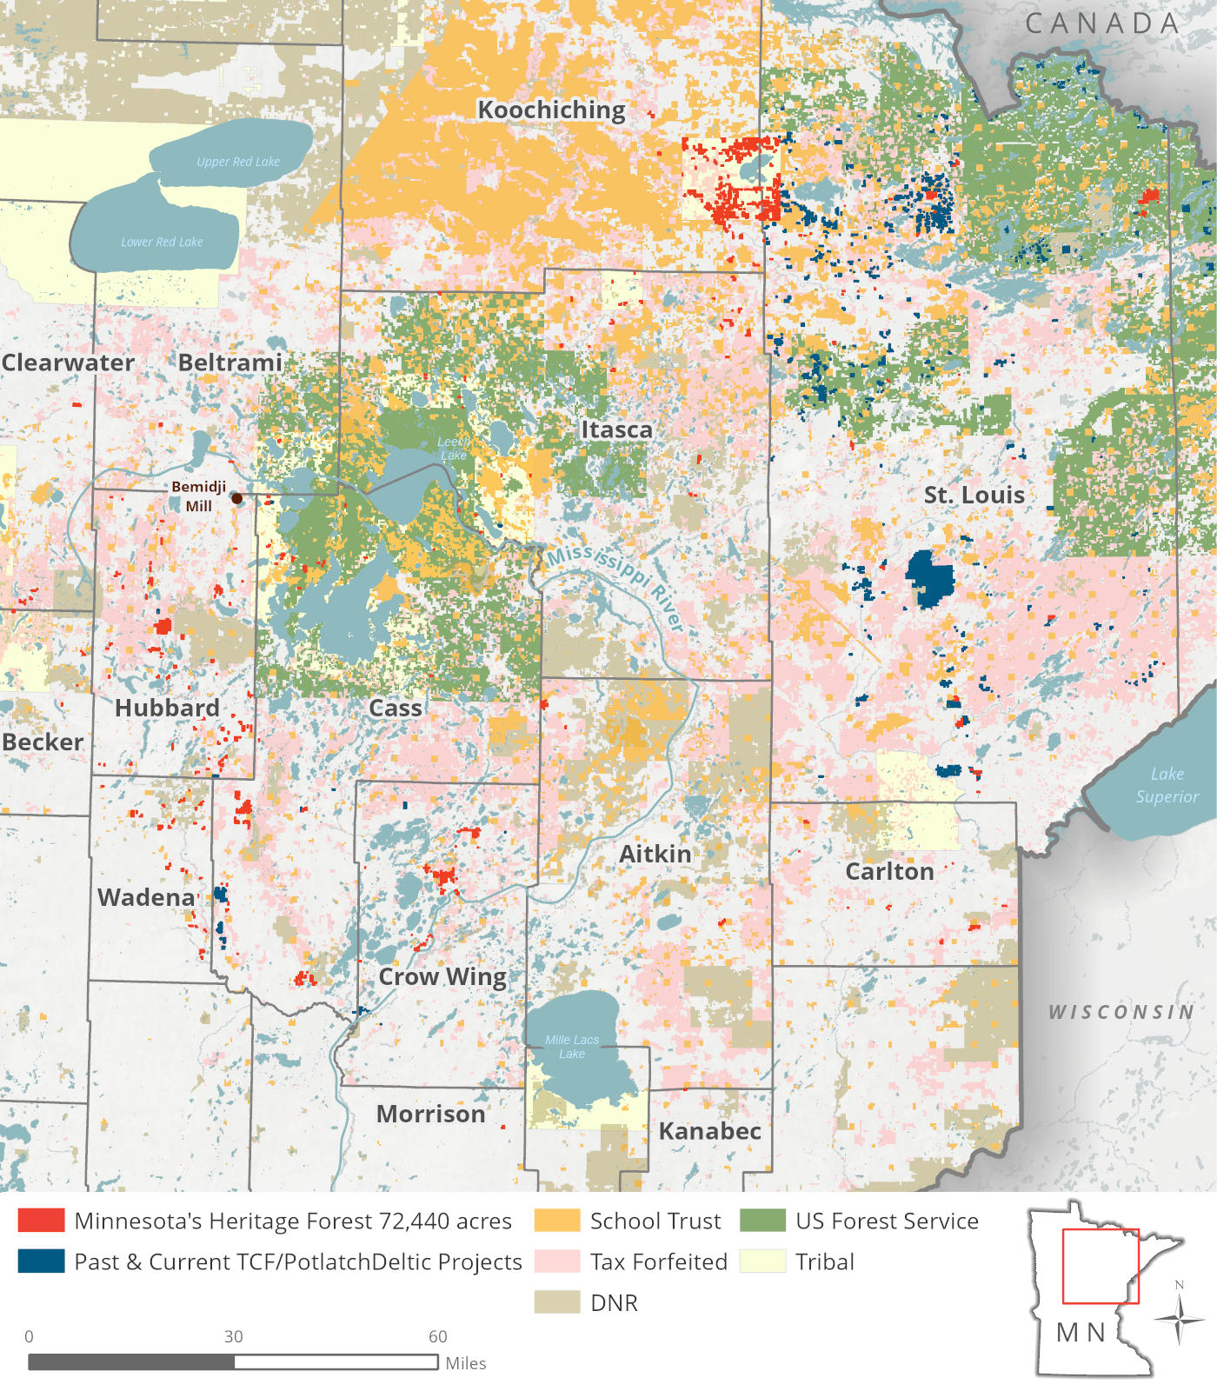
Minnesota’s Heritage Forest
Purchased from Potlatch in November 2020
Nearly $48M purchase price
Plan to hold for up to 10 years
TCF will pay property taxes
Bemidji Mill
More than 30,000 acres within the Mississippi River Headwaters
28,000 acres in the Bois Forte Reservation

Slide 11
Approximate Acres by County

Slide 12
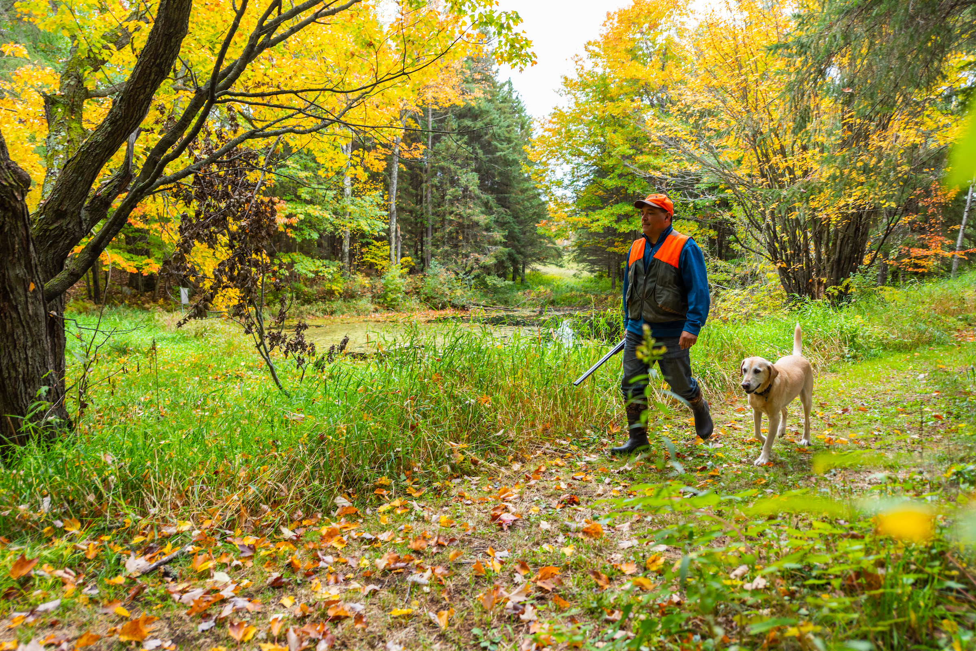
Project Goals
Support working forests
Support local economies
Support timber related jobs
Conserve forestlands for
  clean air and water
  maintaining climate resilient habitat for wildlife
  recreation opportunities
  climate change mitigation
Photo: Sparky Stensas

Slide 13
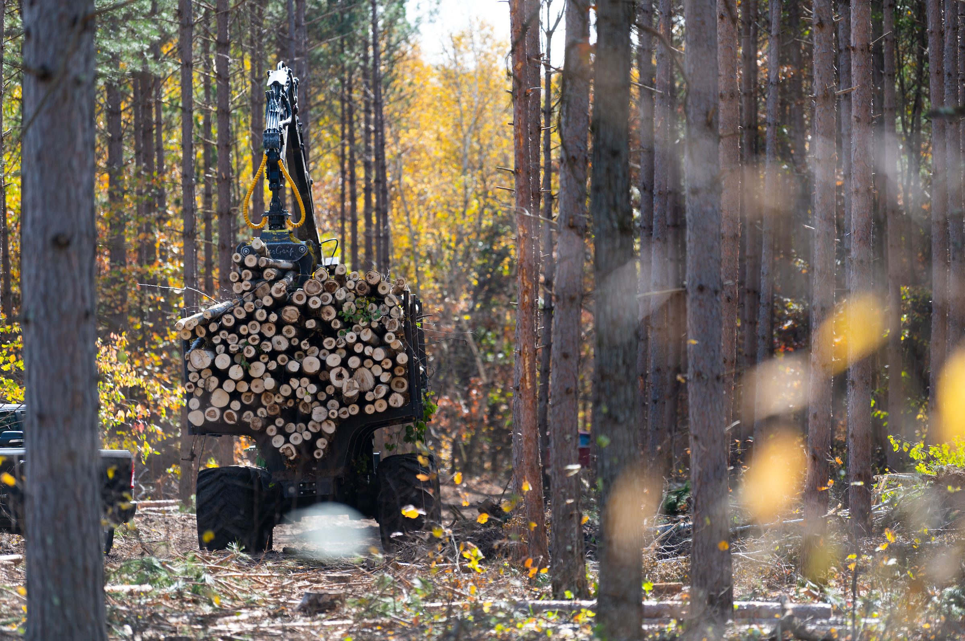

Management of the land by TCF
Manage as working forests
TCF is Sustainable Forestry Initiative (SFI) certified
Timber will continue to feed mills
Work with counties and local government on land adjustments

Slide 14
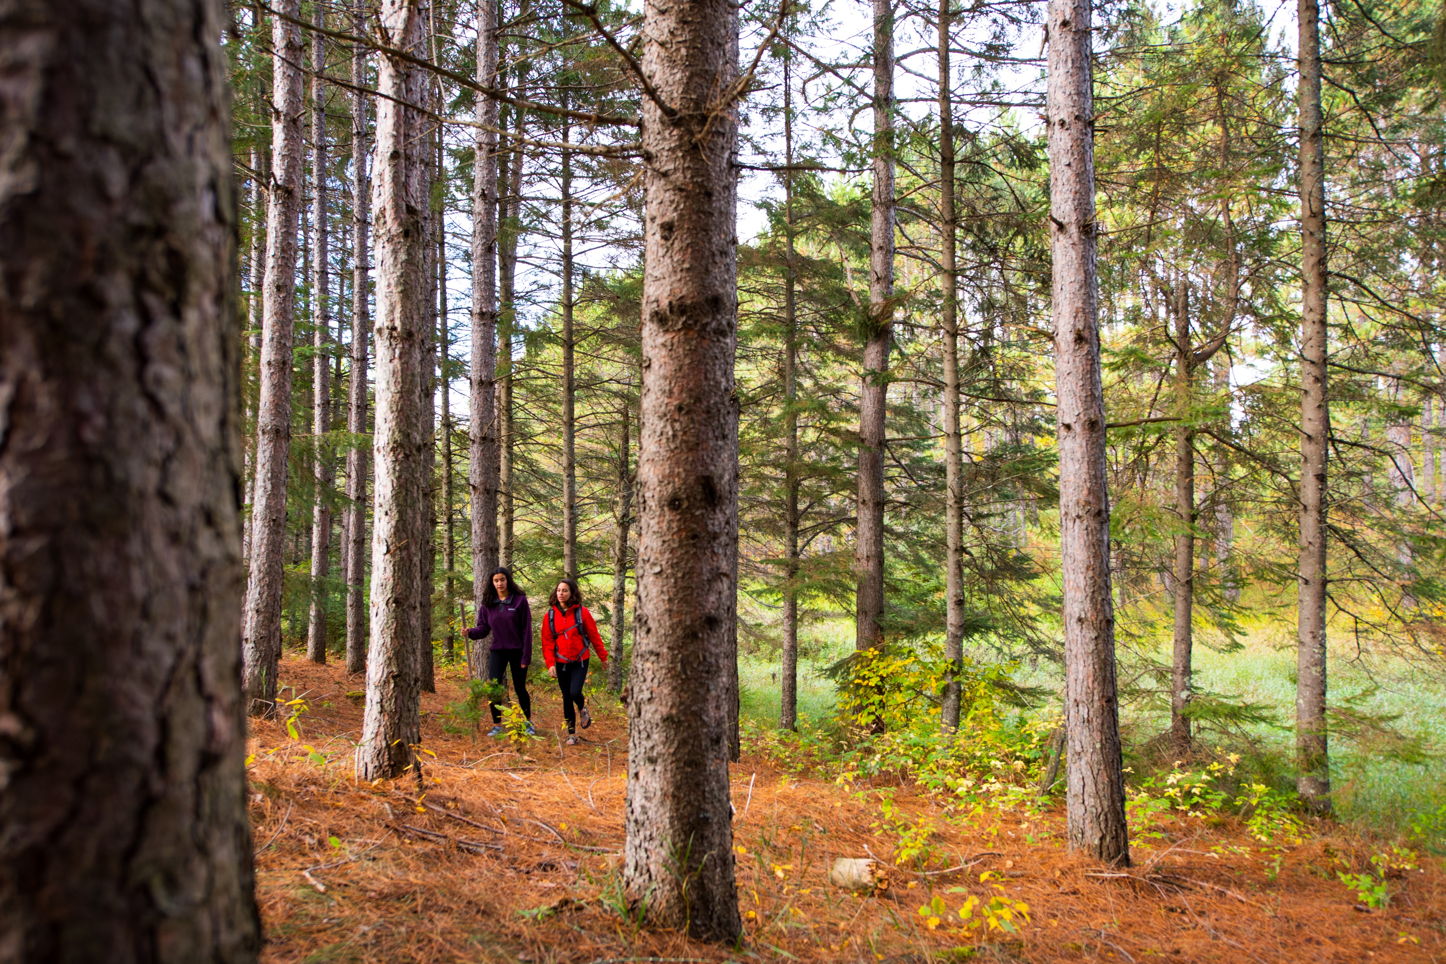
Tools to Accomplish Conservation Outcomes
  Fee title acquisition by
    Tribal entities
    NGOs
    County/State/Federal
  Conservation easements
  Land exchanges

Slide 15
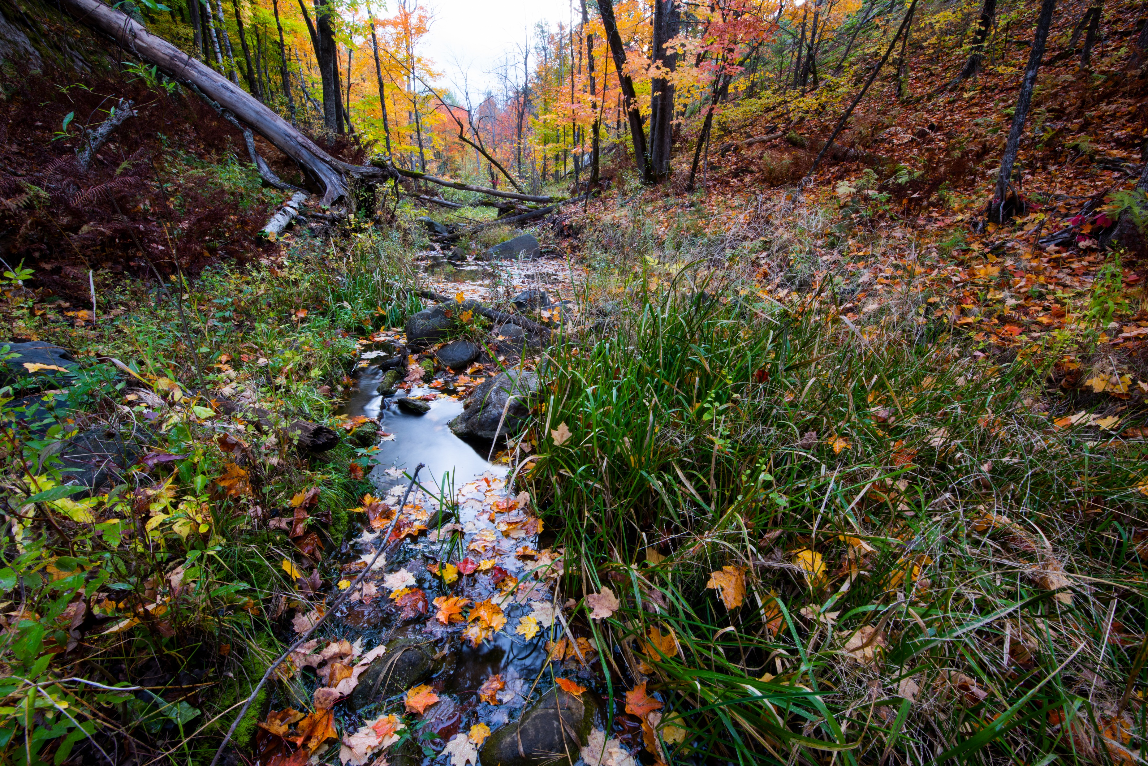
Why a Land Exchange?
Allows County and State to select more productive lands
  Generates more revenue toward county and state goals
More certainty for County and State to receive desired land asset
No mechanism to protect ecologically important School Trust or Tax Forfeited lands
  Auction only per statute

Slide 16
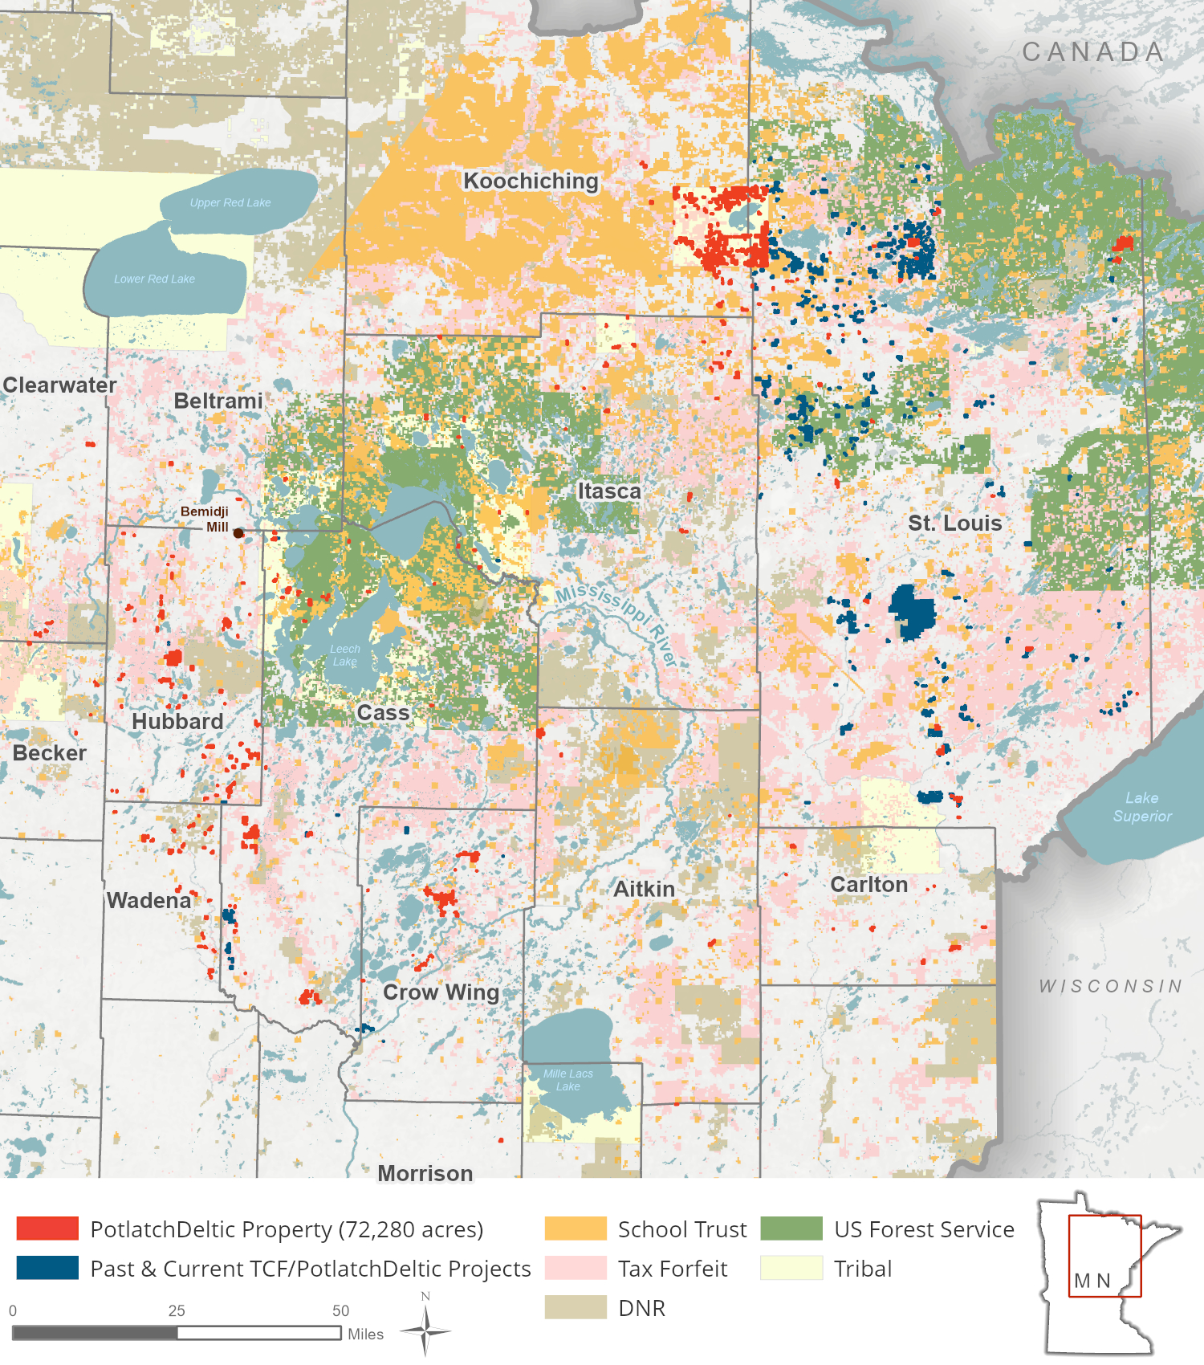
Potlatch Property Map

Slide 17
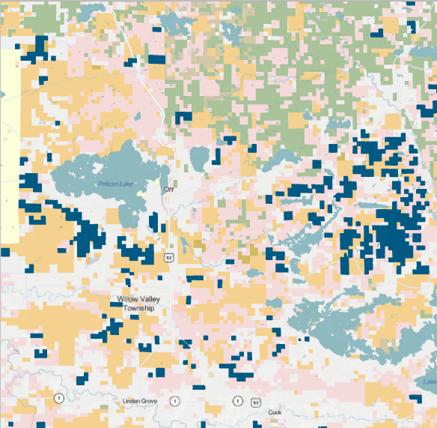
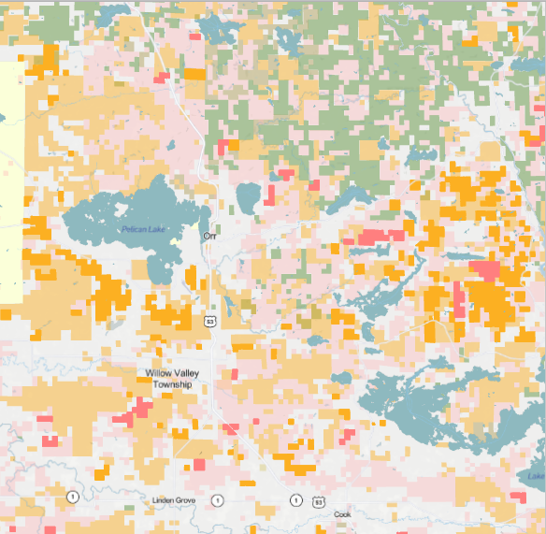

Example: Land Exchanges and Forest Consolidation – St. Louis County
Before
After Land Exchange

Slide 18

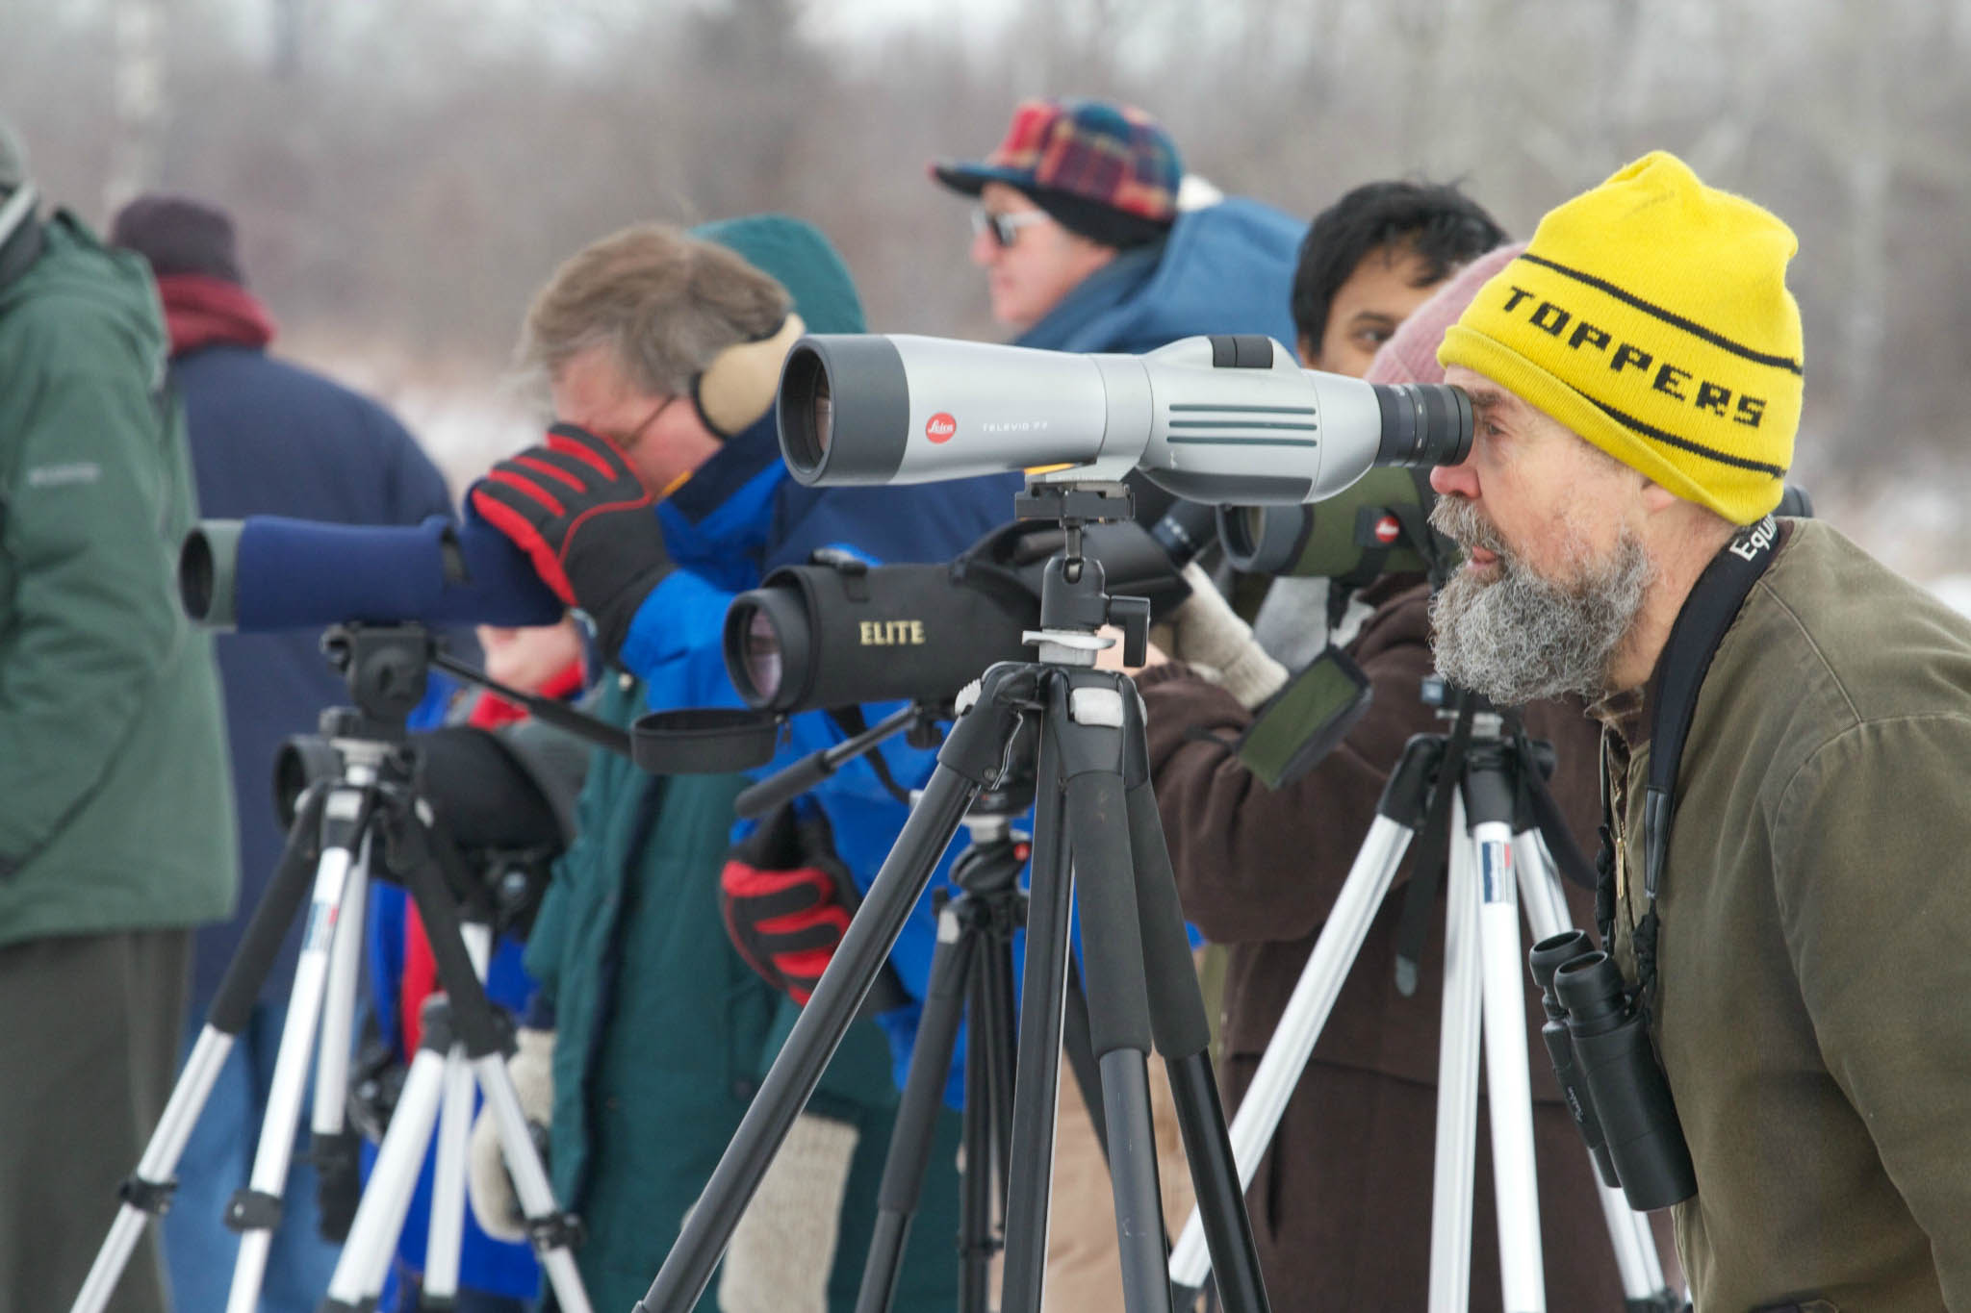
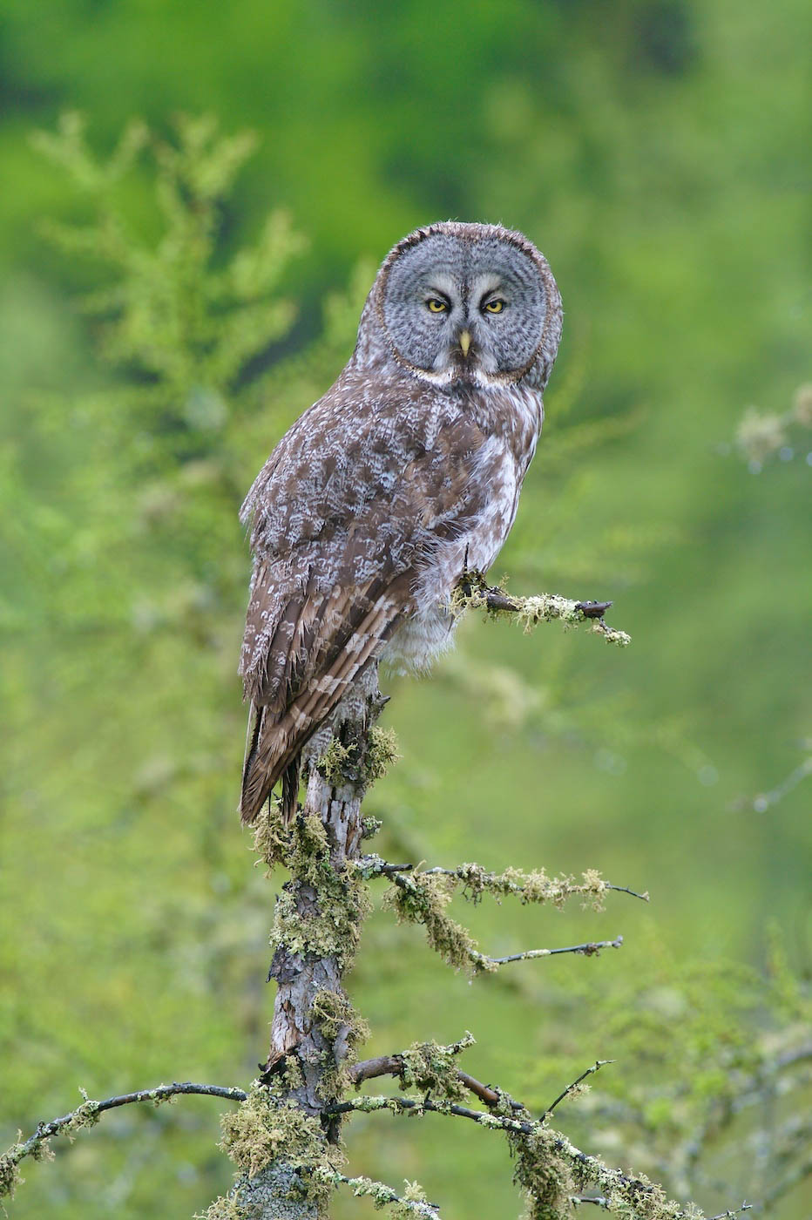
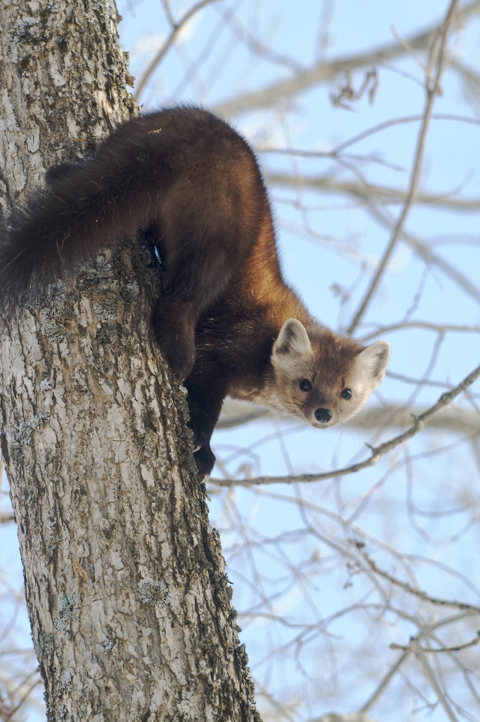
Sax-Zim Bog
Sax-Zim Bog
24,000+ acres
Photos: Sparky Stensaas

Slide 19
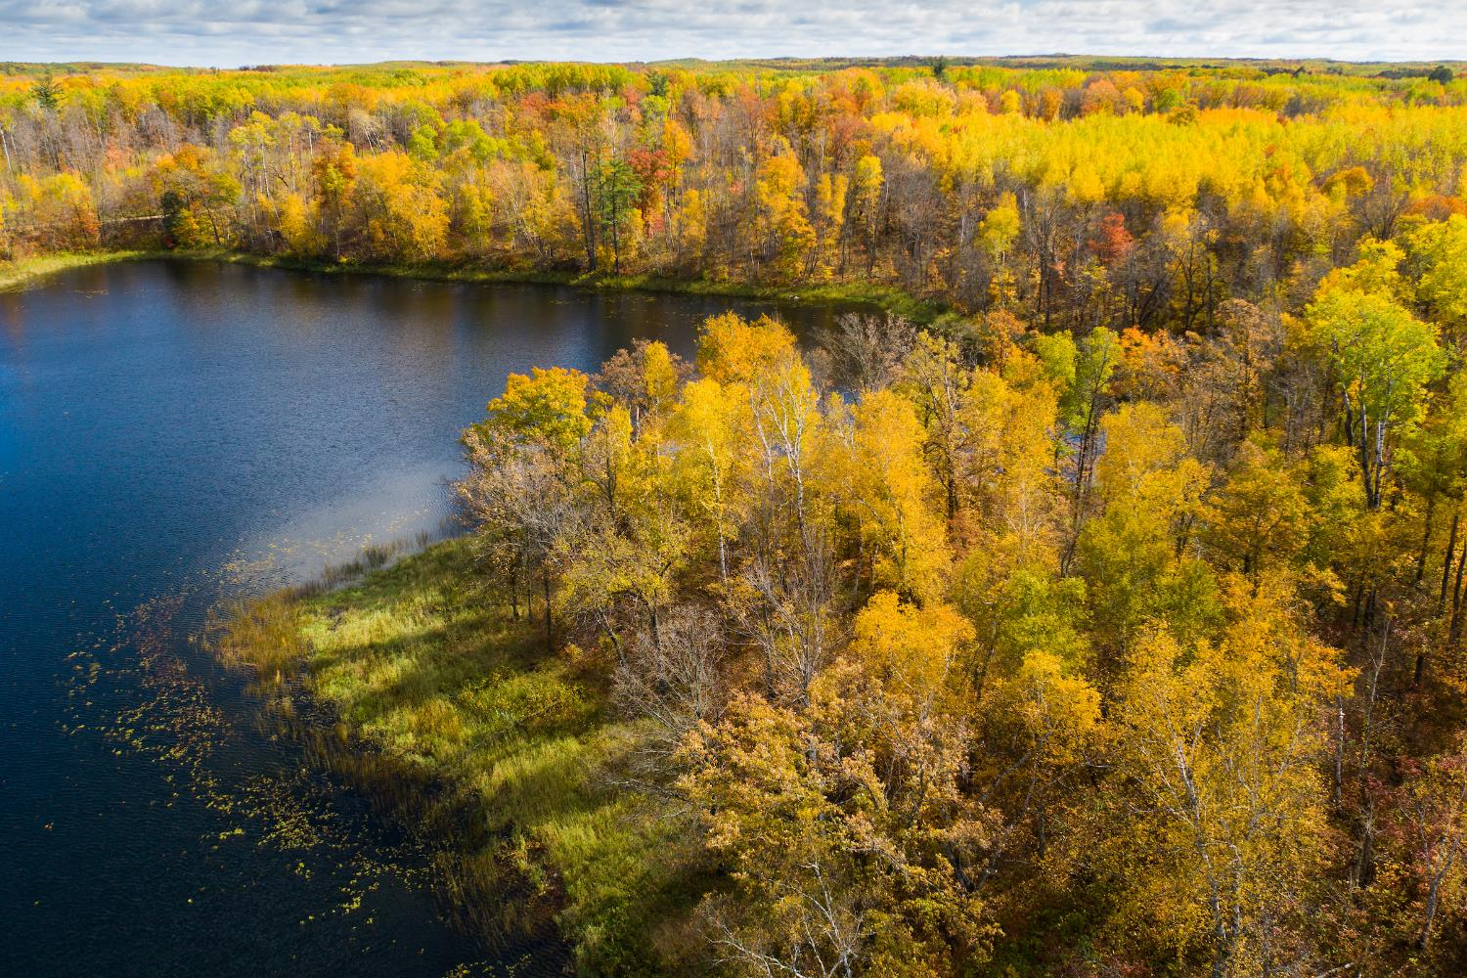
Summary
This project allows time for conservation solutions to develop
Mix of conservation funding
Other NGOs and public partners will be grant applicants
Permanent Conservation Strategy
Transparency is Key

Slide 20
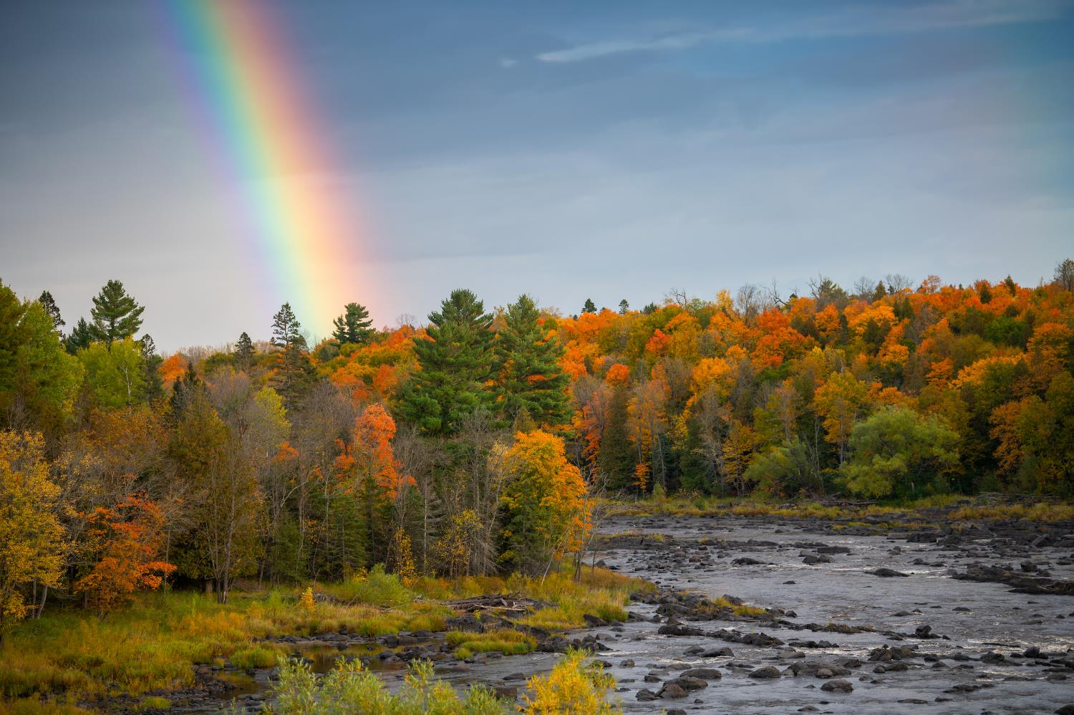
Questions?
Kim Berns-Melhus, Minnesota State Director
kberns@conservationfund.org
612-702-5277
Emilee Nelson, Minnesota Associate State Director
enelson@conservationfund.org
952-595-5768

