Slide 1
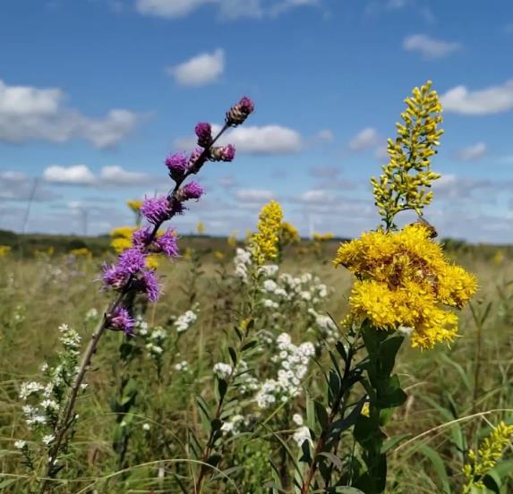
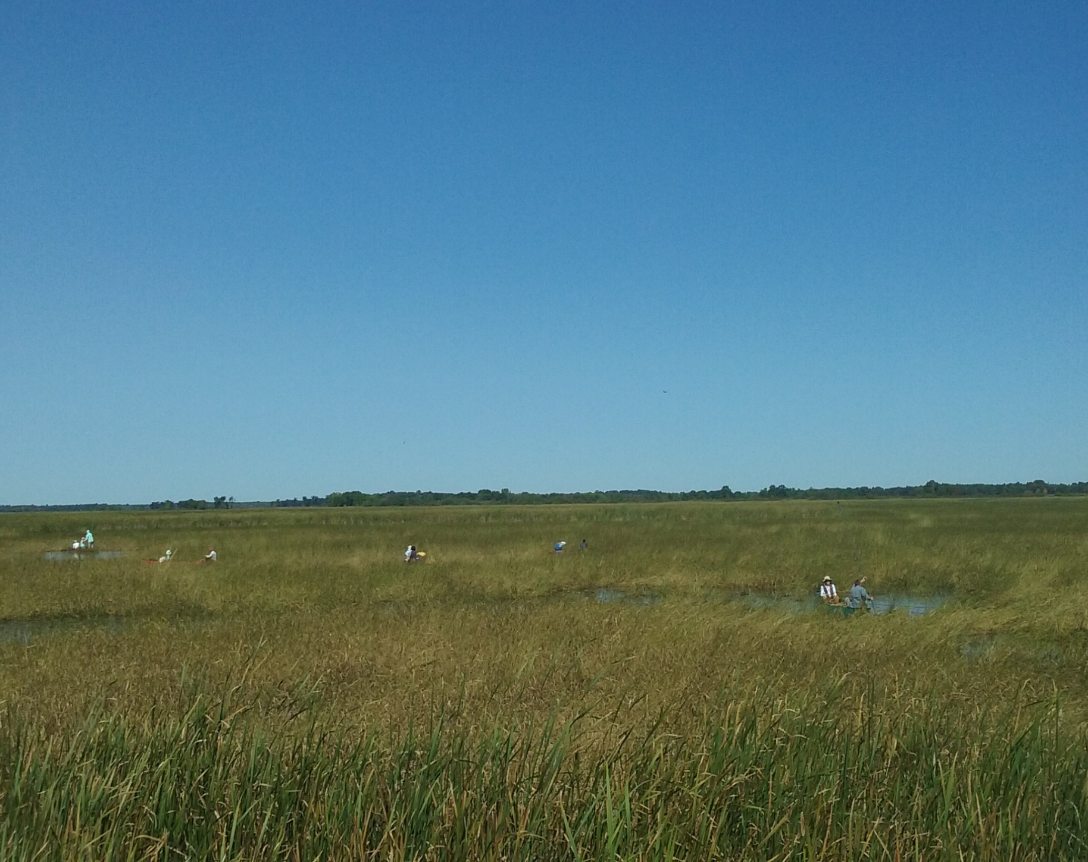
Carbon, Climate, and OHF Projects
Greg Hoch - Prairie Habitat Supervisor
Neal Feeken – Grassland Cons. Prog. Dir

Slide 2
There are many aspects to these issues
Assisted migration of species and/or habitats
How that affects restoration plans
Building a resilient landscape
Climate change and effects of climate change
Several others
Focus today on Carbon
As it relates to OHF projects

Slide 3
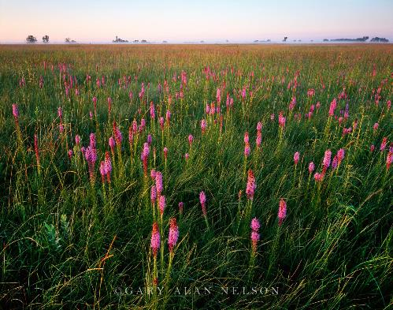
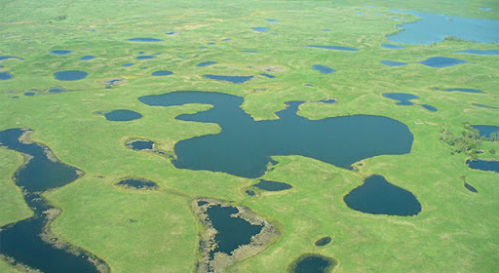
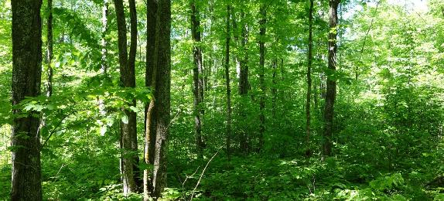
We’re already doing good things
OHF projects have been storing carbon all along
Every OHF project has a carbon benefit
We just haven’t been talking about it
We don’t need to change, just do more things
Gives us a new storyline to take our message to a new and larger audience
PPJV.org

Slide 4
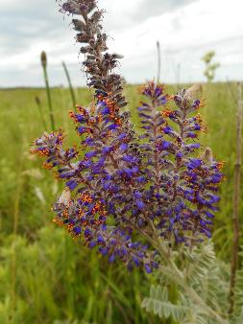
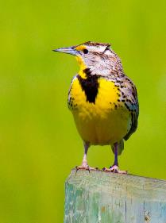
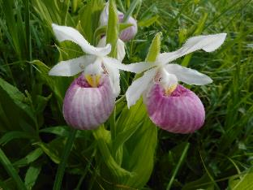
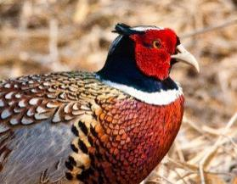
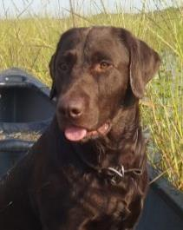
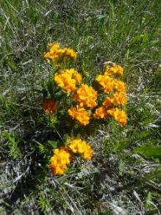
Biology 101
Carbon + Water < > Sugar + Oxygen
CO₂ + H₂O < > C₆H₁₂O₆ + O₂
Oxygen
Carbon

Slide 5
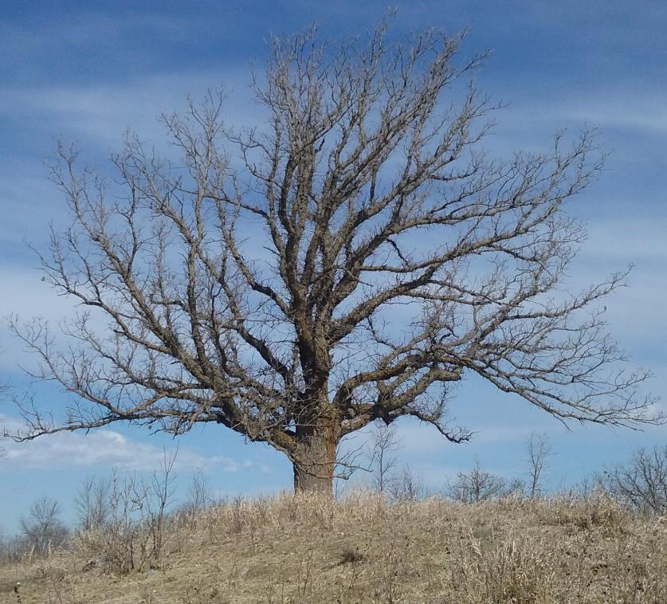
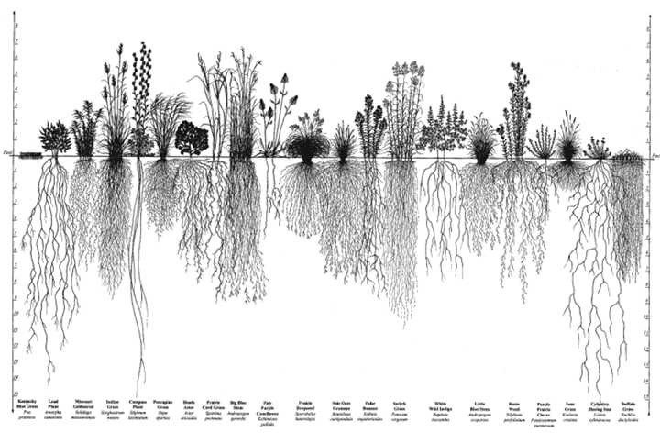
Prairies, wetlands, and Forests – Where is the Carbon?
Carbon
Carbon

Slide 6
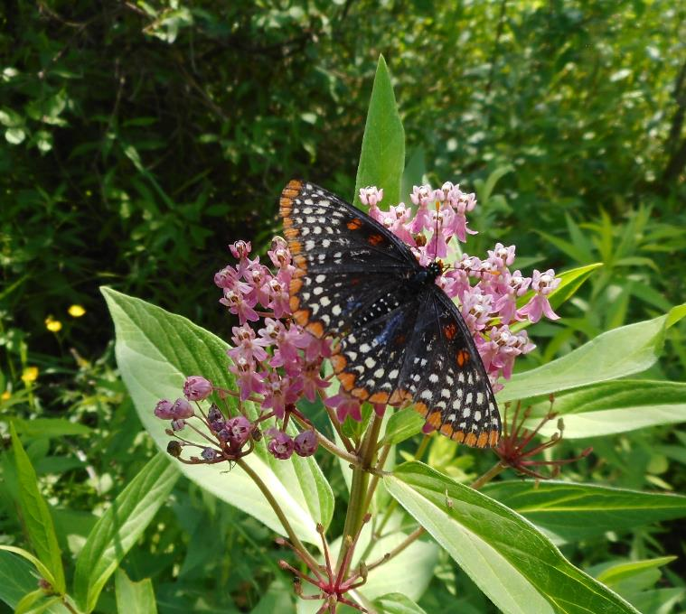
Diversity - Pollinators, Wildlife, and Carbon
Two studies from Cedar Creek
“…higher plant diversity leads to greater soil C and N accumulation on agriculturally degraded soils… Fornara and Tilman 2008
“Our results suggest that restoration of high plant diversity may greatly increase carbon capture and storage rates…” Yang et al. 2019
We’ve been planting diverse seed mixes for pollinators and wildlife all along. Turns out, what we were doing for them is also the best action we can take for carbon.
Everything is coming together!

Slide 7
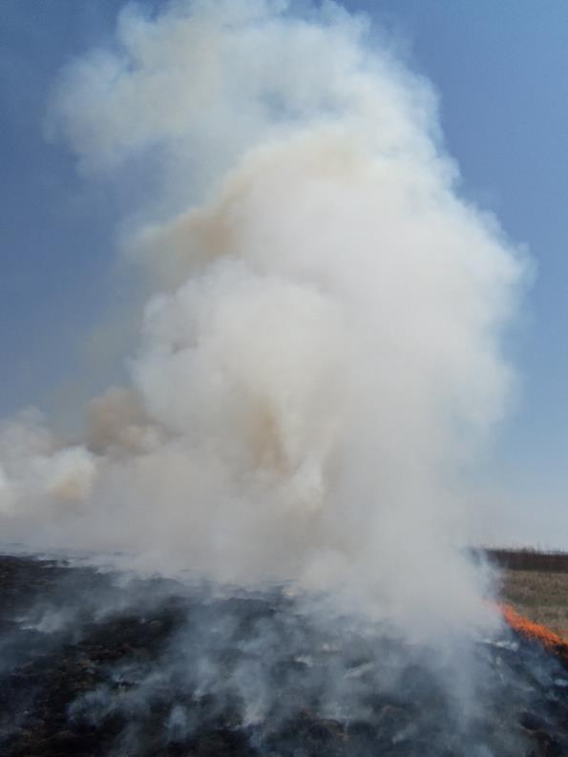
Enhancement / Management and Carbon??
What is the effect of a prescribed fire?
In short-term, releases carbon
But if it stimulates growth, what are the long-term effects?
What is the best way to graze a prairie
for wildlife, livestock, and carbon?
What is the best rotation/method for logging
that meets wildlife, timber, and carbon objectives?

Slide 8
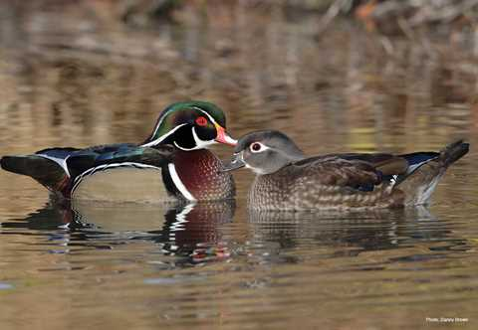
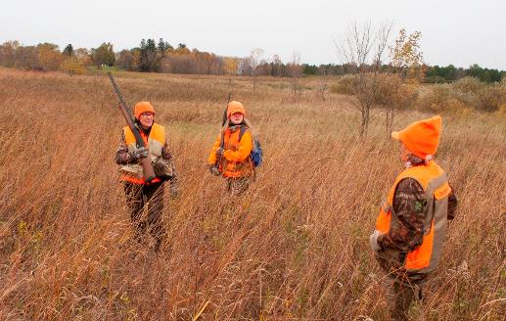
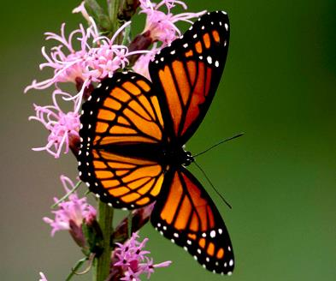
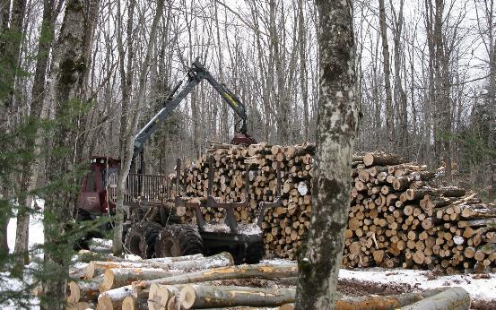
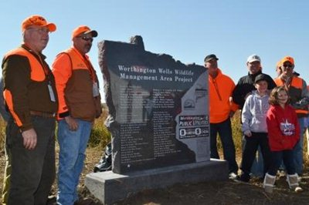
Stacked Benefits
In addition to storing carbon, grasslands, wetlands, and forests….
Provide wildlife habitat
Provide pollinator habitat
Provide recreational lands
Help purify and hold water
Benefit our economy
pfmowercountyhabitat.org
Ducks.org
Fs.fed.gov
Nature.org
Pheasantsforever.org

Slide 9
Habitat vs Habitat – My Habitat is better than Your Habitat
These debates are ultimately self-defeating
We shouldn’t restore grasslands near Grand Marais
We shouldn’t plant forests near Luverne

Slide 10
Question – Impact of LSOHC Investment on Climate Resiliency?
Carbon is most common metric
Multiple Pathways to storing Carbon

Slide 11
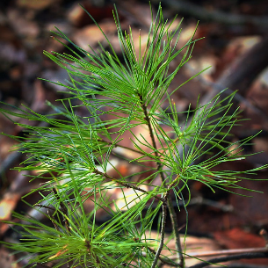
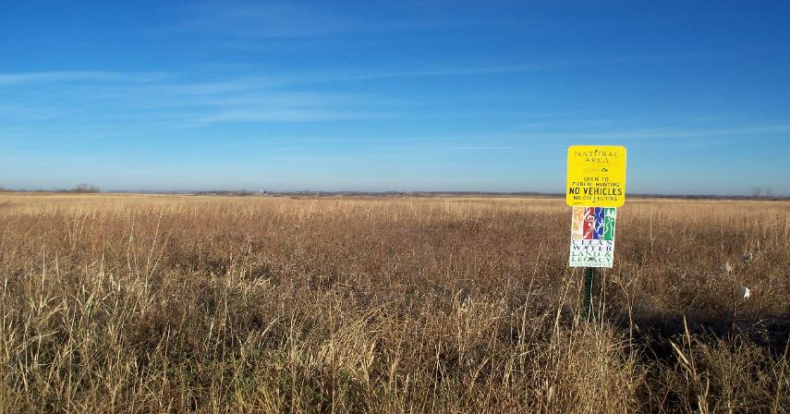
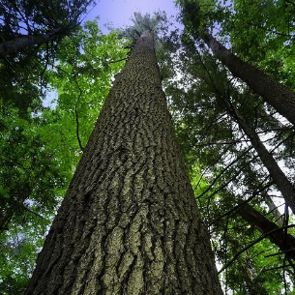
Question 1 – Impact of LSOHC Investment on Climate Resiliency?
Avoided Conversion
Restoration
Management (Enhancement)

Slide 12
Question 2 – Impact of LSOHC Investment on Climate Resiliency?

Slide 13
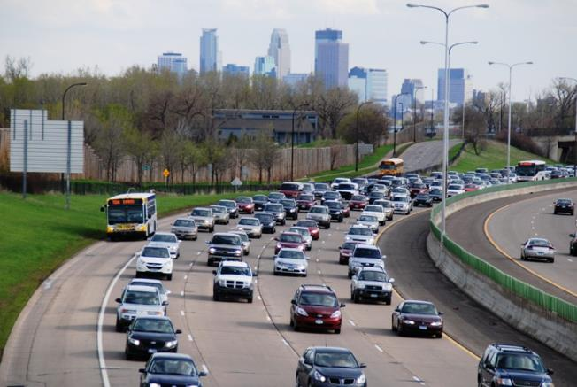
Question 3 – Impact of LSOHC Investment on Climate Resiliency?
Estimates to Date (2009 – 2020)
Forest Grasslands
Protected - 261,000 acres 75,000 acres
C stored - 32,593,429 MtCO2e 4,876,808 MtCO2e
Equivalent to removing approximately 10% of cars from MN roads per year*
*2019 Motorization Trends in MN – Institute for Urban & Regional Infrastructure Finance

