Slide 1
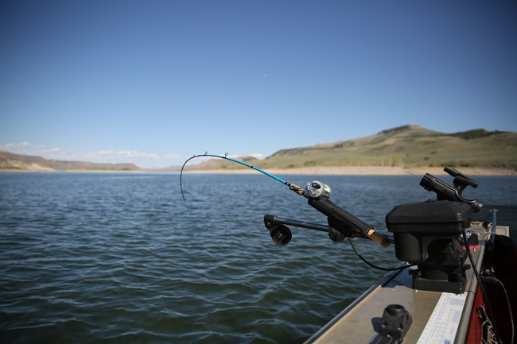
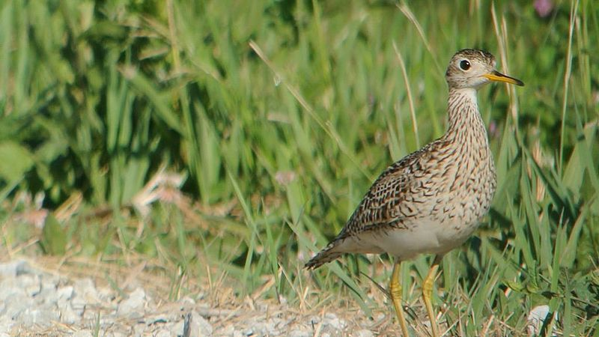
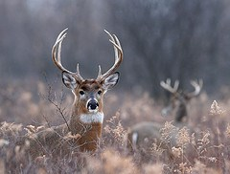
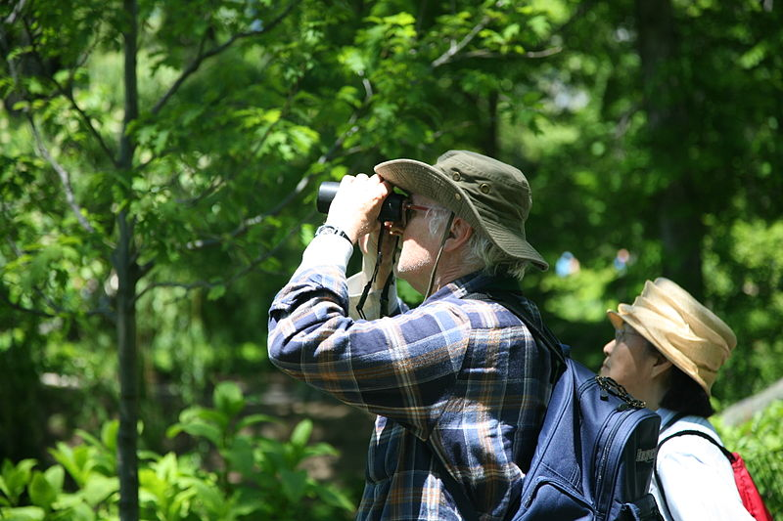
OHF investments: Assessing a suite of benefits
Ryan Noe, University of Minnesota - Twin Cities
Christina Locke, University of Minnesota - Twin Cities
U.S. National Park Service
Andy Reago & Chrissy McClarren
U.S. National Park Service
Daniel Schwen
Notes:
Introduction
Acknowledge NRRI and IonE
Some context on goals
Builds on 2017 report on outcomes and impacts
List of metrics
Metric methodology
Example
Portfolio analysis (Report Section 1: OHF scores on individual metrics)
...but... of course you have benefits, the next questions are
How did you do compared to similar, non-OHF parcels? Matching methodology.
What is well represented and what isn't?
There isn't a right answer of how much of what should be in your portfolio, that is a values question, but we want to illustrate what is there and how that changes over time.
Mention there is also a section highlighting the highest scoring OHF parcel for each metric
Multiple Benefits (Report Section 2)
Was it efficient?
How does it compare to the population?
Benefits outside of constitutional mandate are still worth communicating and can be the basis for collaborations
Added conservation value of OHF investments (Report Section 4)
Caveat the reason for WMAs
All the big benefits from a billion dollars... double this triple that etc…
Future Directions
Data quality
Ensuring boundaries don't overlap and are consistently linked to a single record
Cost data is uniform (0’s without donation attribute and vice versa) 77 cases of duplicates (overlapping shapes with different attributes - 185 rows out of 1465)
155 have 0 for total_purchase, 9 are donated
111 est_cost 0, 36 are donated
177 listed as not donated but have some donated value - partial donations not well represented
Report card, repeatability
Case studies to highlight on-the-ground impacts of restoration or protection (spectrum slide)
Summary
Portfolio has targeted x,y,z
Big increases to several indicators relevant to their mandate
Also increased, for example, wetland SGCN - but still under represented relative to non-OHF parcels
Multiple benefits: above average number of benefits on OHF land, but opportunities for further targeting
Shows it’s possible to have a repeatable, statewide assessment that communicates the full suite of benefits that OHF parcels are providing

Slide 2
Our collaborators
Eric Lonsdorf
George Host
Lucinda Johnson
Jessica Gorzo
Alexis Grinde
Michael Joyce
Josh Bednar
Josh Dumke
Mark Johnson
Joe Pavelko

Slide 3
The purpose of this project is to assess outcomes of OHF investments (easement and fee)
Easement
Fee
Notes:
Photo credits, from left: fishing: U.S. National Park Service, bird: Andy Reago & Chrissy McClarren (cropped), deer: U.S. National Park Service, birdwatchers: Daniel Schwen (cropped).

Slide 4
The purpose of this project is to assess outcomes of OHF investments (easement and fee)
Outcomes of habitat conservation go beyond # acres protected & restored
Notes:
Photo credits, from left: fishing: U.S. National Park Service, bird: Andy Reago & Chrissy McClarren (cropped), deer: U.S. National Park Service, birdwatchers: Daniel Schwen (cropped).

Slide 5
The purpose of this project is to assess outcomes of OHF investments (easement and fee) based on a suite of indicators recommended in:

Slide 6
What this report captures:
Fish habitat
Unique species presence
Primary outcomes of interest
Wildlife habitat
Habitat suitability
Species diversity
Risk of loss
Outdoor recreation
Public use
Accessibility
Nearby population
Benefits to people
Wellhead protection
Secondary outcome of interest
Notes:
Upland birds (

Slide 7
What this report captures:
Metrics:
Fish habitat
Unique species presence
Lakes of Biological Significance
Trout Streams
Primary outcomes of interest
Wildlife habitat
Habitat suitability
Species diversity
Risk of loss
Outdoor recreation
Public use
Accessibility
Nearby population
Benefits to people
Wellhead protection
Secondary outcome of interest
Notes:
Upland birds (

Slide 8
What this report captures:
Metrics:
Fish habitat
Unique species presence
Primary outcomes of interest
Wildlife habitat
Habitat suitability
Species diversity
Risk of loss
Species of Greatest Conservation Need (SGCN)
Game species
Pollinators
Outdoor recreation
Public use
Accessibility
Nearby population
Benefits to people
Wellhead protection
Secondary outcome of interest
Notes:
SGCN:
Forest birds
Grassland/prairie birds
Wetland birds
Mammals
Game species:
Upland birds (woodcock, grouse, turkey)
Pheasant
Waterfowl
Mammals/furbearers
Deer

Slide 9
What this report captures:
Metrics:
Fish habitat
Unique species presence
Primary outcomes of interest
Wildlife habitat
Habitat suitability
Species richness
Risk of loss
Bird Species Richness
Outdoor recreation
Public use
Accessibility
Nearby population
Benefits to people
Wellhead protection
Secondary outcome of interest
Notes:
Upland birds (

Slide 10
What this report captures:
Metrics:
Fish habitat
Unique species presence
Primary outcomes of interest
Wildlife habitat
Habitat suitability
Species richness
Risk of loss
Risk of development
Risk of agricultural conversion
Outdoor recreation
Public use
Accessibility
Nearby population
Benefits to people
Wellhead protection
Secondary outcome of interest
Notes:
Upland birds (

Slide 11
What this report captures:
Metrics:
Fish habitat
Unique species presence
Primary outcomes of interest
Wildlife habitat
Habitat suitability
Species richness
Risk of loss
Outdoor recreation
Public use
Accessibility
Nearby population
Wild Rice Sites
Birdwatching
Lake Recreation
Trail Proximity
Nearby Population
Benefits to people
Wellhead protection
Secondary outcome of interest
Notes:
Upland birds (

Slide 12
What this report captures:
Metrics:
Fish habitat
Unique species presence
Primary outcomes of interest
Wildlife habitat
Habitat suitability
Species diversity
Risk of loss
Outdoor recreation
Public use
Accessibility
Nearby population
Benefits to people
Wellhead protection
Secondary outcome of interest
Notes:
Upland birds (

Slide 13
Scoring the indicators
Each metric was scaled from 0 to 1, where 0 represents absent or lowest quality, and 1 is highest quality.
A land parcel scored “high” if it scored in the top half of parcels statewide for a given metric, and “low” if it scored in the bottom half.
A parcel scored “highest” if it scored in the top quarter of parcels statewide.
Notes:
Ryan – how to illustrate this?

Slide 14
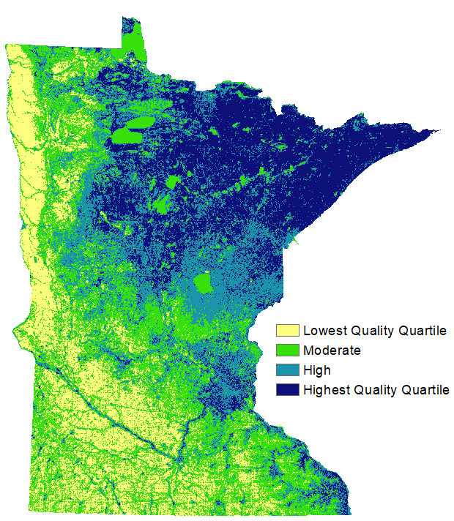
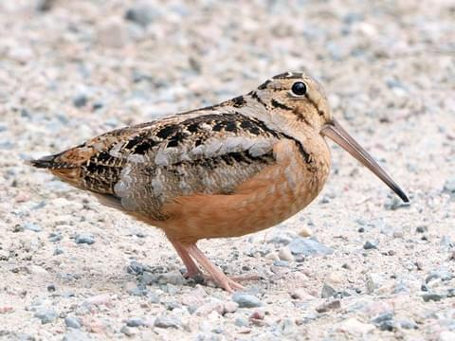
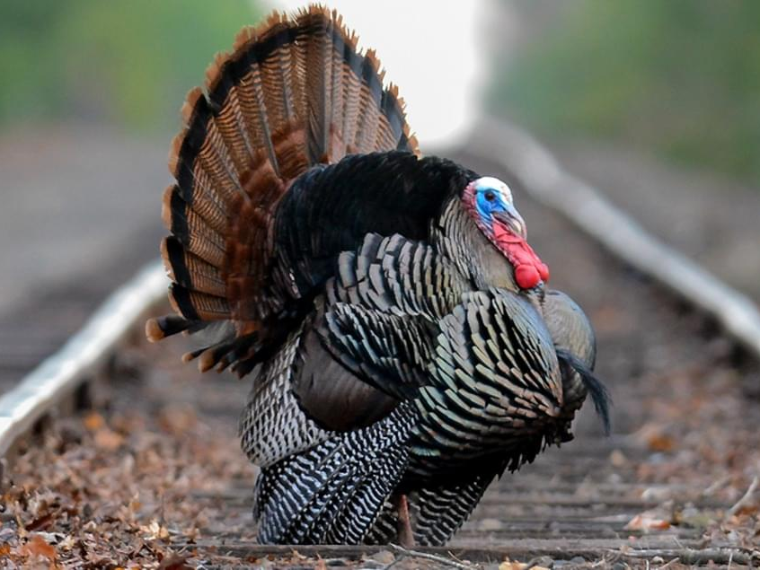
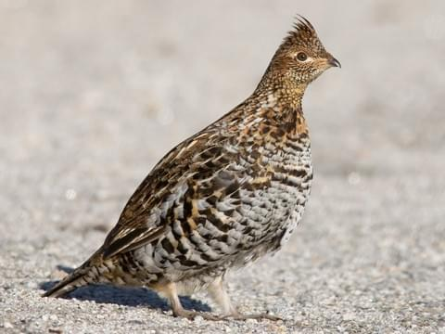
Example: upland game bird habitat
American Woodcock Wild turkey
Ruffed grouse
Notes:
These are Minnesota Breeding Bird Atlas habitat suitability models combo’ed for American Woodcock, Wild Turkey, and Ruffed Grouse. Models based on point counts and volunteer obsesrvations. Note that several upland game bird species such as Ring-necked Pheasant, Sharp-tailed Grouse and Greater Prairie-Chicken did not have the adequate sample sizes to develop habitat suitability models for the MNBBA, thus were not included in this analysis.

Slide 15
Analyses in our report:
OHF portfolio scores on individual metrics
Multiple benefit scoring
Added conservation value of OHF investments
Notes:
We can give you a score for pheasant production, or a score for lake recreation, but it doesn’t tell you anything on its own. Compared to what?

Slide 16
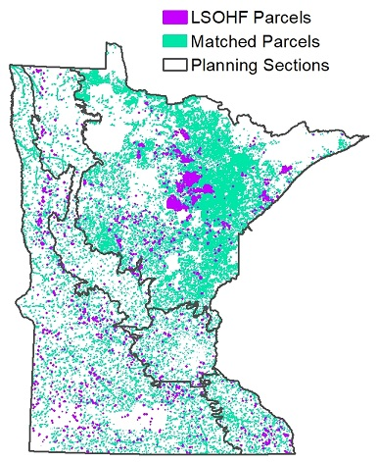
We used matching methods to compare OHF parcels to similar, non-OHF parcels
OHF Parcels
Matched Parcels
Planning Sections
Matched OHF parcels to non-OHF parcels in the same region that were similar in size, shape, and land value
5 matches for each OHF parcel

Slide 17
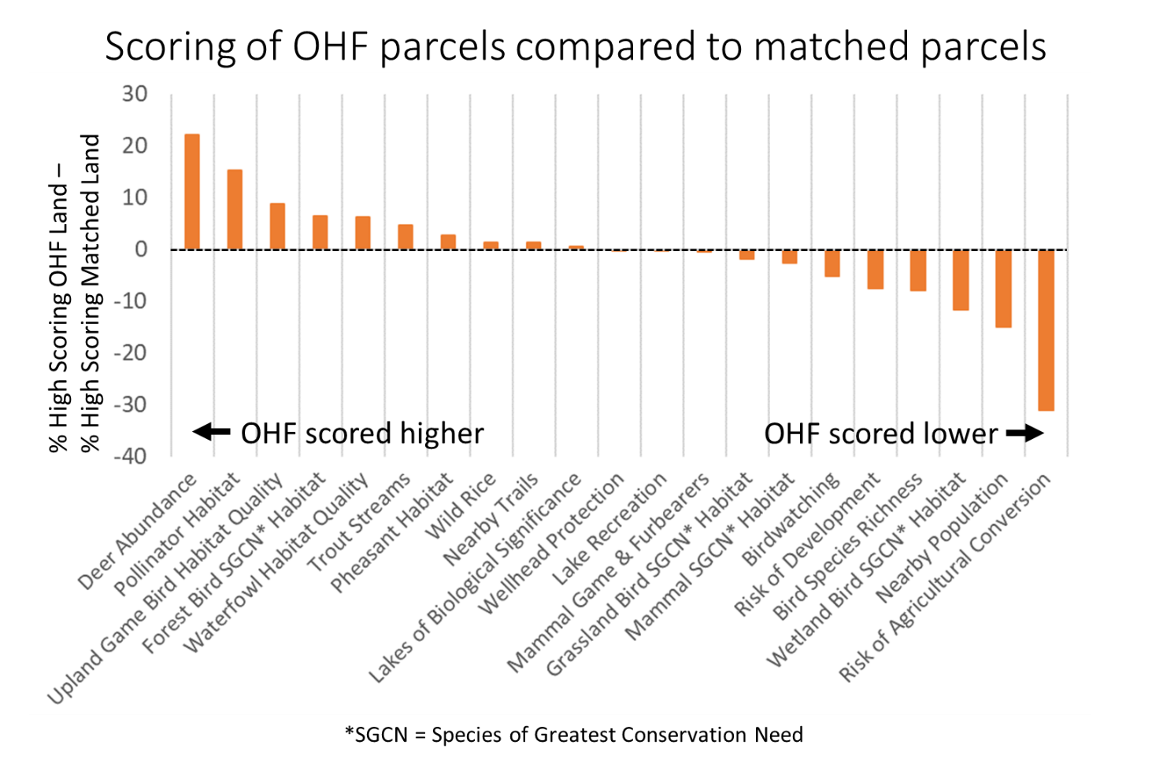
OHF portfolio scored highly on many habitat metrics
Notes:
There isn't a right answer of how much of what should be in your portfolio, that is a values question, but we want to illustrate what is there and how that changes over time.
Mention there is also a section highlighting the highest scoring OHF parcel for each metric

Slide 18
OHF portfolio scored lower on accessibility and risk metrics
Notes:
There isn't a right answer of how much of what should be in your portfolio, that is a values question, but we want to illustrate what is there and how that changes over time.
Mention there is also a section highlighting the highest scoring OHF parcel for each metric

Slide 19
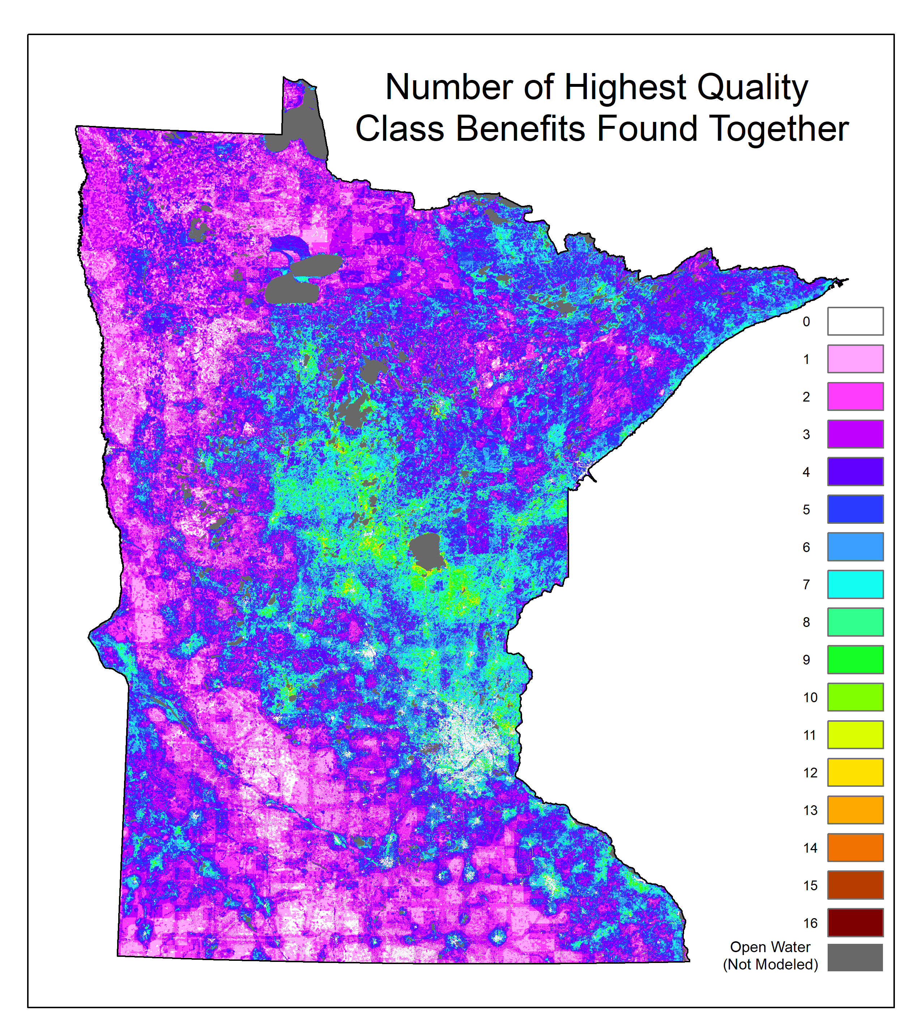
Multiple benefit scoring
One of many useful strategies
Can get more bang for your buck
Opportunity for collaboration
Of our 21 metrics, the highest quality class for 1-3 were typically found together, but some land had up to 16

Slide 20
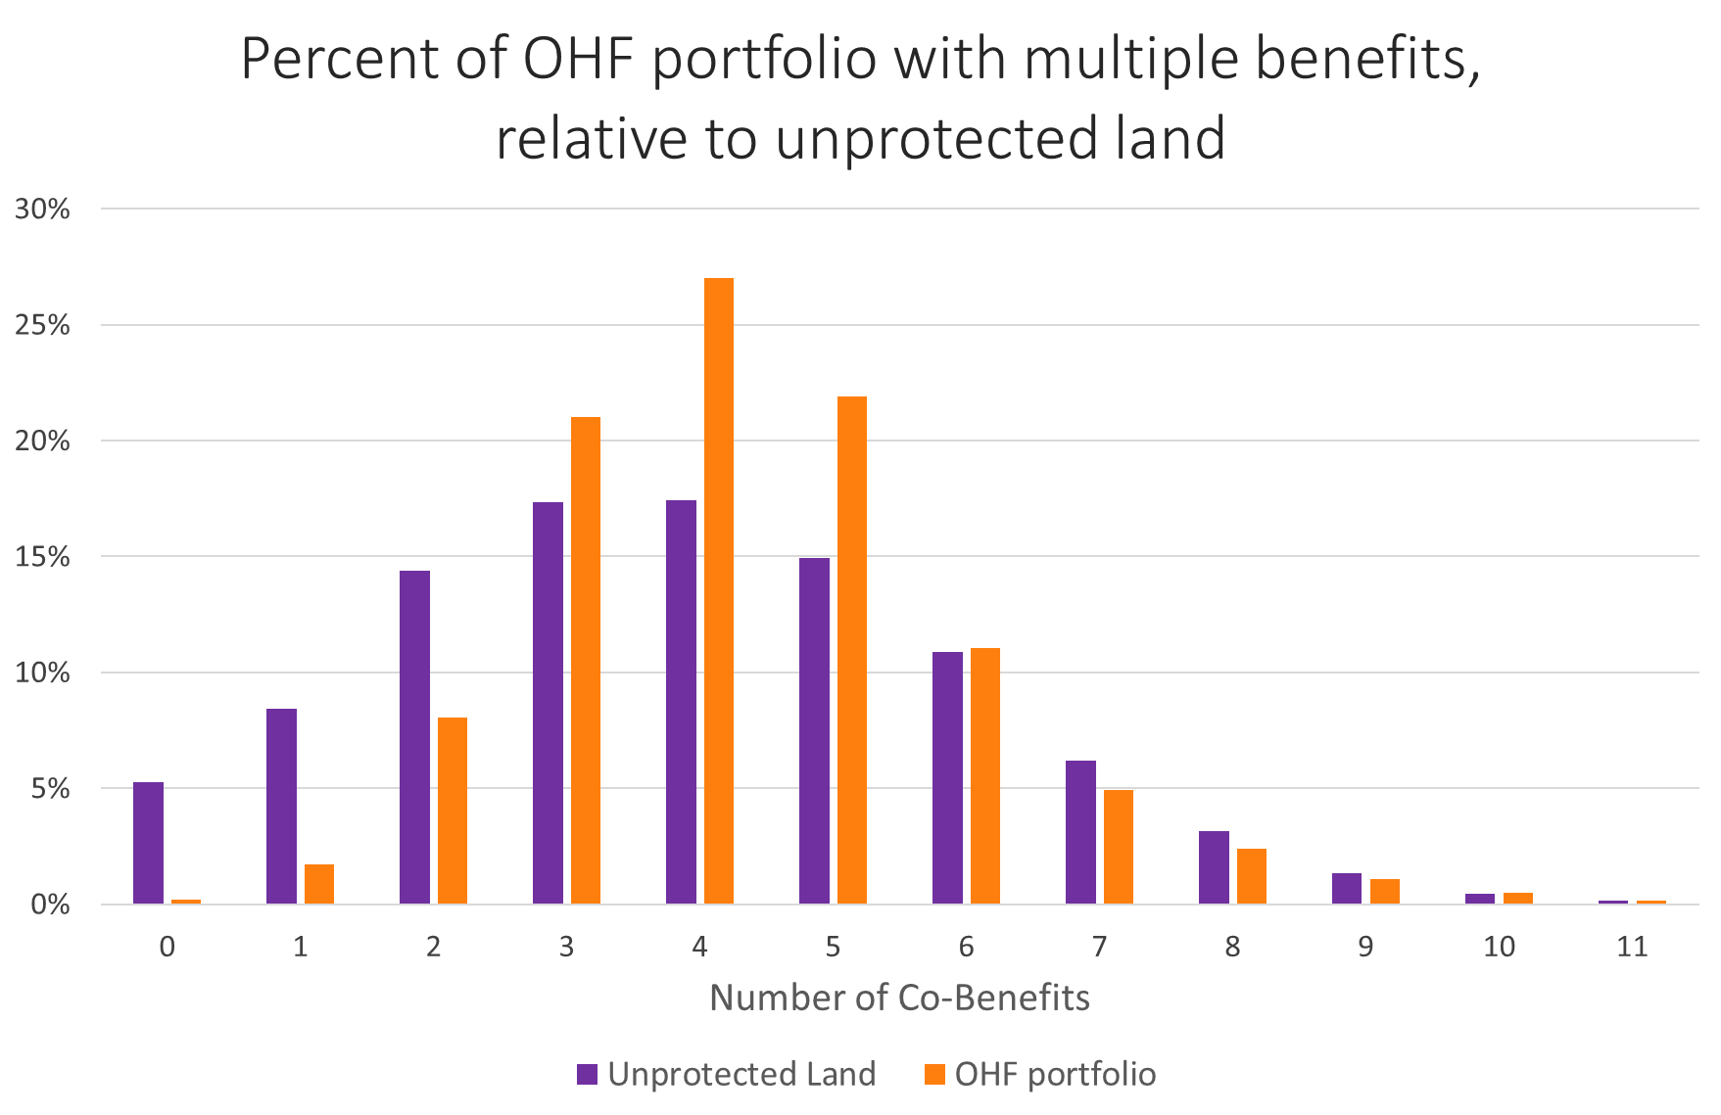
Multiple benefit scoring
OHF portfolio successfully targeted land with multiple benefits
98% of OHF land scored in the highest quality class on 2 or more metrics
While rare, some land scored highly on 12+ metrics. 93% of this land is unprotected by any program

Slide 21
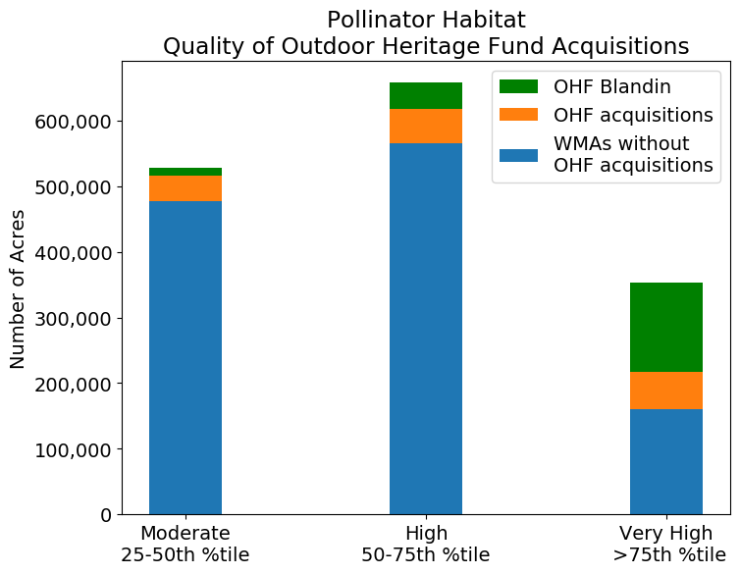
Added conservation value
Approximate WMA area without OHF acquisitions: 1.3 million acres
Added protection for over 200,000 acres of very high quality class pollinator habitat
More than doubled the very high quality class area protected by WMAs

Slide 22
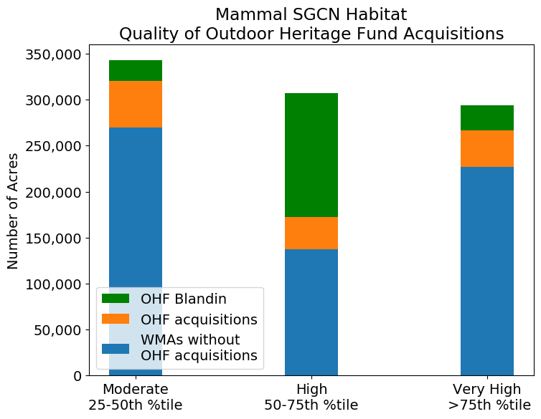
Added conservation value
Added protection for over 200,000 acres of high or very high mammal SGCN habitat

Slide 23
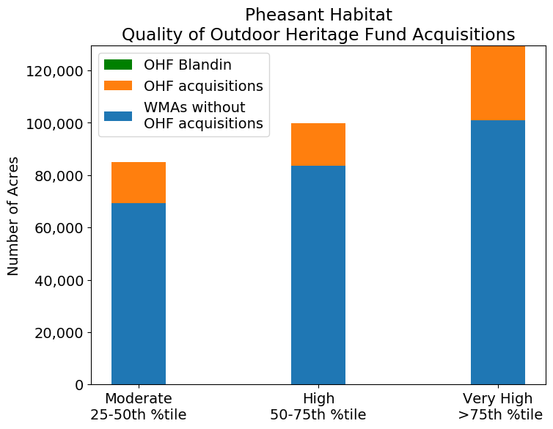
Added conservation value
Over 40,000 acres of high or very high quality pheasant habitat added to portfolio
Of land in the pheasant habitat range, majority of acquisitions were in the very high quality class

Slide 24
Future directions for data collection and management
Existing data quality limitations
Cost variables were inconsistently used
Multiple overlapping boundaries were present
Identifiers linking boundaries and other records not always unique

Slide 25
Future directions for data collection and management
Statewide, repeatable,
less detailed
More detailed, more expensive, limited scope
Old Status:
Acres and Dollars
This Report:
Environmental Benefits Database
Complementary Future Direction:
Individual Parcel Case Studies
Field observations and data collection
(including restoration and enhancement)
Repeated measures over time
Data on the quantity and quality of all land acquired for 21 metrics
Dashboard view of portfolio of benefits
Readily accessible data
Easy to communicate
Repeatable report card foundation

Slide 26
Summary
Portfolio Representation: OHF parcels scored highly on habitat metrics for deer, pollinators, upland game birds, forest bird Species of Greatest Conservation Need (SGCN), trout, and pheasant.
Multiple Benefits: 70% of OHF land scored highly on three, four, or five co-benefits, compared to 50% of non-urban land unprotected by any conservation program.
Added Conservation Value: OHF increased the protected area of highest quality habitat for game mammals, upland game birds, and forest bird SGCN by approximately 75%, and more than doubled the protected area of highest quality pollinator habitat, compared to WMAs.
Future directions: The methods developed for this report can be repeated as the OHF portfolio grows to provide a statewide update on the amount and type of benefits added to the portfolio.

Slide 27
Summary
Portfolio Representation: OHF parcels scored highly on habitat metrics for deer, pollinators, upland game birds, forest bird Species of Greatest Conservation Need (SGCN), trout, and pheasant.
Multiple Benefits: 70% of OHF land scored highly on three, four, or five co-benefits, compared to 50% of non-urban land unprotected by any conservation program.
Added Conservation Value: OHF increased the protected area of highest quality habitat for game mammals, upland game birds, and forest bird SGCN by approximately 75%, and more than doubled the protected area of highest quality pollinator habitat, compared to WMAs.
Future directions: The methods developed for this report can be repeated as the OHF portfolio grows to provide a statewide update on the amount and type of benefits added to the portfolio.

Slide 28
Summary
Portfolio Representation: OHF parcels scored highly on habitat metrics for deer, pollinators, upland game birds, forest bird Species of Greatest Conservation Need (SGCN), trout, and pheasant.
Multiple Benefits: 70% of OHF land scored highly on three, four, or five co-benefits, compared to 50% of non-urban land unprotected by any conservation program.
Added Conservation Value: OHF increased the protected area of highest quality habitat for game mammals, upland game birds, and forest bird SGCN by approximately 75%, and more than doubled the protected area of highest quality pollinator habitat, compared to WMAs.
Future directions: The methods developed for this report can be repeated as the OHF portfolio grows to provide a statewide update on the amount and type of benefits added to the portfolio.

Slide 29
Summary
Portfolio Representation: OHF parcels scored highly on habitat metrics for deer, pollinators, upland game birds, forest bird Species of Greatest Conservation Need (SGCN), trout, and pheasant.
Multiple Benefits: 70% of OHF land scored highly on three, four, or five co-benefits, compared to 50% of non-urban land unprotected by any conservation program.
Added Conservation Value: OHF increased the protected area of highest quality habitat for game mammals, upland game birds, and forest bird SGCN by approximately 75%, and more than doubled the protected area of highest quality pollinator habitat, compared to WMAs.
Future directions: The methods developed for this report can be repeated as the OHF portfolio grows to provide a statewide update on the amount and type of benefits added to the portfolio.

Slide 30
Questions?
Ryan Noe, RRNoe@umn.edu
Christina Locke, clocke@umn.edu
U.S. National Park Service
Andy Reago & Chrissy McClarren
U.S. National Park Service
Daniel Schwen
Notes:
Introduction
Acknowledge NRRI and IonE
Some context on goals
Builds on 2017 report on outcomes and impacts
List of metrics
Metric methodology
Example
Portfolio analysis (Report Section 1: OHF scores on individual metrics)
...but... of course you have benefits, the next questions are
How did you do compared to similar, non-OHF parcels? Matching methodology.
What is well represented and what isn't?
There isn't a right answer of how much of what should be in your portfolio, that is a values question, but we want to illustrate what is there and how that changes over time.
Mention there is also a section highlighting the highest scoring OHF parcel for each metric
Multiple Benefits (Report Section 2)
Was it efficient?
How does it compare to the population?
Benefits outside of constitutional mandate are still worth communicating and can be the basis for collaborations
Added conservation value of OHF investments (Report Section 4)
Caveat the reason for WMAs
All the big benefits from a billion dollars... double this triple that etc…
Future Directions
Data quality
Ensuring boundaries don't overlap and are consistently linked to a single record
Cost data is uniform (0’s without donation attribute and vice versa) 77 cases of duplicates (overlapping shapes with different attributes - 185 rows out of 1465)
155 have 0 for total_purchase, 9 are donated
111 est_cost 0, 36 are donated
177 listed as not donated but have some donated value - partial donations not well represented
Report card, repeatability
Case studies to highlight on-the-ground impacts of restoration or protection (spectrum slide)
Summary
Portfolio has targeted x,y,z
Big increases to several indicators relevant to their mandate
Also increased, for example, wetland SGCN - but still under represented relative to non-OHF parcels
Multiple benefits: above average number of benefits on OHF land, but opportunities for further targeting
Shows it’s possible to have a repeatable, statewide assessment that communicates the full suite of benefits that OHF parcels are providing

