Slide 1
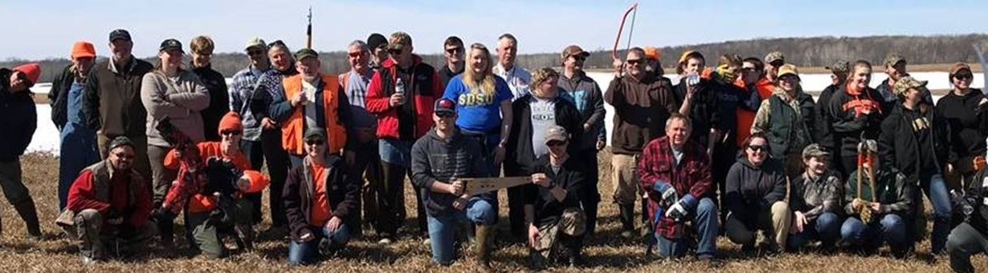

DNR & Partner Coordination on OHF Projects
Lessard-Sams Outdoor Heritage Council | December 8, 2020
Pat Rivers, Fish and Wildlife Deputy Director
Joe Stangel, Assistant Regional Wildlife Manager
Bill Schuna, Area Wildlife Supervisor

Slide 2
Purpose & agenda
Purpose:
Request from Council staff following Aug./Sept. hearings
How DNR and partners coordinate on proposals and projects:
  Primarily, acquisition (fee and easement)
  Secondarily, restoration and enhancement
Partners consulted ahead of time on this presentation
Agenda:
Key messages
Plans and partners
Coordination overview
Project examples

Slide 3
1. Key messages
There is too much work to do alone; many needs remain unmet
We need everyone’s respective strengths, and collaboration yields better outcomes (and it’s fun!)
Depending on program/project, DNR can offer holistic coordination or “lead from behind,” and NGOs serve their missions – all in service of OHF
Partners often represent specific:
  User/interest groups, relationships, capacity
  Watersheds, species, eco-regions, local conservation implementation, habitat types
Requirements are met consistently – e.g., county approval, state process, landowner rights
Collaboration reflects intent of Council formation

Slide 4
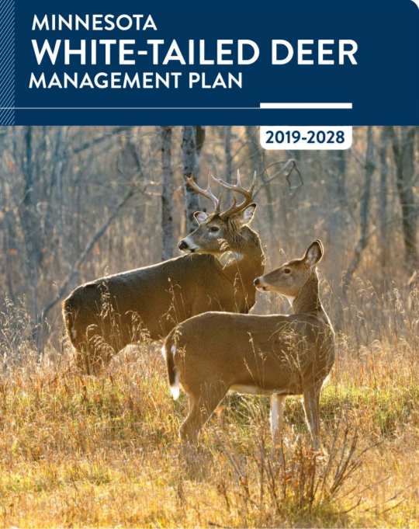
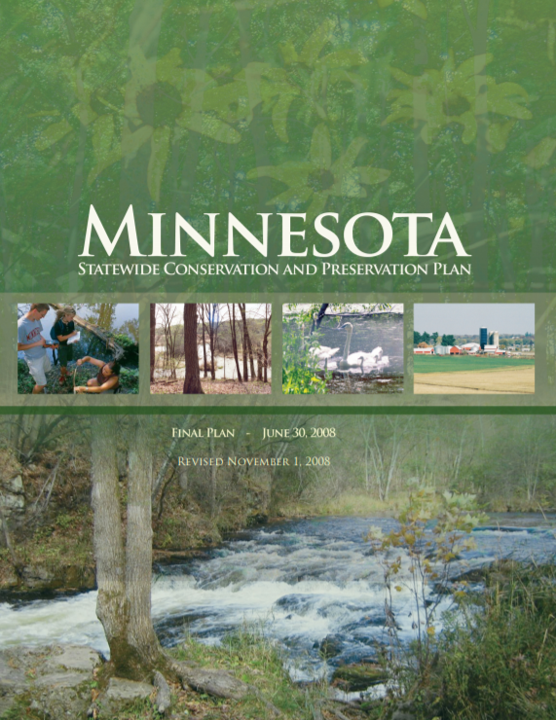
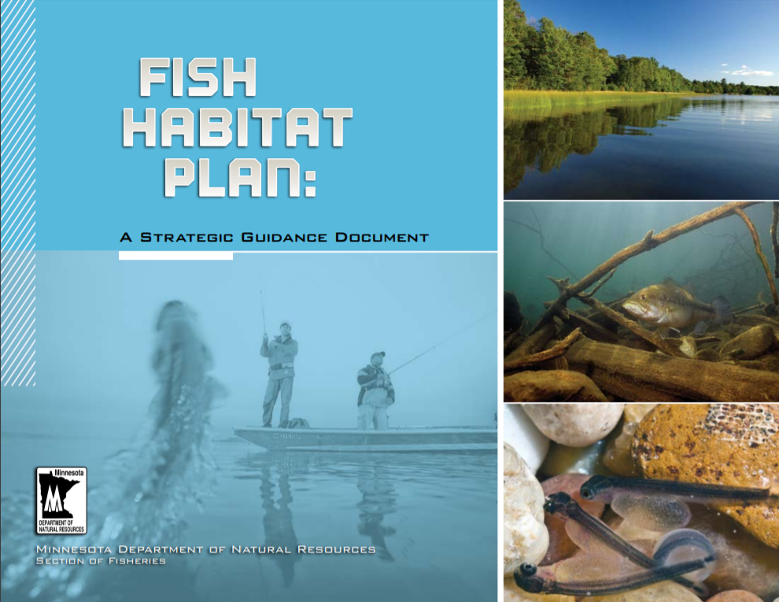
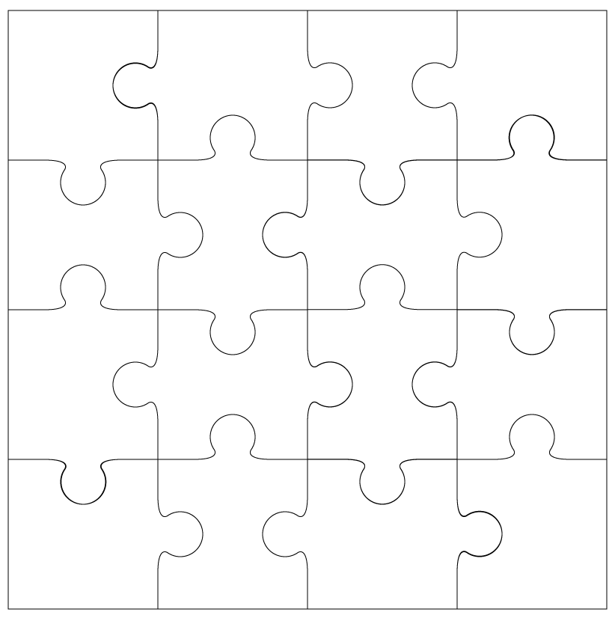
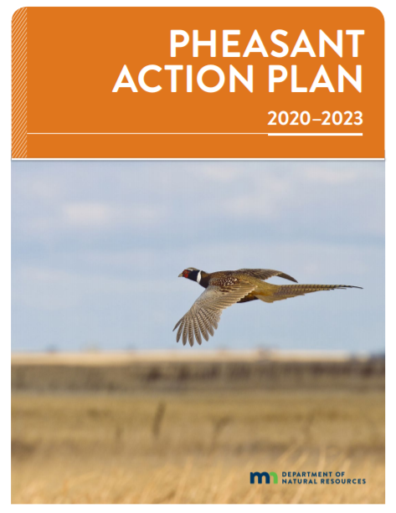
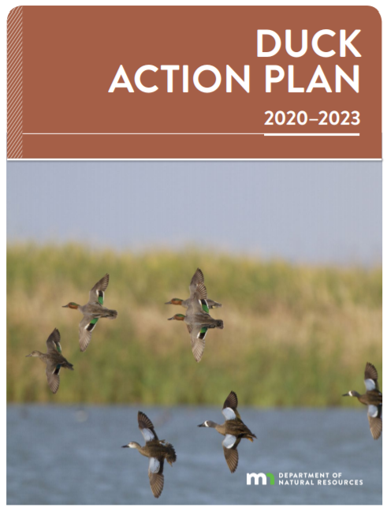
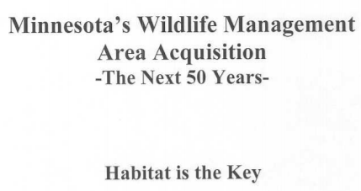
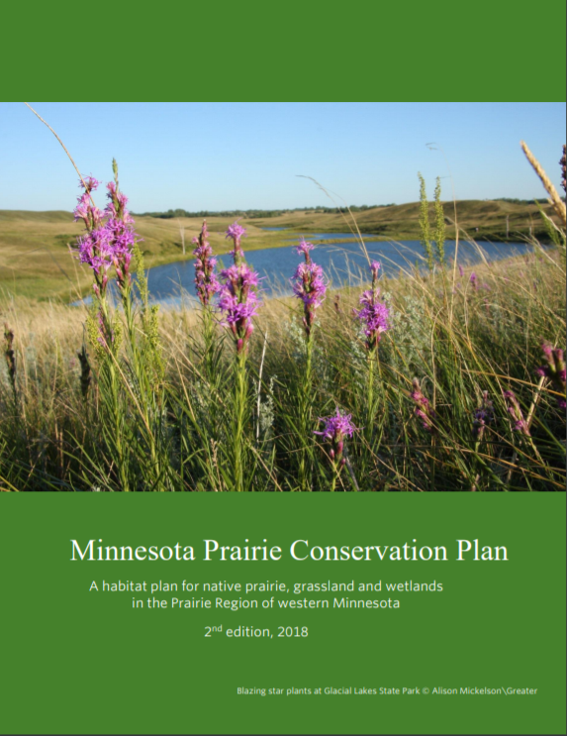
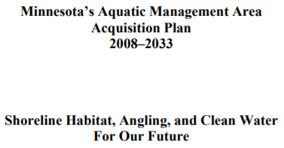
2. Strategic planning

Slide 5

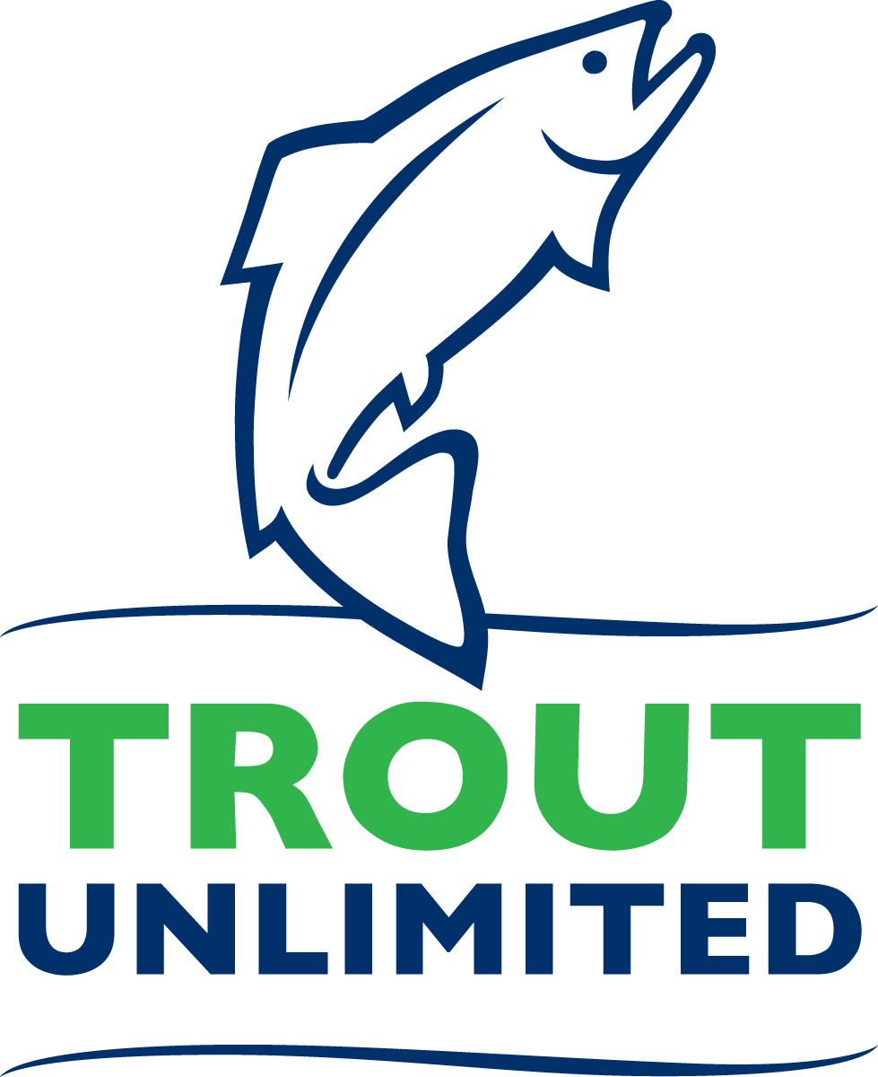

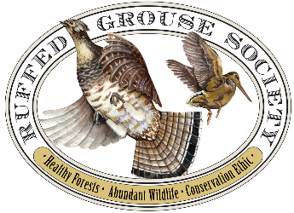
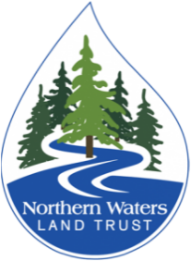
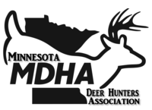

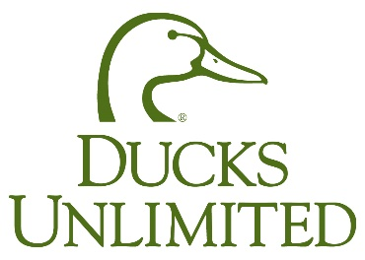
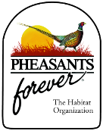



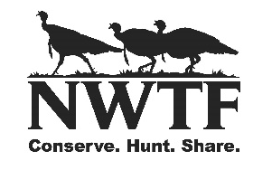

… and many other partners

Slide 6
3. Coordination overview
Acquisition projects:
Projects identified via landowner/partner/DNR area coordination
Area/partner(s) evaluate project merits
Desirable projects advance to regional evaluation
Statewide program staff collate ranked projects per planning section
Spring meeting to allocate projects
Partners/DNR submit proposals with preferred parcels
Post-funding recommendation, partners/DNR revise parcels
Ongoing formal/informal project coordination
Restoration/enhancement projects:
On WMAs and AMAs:
Areas submit projects through DNR’s WMA/AMA habitat management system (partner coordination as needed/indicated)
Statewide program staff collate projects into respective proposals
Partner/DNR collaboration on project implementation based on land administration, equipment, habitat/species focus, community/volunteer leverage
On partner-led projects, DNR assumes various roles:
Technical expertise
Permitting guidance
Assistance with grant writing

Slide 7
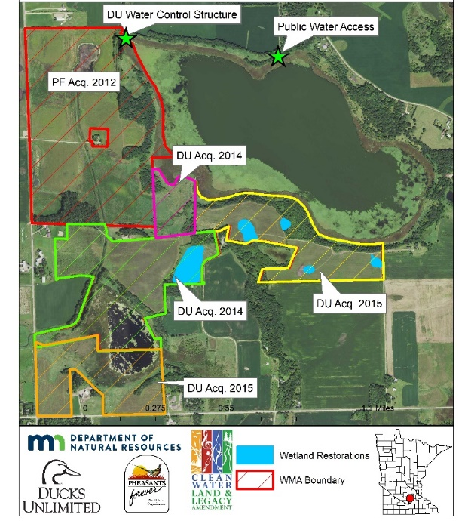
4. Project examples – acquisition
Sanborn Lake WMA
Le Sueur County
Lake Maria WMA
Murray County

Slide 8
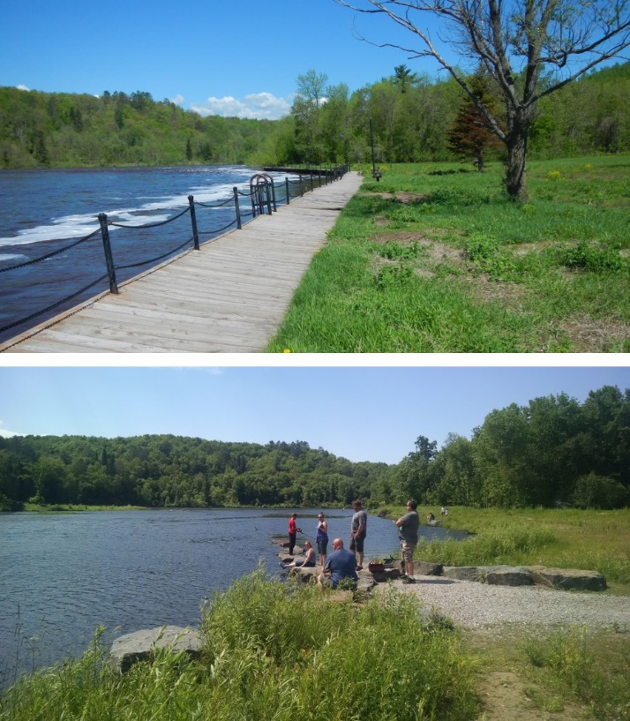
4. Project examples – restoration/enhancement
Willowsippi WMA, Aitkin County
With MN Sharp-tailed Grouse Society/Pheasants Forever, opening landscape for sharp-tailed grouse lek and nesting. 300 acre acquisition and tree removal, brush mowing, firebreaks, fence removal followed with prescribed burn and diversity seeding planned. Future volunteer work will leverage CPL.
St. Louis River Restoration Initiative
With MN Land Trust, restoring 29 acres of biologically productive sheltered bay habitat at Radio Tower Bay (impaired by legacy milling wood waste) and restoring 1,000 feet of hardened shoreline at Chambers Grove while creating 10 acres of valuable Lake Sturgeon spawning habitat.
Native Prairie Bank and SNA Acquisition
Prairie Plan Local Technical Teams (LTTs) promote easements and bring potential projects forward.

Slide 9
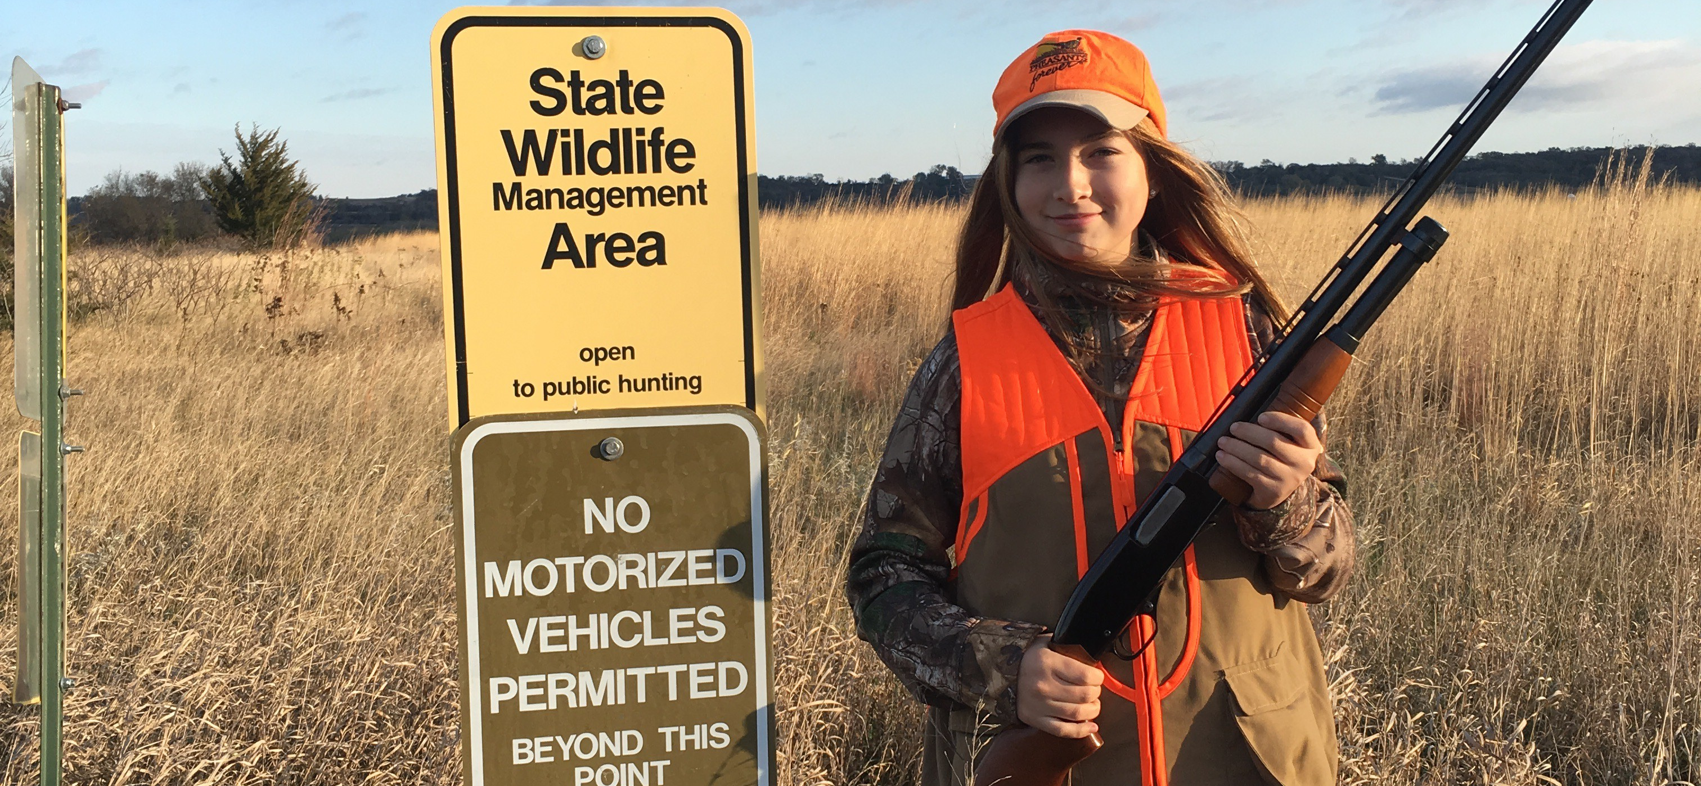
Conclusion
Continuous improvement
  Common Ground Summit
  FAW strategic planning – acquisition improvement
  LAM partner calls

