Slide 1
CWD Surveillance & Management in Minnesota
Dr. Michelle Carstensen, Minnesota Department of Natural Resources
November 19, 2020

Slide 2
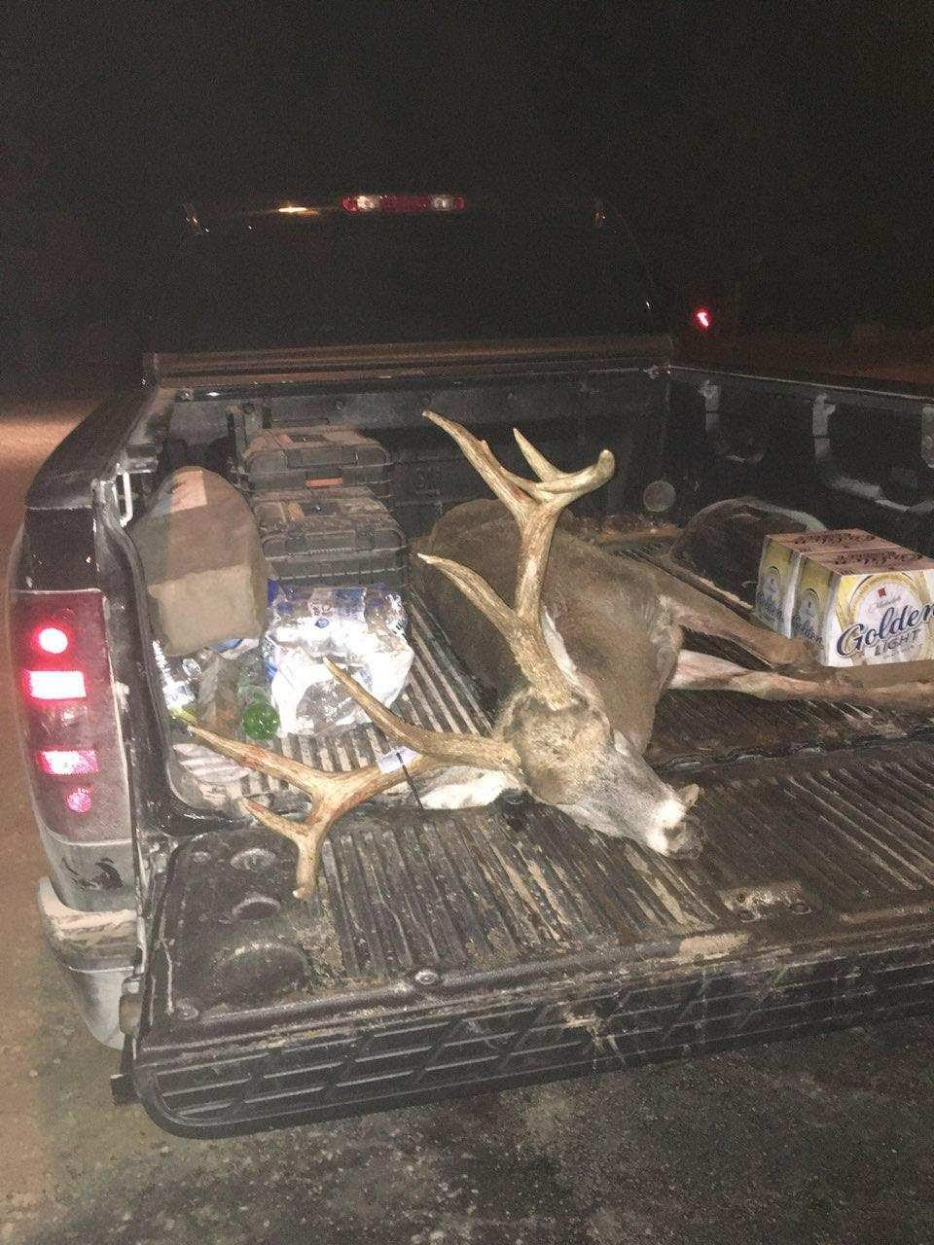
Outline
Brief overview of Chronic Wasting Disease
Challenges with managing the deer waste stream
Adopt-A-Dumpster Program
Recap of Fall 2019 efforts
New areas with increased risk for CWD in 2020
Douglas County – CWD-infected deer farm
Pine County – CWD-infected deer farm
Dakota County – CWD-infected wild deer
CWD surveillance changes for Fall 2020; responding to Covid-19 risks
Testing to date in Fall 2020

Slide 3
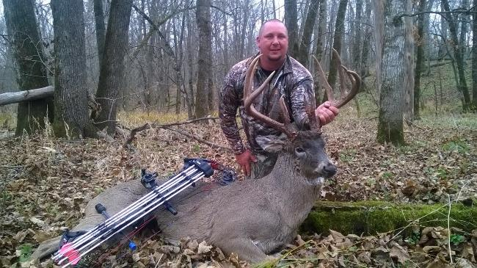
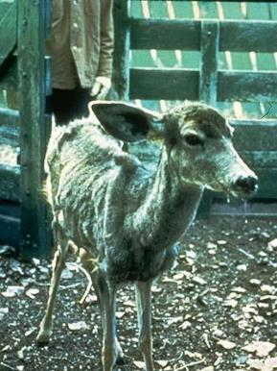
Chronic Wasting Disease: What is it?
CWD is a slowly progressive, brain disease of deer, elk, moose, and reindeer
CWD belongs to the family of diseases known as transmissible spongiform encephalopathies (TSE) or prion diseases
Not caused by a virus, fungus, or bacteria – mis-shapen protein
Spread animal-to-animal, mostly through saliva, feces, urine
Clinical Disease
Photo by J. Skukrud
Both Deer are CWD-Positive
Top Photo: Pre-clinical disease
Bottom Photo: Clinical disease
Photo by Terry Kreeger
Notes:
Other TSEs include scrapie in sheep, bovine spongiform encephalopathy (or mad cow disease) in cattle, and Creutzfeldt-Jakob disease in humans.

Slide 4
Understanding the CWD Agent
Infectious agent is called a prion, which is a mis-shapen protein
It can remain infectious for years outside of the host body, readily binds to soil and can even be uptaken by plant roots.
Extremely difficult to denature
Heat must be >1500°F to destroy
Normal disinfectants, such as bleach, do not destroy prions
Recent study showed 40% bleach solution over 5 minutes was effective for surface decomtamination

Slide 5
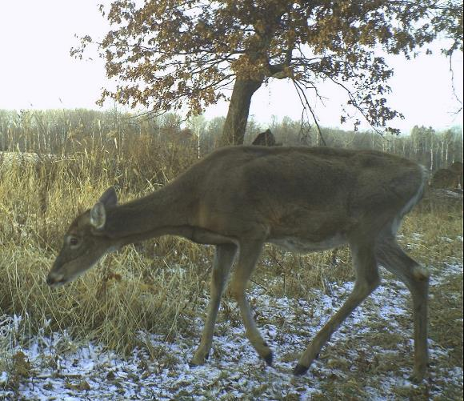
Characteristics of CWD
Neurologic clinical signs: tremors, head tilt, excessive salivation, in-coordination, abnormal behavior, loss of body condition
No treatment or vaccine, always fatal
Prions persist in the environment and remain infectious for an undetermined length of time
Incubation of disease is 1.5 to 3 years from exposure to development of clinical signs; once clinical, death <6mos
Infected animals begin to shed prions soon after exposure
There is no genetic immunity
CWD not shown to infect humans or cattle, but health agencies recommend NOT to eat an infected animal
CWD Positive Deer – Pine Island - 2010

Slide 6
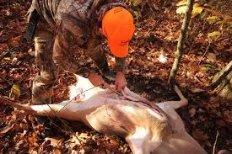
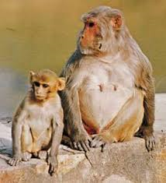
Can Humans get CWD?
No known cases of CWD in humans
The human TSE, Cruetzfeldt-Jakob Disease (CJD), is a different disease than CWD and naturally affected 1 in a million people
Center for Disease Control (CDC) recommends no consumption of CWD+ venison
Macaques fed infected venison (1) and brain (1) developed disease in Canadian study; unpublished data
Test your animal if you hunt in a CWD area and don’t mix your venison with others, process your deer individually
Is the species barrier complete?
Transgenic mice studies, route of exposure, prion strain adaptation, and serial passage studies have all demonstrated that humans can not get CWD
Mad Cow Disease happened in UK in the 1980s when cattle were fed processed animal remains of sheep infected with scrapie. Humans ate the infected cattle and developed new variant CJD. Since 1996, >200 people died in Britain and France. Likely >1million BSE-cattle entered food chain.
Notes:
93% DNA similarity with humans

Slide 7
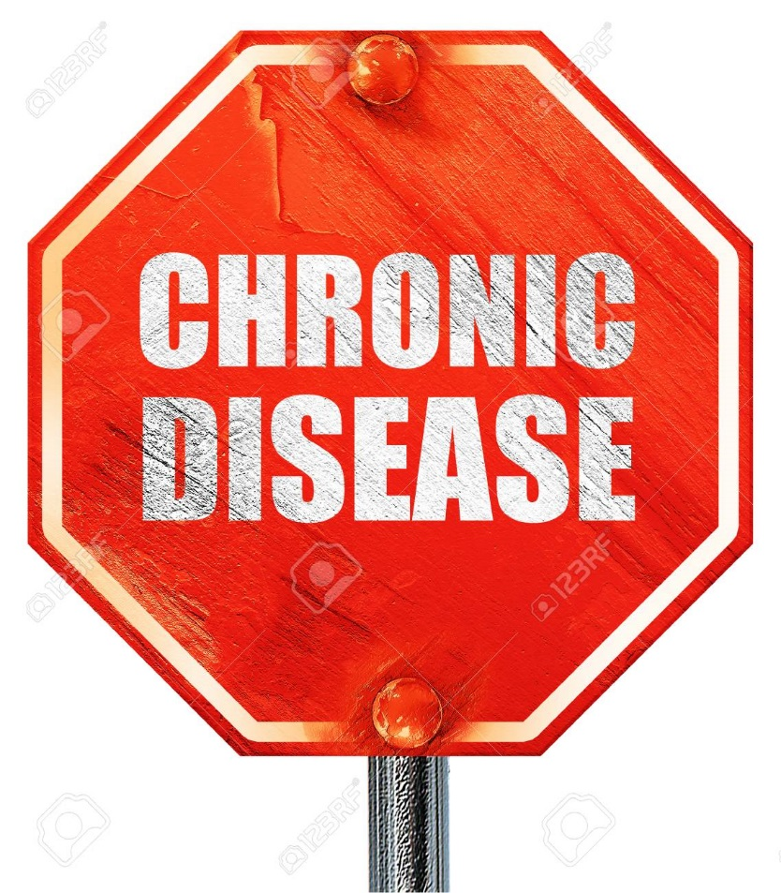
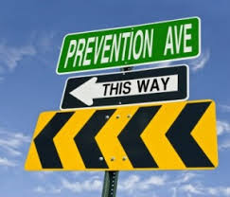
The number 1 way to address wildlife disease?
PREVENTION! PREVENTION! PREVENTION!
Once a disease is established in a wild population of animals, it is nearly impossible to get rid of.

Slide 8
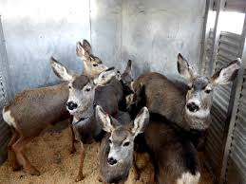
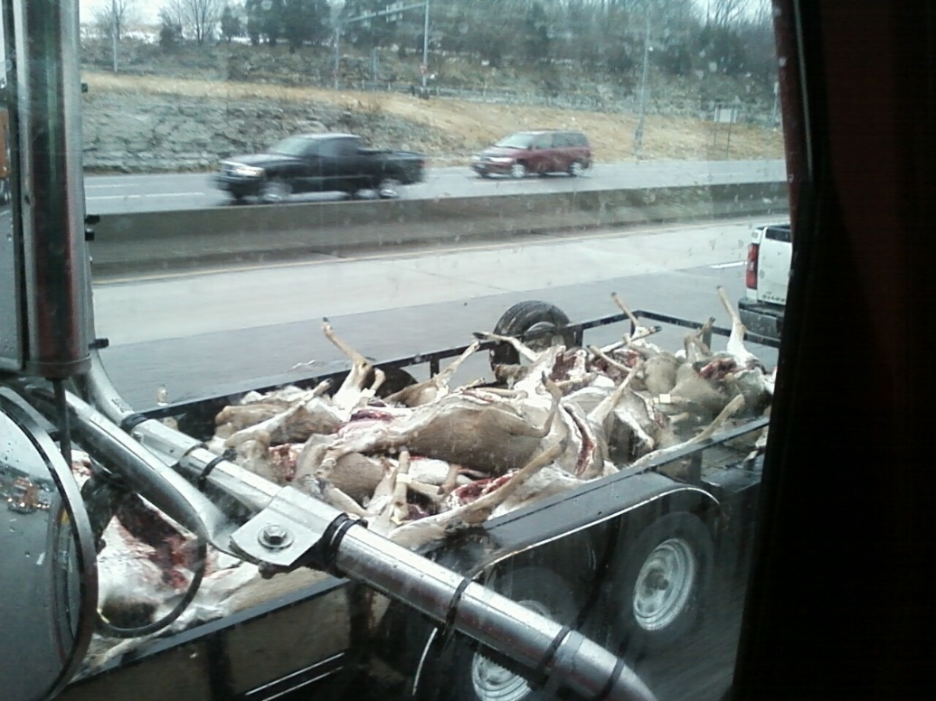
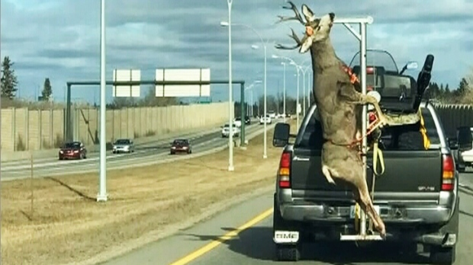
The 2 BIGGEST risks to spreading CWD across North America
Movement of live cervids (both through the cervid industry and wildlife agencies)
Movement of cervid carcasses and their parts

Slide 9
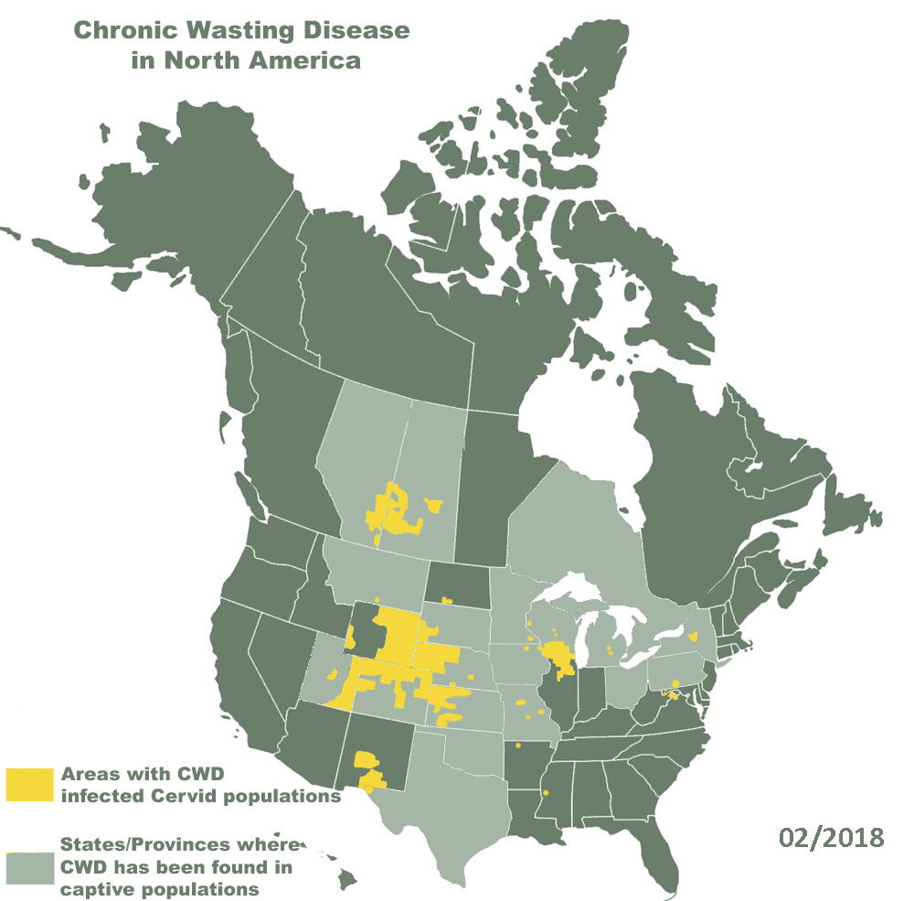
Cervid Carcass Import Ban, Blanket Rule 2016
No importation of whole cervid carcasses into MN from ANYWHERE in North America
Meat that is boned out or that is cut and wrapped (either commercially or privately).
Quarters or other portions of meat with no part of the spinal column or head attached.
Hides and teeth.
Antlers or clean (no brain tissue attached) skull plates with antlers attached.
Finished taxidermy mounts.
Nonresidents transporting whole or partial carcasses on a direct route through Minnesota are exempt from this restriction; however, importation restrictions exist in all surrounding states.
Source: CWD Alliance

Slide 10
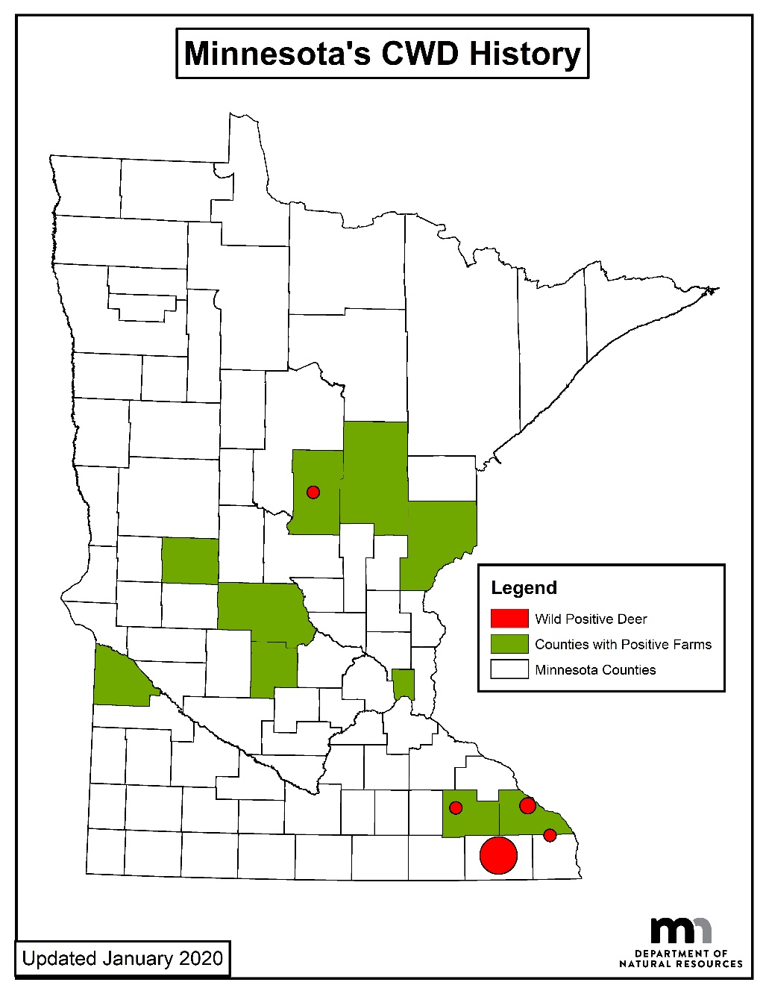
Minnesota’s Current CWD Status
Since 2002, >90,000 wild deer sampled for CWD
Positive wild white-tailed deer (n=88)
2-Olmsted Co. (2010; 2019); 2.0 mi from CWD+ farm
67-Fillmore Co. (2016-2020)
4-Houston Co. (2018-2019)
13-Winona Co. (2019-2020); <0.5 mi from CWD+ farm
1-Crow Wing Co. (2019); <0.5 mi from CWD+ farm
1-Dakota Co. (2020)
Positive cervid farms (n=11)
3 elk, 7 white-tailed/mixed deer, & 1 red deer farm; latest one in Houston County in Oct 2020
Oct 2020 CWD+ Farm

Slide 11
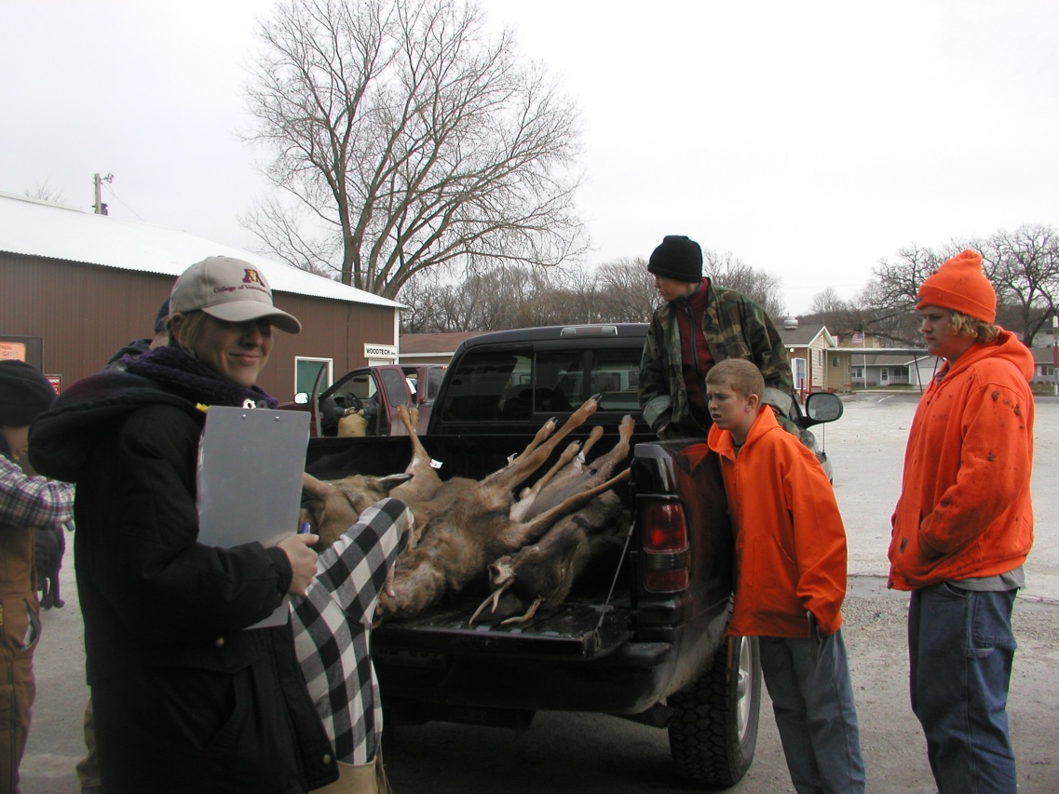
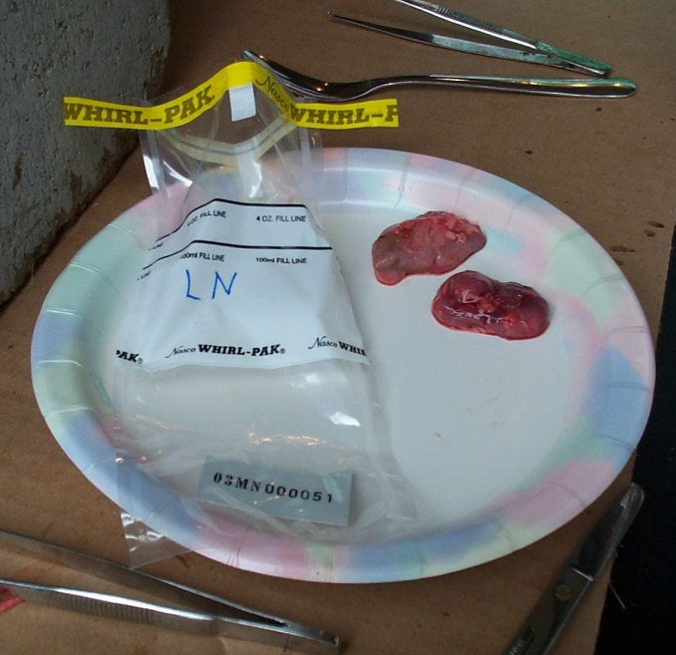
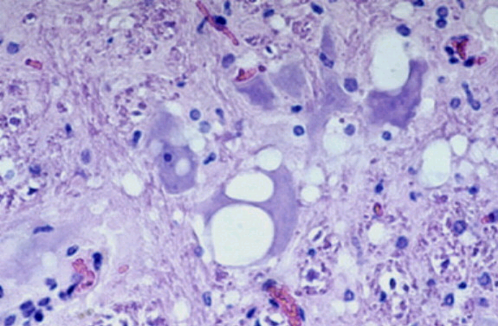
How do we test for CWD?
Extract retropharyngeal lymph nodes and ship to University of Colorado for testing.
ELISA takes 3-4 business days and will tell us if a deer is “suspect” or “not detected”
If suspect, sample is confirmed with the disease using immunohistochemistry (IHC), takes about a week
Confirmed CWD-positive deer carcasses & meat are recovered and brought to the alkaline digester at the UMN Veterinary Diagnostic Lab in St. Paul, whenever possible

Slide 12
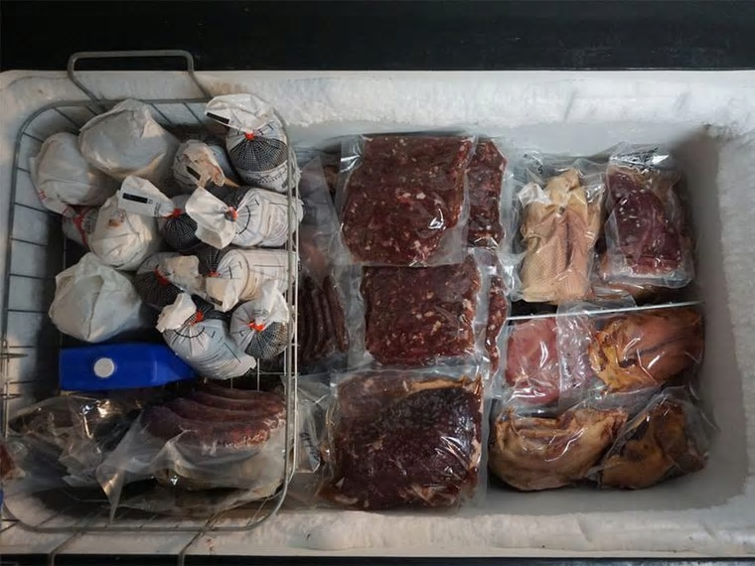
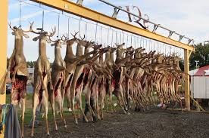
What are the options for hunters to dispose of the carcass?
Hunters are only required by DNR rules to do 3 things:
Register the deer after harvesting it (via phone, on-line, or walk-in big game station)
Comply with mandatory CWD testing, either via self-service sampling station (available for archery and muzzleloader season) or in person at sampling stations (firearm season)
Do NOT take the intact carcass outside of the CWD Zones prior receiving CWD test results (4-5 business days, can be up to 2 weeks)
Options?
Drop the deer off at a meat processor inside the CWD zone
Hang the deer or place the carcass remains on private land; natural decomp ok if CWD test is clear
Quarter the deer and place carcass remains in a dumpster through the Adopt-a-Dumpster Program

Slide 13
Managing the deer carcass waste streams of CWD-positive deer
Approved methods for disposal of CWD-positive deer:
Alkaline digestion (University of Minnesota)
Lined landfills
Incineration (if temperatures exceed 1500°F)
DNR has confirmed a total of 88 CWD+ wild deer since 2010, here’s where carcasses went:
Whole carcass to digester: 23
Meat to digester and butcher remains in DNR dumpster: 47
Meat processor waste stream: 6
Left on the landscape and mostly scavenged, remains recovered and digested: 11
Carcass buried on property: 1
***6 hunters chose to consume known positive venison***

Slide 14
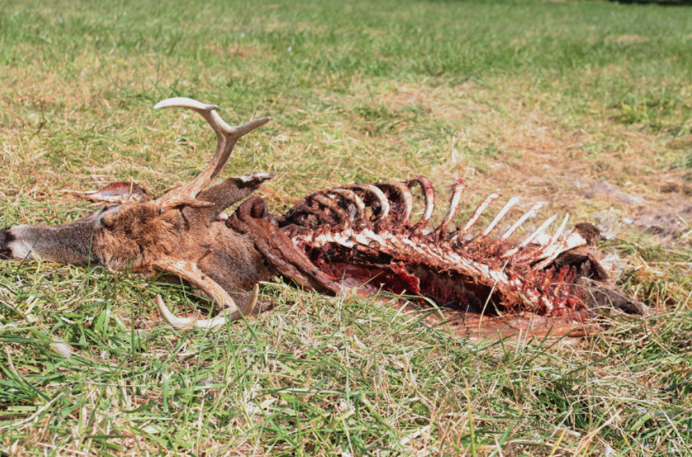
Deer Disposal in a CWD Surveillance Area
Getting the carcass disposed of properly is the key.
If left on the landscape, an infected deer carcass becomes a source of disease; thus, the landfill is the best solution to reduce these risks by providing containment!
There is no human health risk associated with landfilling, the health advisory is only tied to EATING CWD-positive venison
Testing can determine knowns and unknowns.
DNR will attempt to recover any confirmed CWD-positive deer and utilize the alkaline digester at UMN
Due to delays in receiving CWD test results, carcass remains may already be in the waste stream and not recoverable

Slide 15
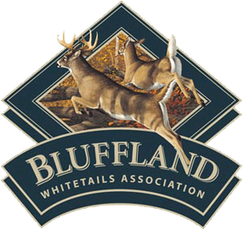
Adopt-A-Dumpster Program

Slide 16
Adopt-A-Dumpster Program
Minnesota Session Laws-2019, Ist Special Session Chapter 4, Article 1 Sec. 3 Subd. 6.
$50,0000 from Wild Cervid Health Management Account in the Game and Fish Fund
Provide dumpsters dedicated to disposing of deer carcasses where CWD has been detected
Work with solid waste haulers and other interested parties and encourage volunteer support to ensure dumpsters are located at convenient locations with appropriate signage, lined, and maintained.
Ensure the carcasses collected are properly disposed of
Work with Department of Health and Pollution Control Agency to develop guidelines for
hunters for handling deer in the field and transporting and disposing of carcasses
solid waste facilities and solid waste haulers for proper handling, processing, and disposal of deer carcasses
Taxidermists and meat processors for proper handling, processing, and disposal of deer carcasses
Submit a report

Slide 17
Adopt – A – Dumpster Program
Legislature allocated $50k to establish program
Goal was to reduce risk of CWD-infected carcass remains on the landscape
20 dumpsters in the SE and 6 in the NC zones last fall
RESULTS:
200 tons of deer parts were brought to landfill
Cost ~$200k

Slide 18
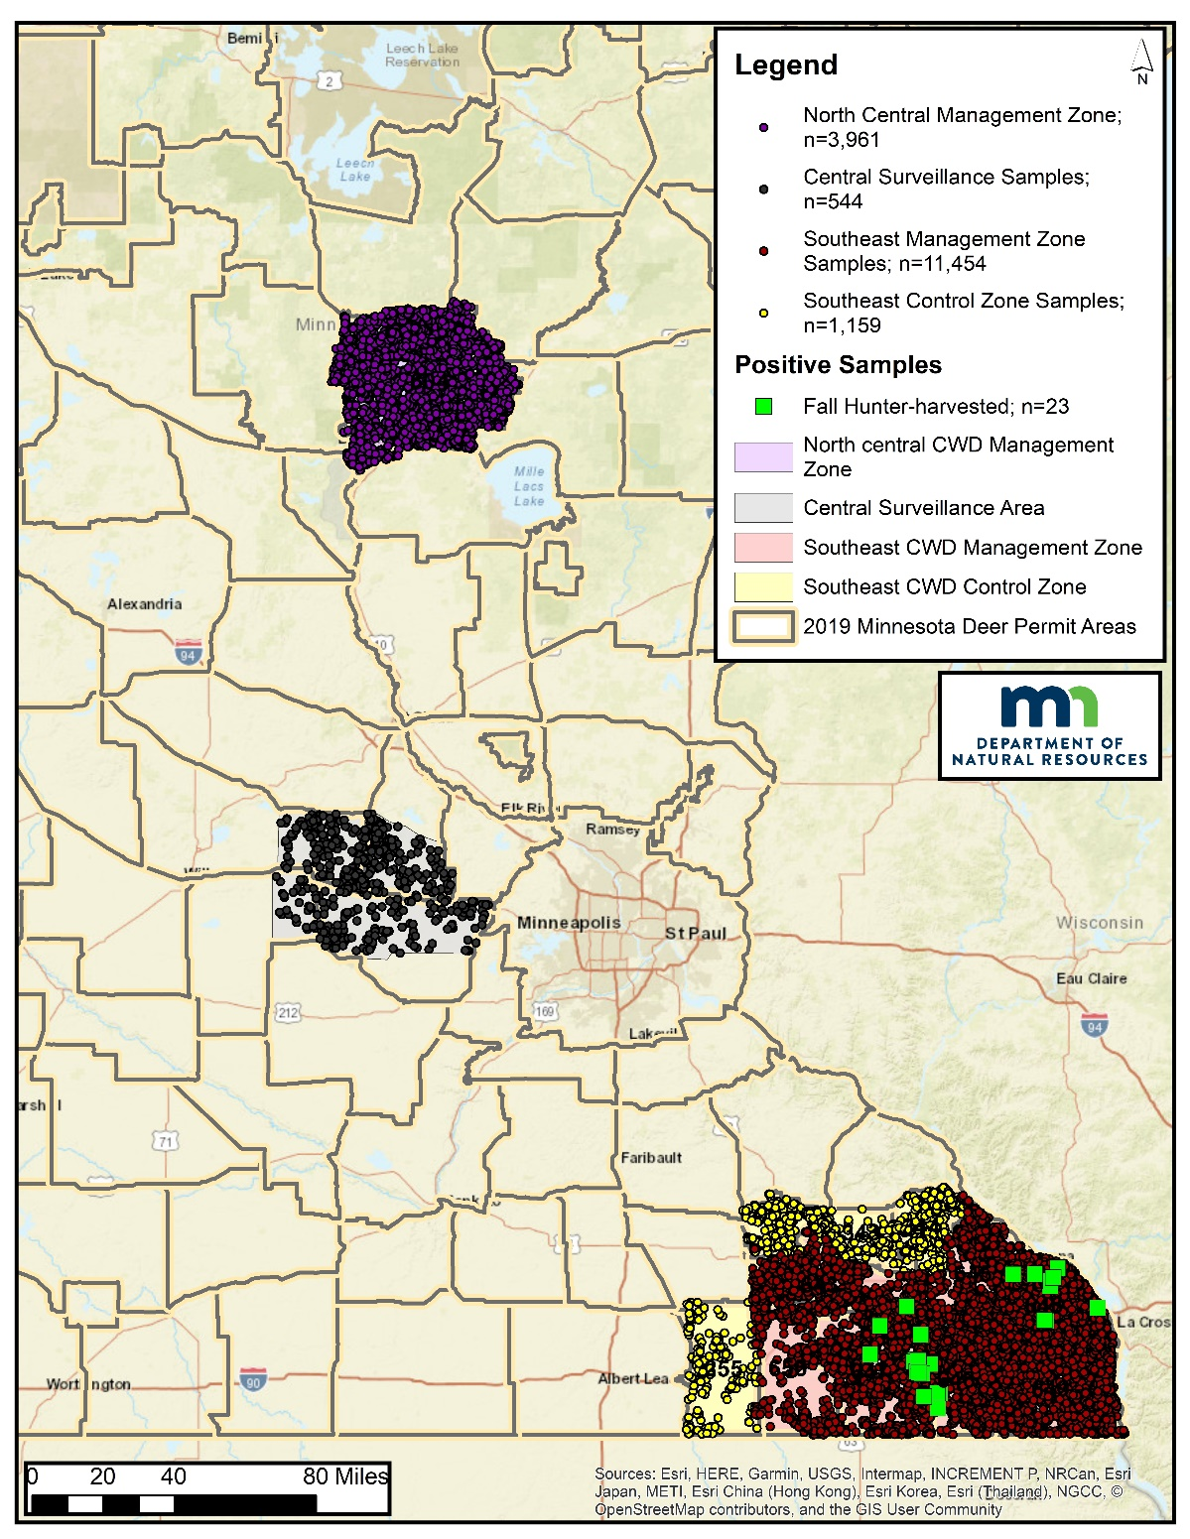
CWD Testing Results from Fall 2019
Total hunter-harvested samples collected during fall 2019: 17,118
23 CWD-positives, all in the southeast
No positives in the North-Central or Central Zones
An additional 1,040 were sampled post-season in the southeast through special late hunts (567), landowner permits (10), and agency culling (463)
10 CWD-positives
358 deer were sampled opportunistically statewide (vehicle-killed, found dead, reported sick)
3 CWD-positives, all in the southeast
To date, >90,000 deer tested since 2002
88 positive wild deer in 6 counties: Olmstead, Fillmore, Winona, Houston, Crow Wing, Dakota

Slide 19
Taxidermists
DNR staff contacted 46 taxidermists within our CWD zones
28 decided to participate (reimbursed them $15/deer for collecting LN, muscle, a tooth, and data)
1,404 samples were collected by taxidermists last fall = $21,240.
4 positives in 2019, 7 total positive samples have come from taxidermists so far (7/88, 8%)
Trophy heads –
Central = 6 forms
NC = 97 forms
SE = 1,301 forms

Slide 20
Southeast MN
Disease is persisting in Fillmore County area, where originally found in fall 2016. Spread has also occurred in the surrounding area
Two new areas of disease have also been found in Winona/Houston counties:
Immediately surrounding the CWD+ deer farm, there are now 9 cases in the wild
4 CWD+ deer in the same section by Money Creek in Houston County.

Slide 21
CWD Prevalence in DPA 603 - Fillmore County Outbreak
CWD prevalence is still low in DPA 603; however, increased from 2017 to 2018
This infection appears to be persisting in the Preston-Lanesboro area and spreading outward
2019 prevalence estimate only slightly higher than 2018

Slide 22
FY20 Spending on CWD-related Efforts
Overall spending FY20: $2,777,626
DNR staff salary: $1,006,710
Sample collection efforts: $798,303
Includes travel, supplies, student contracts, taxidermists, meat processor, and equipment
CWD diagnostic testing: $335,179
Agency culling with USDA: $295,209
Adopt -A- Dumpster program: $185,791
CWD-related research projects: $156,434
Funding sources: General Fund ($1,592,162), Game & Fish ($550,127), DNR Dedicated Accounts ($635,337)

Slide 23
2020 CWD Surveillance
New: West Central Surveillance Area (Douglas County farm response)
New: East Central Surveillance Area (Pine County arm response)
New: South Metro Surveillance Area (Dakota County wild deer response: orange area)
New: DPA 605 CWD Management Zone (grey area)
Southeast Management and Control Zones
North Central Management Zone

Slide 24
Expanded Deer Feeding and Attractant Use Bans
Deer feeding is prohibited in areas where CWD was detected in farmed deer. This includes all of Carlton, Chisago, Douglas, Isanti, Kanabec, Pine, Pope and Stearns counties.
In addition to deer feeding, deer attractants are prohibited in counties within proximity to where wild deer have been found positive for CWD. This includes Aitkin, Cass, Crow Wing, Dakota, Dodge, Fillmore, Freeborn, Goodhue, Hennepin, Houston, Hubbard, Mille Lacs, Morrison, Mower, Olmsted, Ramsey, Rice, Scott, Steele, Todd, Wabasha, Wadena, Washington and Winona counties.

Slide 25
2020 NEW Changes To CWD Efforts
Shift to a voluntary CWD sampling and surveillance program in all parts of the state for 2020 to minimize social interaction due to COVID-19 concerns.
Sampling designed to maintain high level of confidence in detecting disease, if present.
Encourage hunters to use self-service sample collection stations (head boxes); data collection and sample extraction completed off site by DNR staff and UMN Students (pending fall school decision).
Continue partnering with meat processors and taxidermists, as well as Adopt-a-Dumpster program in our CWD Management and Control Zones, and targeted culling efforts during winter months in core areas of infection

Slide 26
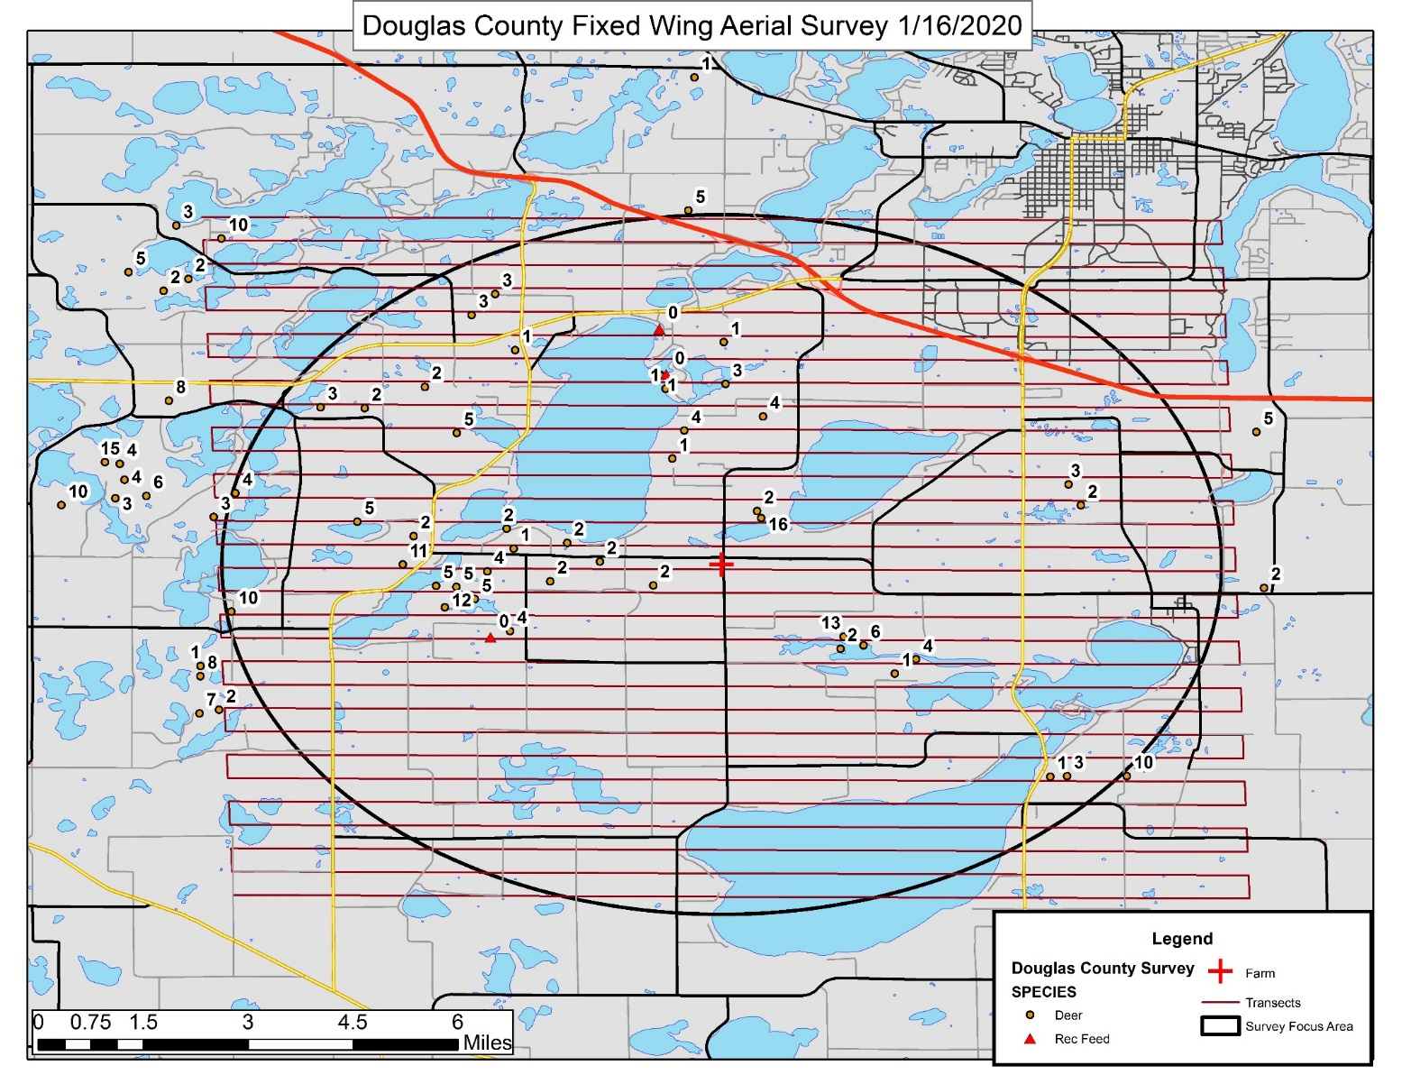
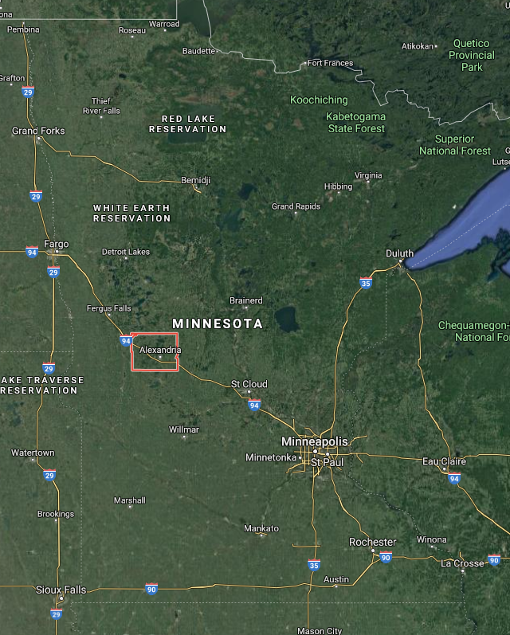
Douglas County (West Central Surveillance Area)
Douglas County Positive Deer Farm
2 deer (1 buck, 1 doe)
The positive doe sourced from a Pine County deer farm
Site visit with BAH, USDA, and DNR ENF showed not much interaction with wild deer along the fences, and not much woody habitat immediate to the deer farm.
Aerial survey in January = 64 deer and 3 feeding sites

Slide 27
Douglas County (West Central Surveillance Area)
Risk based Surveillance Model: Pilot Effort
Samples collected are assigned points based on sample type (age/sex), e.g. adult males or sick deer are worth more.
Better detection probability with decreased samples.
Still achieve 95-99% probability of detecting CWD if present at 0.5-1% of the deer population in this area.
Points can increase or decrease based on risk factors, including: deer density, presence of cervid farms, distance to wild CWD+ deer, presence of taxidermists/meat processors/wildlife (deer) rehab, and past surveillance history.
Partner with taxidermist and meat processors to collect samples for us from hunter harvested deer
802 Points
385 Points

Slide 28
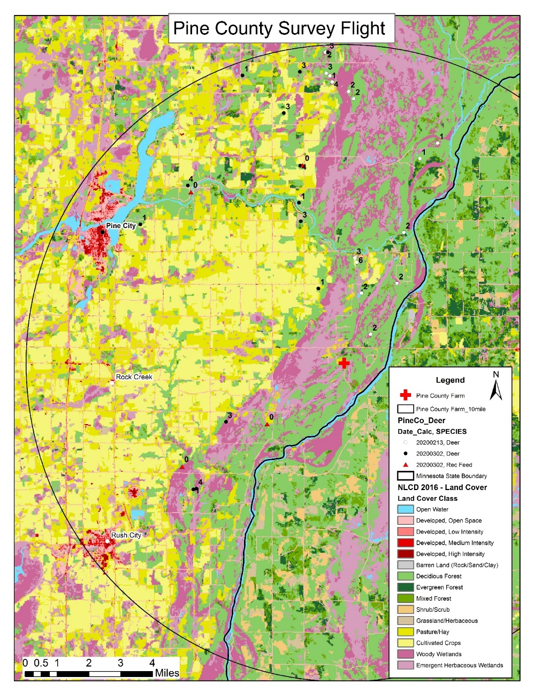
Pine County (East Central Surveillance Area)
1 deer died on farm, tested positive for CWD
8 remaining deer indemnified, 4 tested positive
Total: 5 out of 9 positive on farm
Other deer farms received deer from this facility; the Douglas County positive deer came from this farm
65 deer observed during aerial flight in February
4 recreational feeding sites observed

Slide 29
Pine County (East Central Surveillance Area)
Voluntary testing for hunters during firearms season until a goal of 1000 deer is reached
Increased awareness for sick or found dead deer.
Boundary extended beyond 15 miles due to increased risk
No carcass movement restrictions
3 years of not detected results needed to discontinue surveillance per our CWD Response Plan

Slide 30
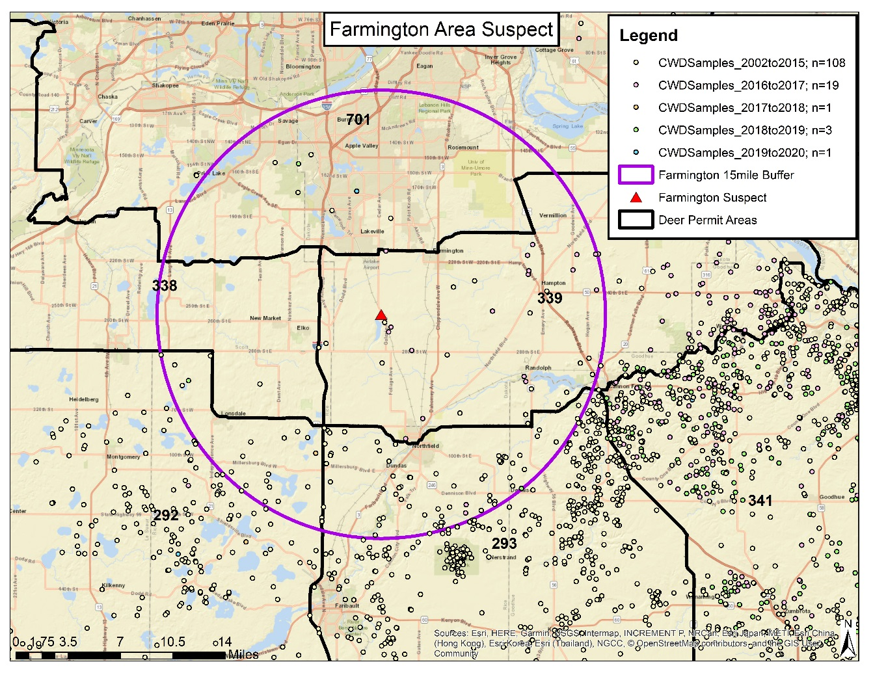
Dakota County wild positive (South Metro)
This deer was reported sick and euthanized on 3/2/2020
It was confirmed positive on 3/13/2020

Slide 31
Dakota County wild positive (South Metro)
NEW South Metro CWD Management Zone, DPA 605 (grey area)
Unlimited disease management permits $2.50/each for antlerless deer only
1 buck per hunter
Carcass movement restrictions apply
Voluntary sampling during all hunting season
Antler point restriction removed and cross tagging of bucks is allowed
Dumpsters available for carcass waste
In place for at least 3 years, if consecutive not detected results then will dissolve back to historic DPA’s; following our CWD Response Plan
South Metro Surveillance Area
(orange area): Testing during firearms season only and until goal of 750 deer is reached in the surrounding DPAs

Slide 32
Expanded Dumpster Program
Over 200 tons of deer waste generated last year! Program costs in 2019: $185k
Dumpster program will continue as last year in NC and SE. Added new dumpsters in 605
All bids for haulers are out now
16 vendor solicitations for 33 dumpster locations
Bids were due 3-Sept, dumpsters in place by mid-Sept
Contracts will require functional lids this time.
Deer hunting groups have been contacted to gauge interest in supporting the continuation of the program
Groups will be provided total costs per dumpster site this year to help plan for 2021

Slide 33
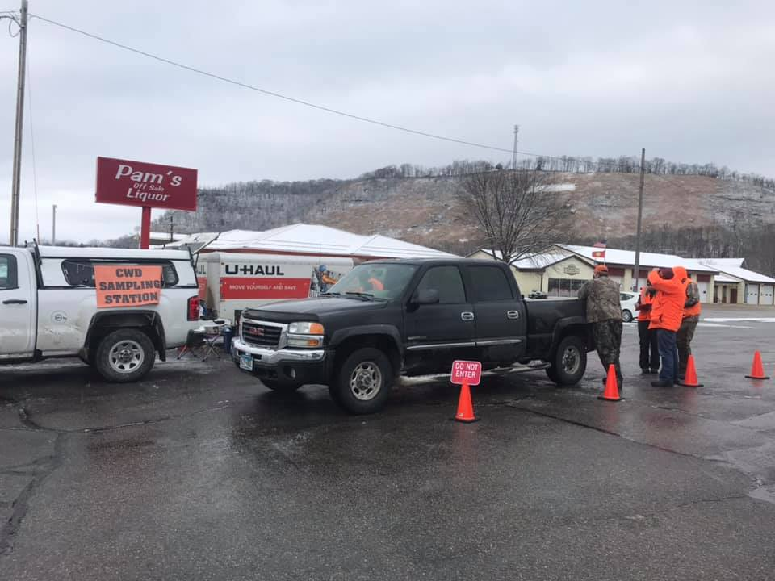
2020: Changes To CWD Efforts
Voluntary CWD sampling for fall 2020 to minimize social interaction due to COVID-19
Sampling goals are designed to maintain high level of confidence in detecting disease
99% confidence for finding the disease, if present in >1% of the population
Hunters within our surveillance areas can make appointments with DNR staff for sample extraction if they are unable to use the self-service system
Partnerships have been made with >50 taxidermists and several meat processors to collect samples
Carcass movement restrictions will remain in place for all Disease Management and Control Zones
Sample extraction and data entry completed at DNR buildings staff and University students

Slide 34
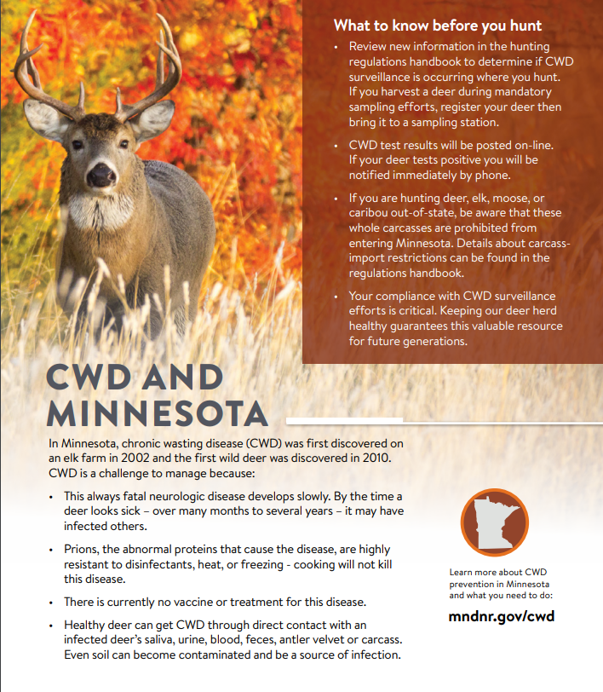
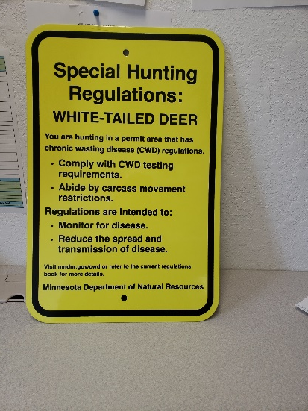
CWD Communications
Press releases, Deer Notes, social media blasts about CWD info will continue
New metal signs for public land hunters in disease management zones
More vinyl signs for self-service stations; sandwich boards for dumpster locations
Improved handouts (Brochure at self-service sampling station, flyers at big license sellers)
Updated CWD webpage and videos
Mass mailings = postcards to licensed hunters in all new areas

Slide 35
Fall 2020 Testing to Date
Sample numbers so far (some results pending): 4,541 total
Southeast: 2,622
3 CWD-positives, 8 CWD-suspects
North-Central: 765; no positives
South-Metro: 728
1 CWD-positive
East-Central: 249; no positives
West-Central: 226; no positives
Opportunistic samples: 291
2 CWD-positives, both in SE MN

Slide 36
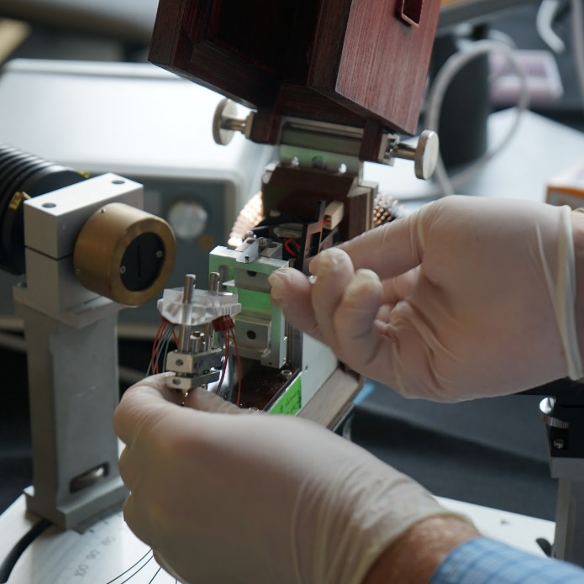
Advances in CWD Science and Diagnostics
DNR has partnered with the University of Minnesota on improved diagnostic test for CWD
Minnesota Center for Prion Research and Outreach (MNPRO)
Developing faster test methods to detect CWD in a variety of substrates
Blood, feces, muscle tissue, lymph nodes, tonsils; could include ante-mortum options
Soil, plants, water; could include testing leachate from landfills
Visit their website here: https://mnpro.umn.edu
Center for Infectious Disease Research and Policy (CIDRAP)
Global leader in address public health preparedness and response
CWD is one focal area, particularly deer waste streams and landfilling
Visit their website here: https://www.cidrap.umn.edu/cwd

Slide 37
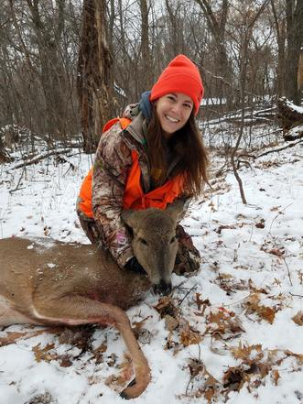
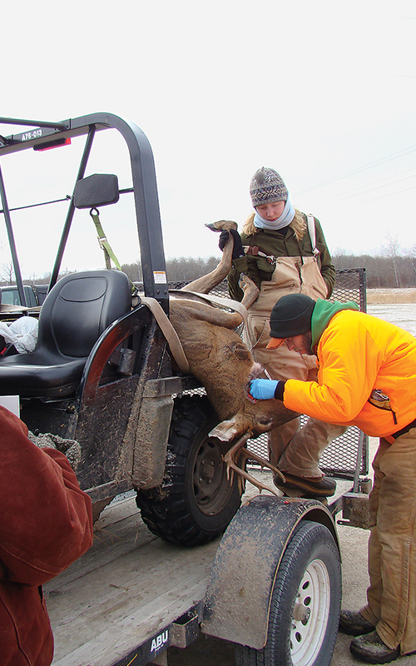
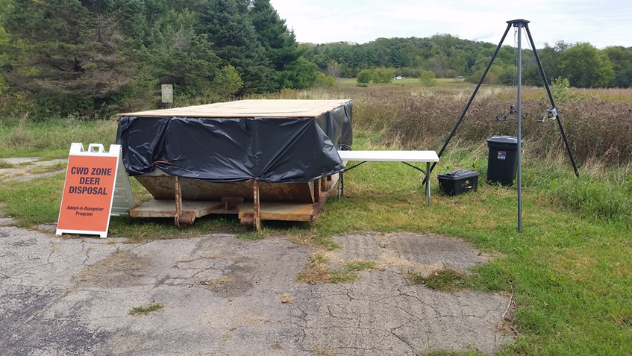
Summary
CWD remains a rare disease in MN
Aggressive approach to protect statewide deer population, hunting heritage
Adapt as we assess effectiveness
We cannot be successful in managing this disease without the help of hunters, cooperators, and businesses

