Slide 1
Minnesota Recreation Information System
A guide to having fun in Minnesota!
Where Can I…?

Slide 2
MnRec
Minnesotan’s have invested!
Disseminating Recreation Information Is Important
Consumers are more sophisticated
High expectations

Slide 3
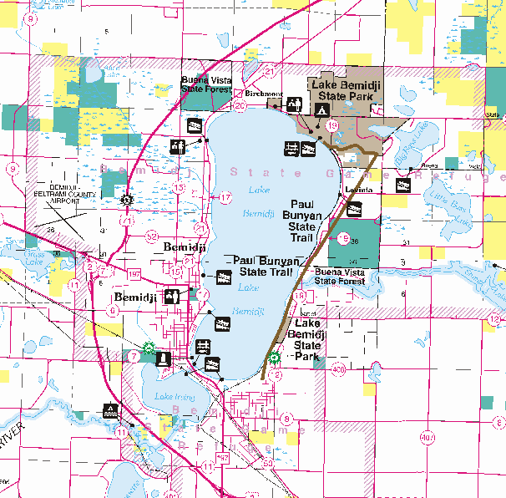
MnREC
PRIM – Public Recreation Information Maps
Developed and distributed by DNR
Original funding
General Fund allocations within DNR
Proceeds from map sales
Professional Services account
Popular and informative product

Slide 4
MnREC
Program has languished
Lack of attention/focus
Staff turn-over
Project Champion has retired
Key staff have moved-on
No Marketing Plan
Demand is there, distribution is not
Maps are no longer being updated and printed
Staff positions no longer exist to support program

Slide 5
MnREC
Access to Recreation Information needs to be rejuvenated!
On-Line access and printing
Print-on-Demand Services
Vendors print and ship customized map product
Provides the most up-to-date information available
GPS Loadable Maps
Handheld GPS Units
Navigation and Fishing
Hiking
Public Safety

Slide 6
Flexibility
Products
On-Line Access
(Where can I…)
Coordination
Partners
State
Feds
Counties
LGU’s
Met Council
U of M
Print-on-Demand
(Private Vendor)
MnREC
Data
Warehouse
GPS Loadable Maps
Mobile Device Access
(You Are Here)

Slide 7
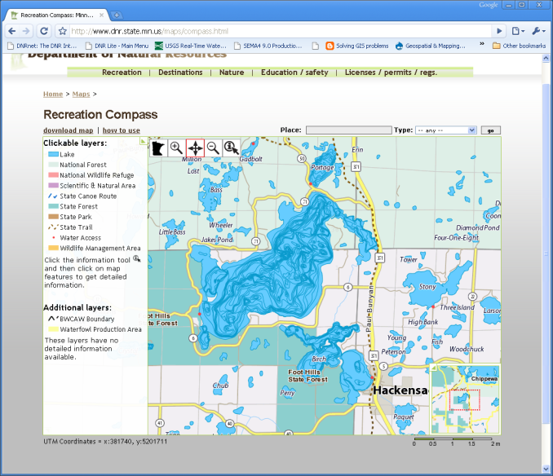
MnREC
On-Line Access – “Where can I…”
Internet – Browser access to recreation information
Maps, tables and other pertinent information
Users have lots of options
Not confined by traditional paper products
Recreation Content
User defined!
Map Scale
High detail or low detail
Area of Interest
Print at home for free!

Slide 8
MnREC
GPS Loadable Maps
Personal GPS sales are booming!
Digital GPS maps are a growing market
Easy to load and use
Not as flexible as on-line maps
Pre-Defined content
Require staff to assemble products and maintain updates
Pick Areas of Interest and Load to GPS
High Detail when zoomed in
Low Detail when zoomed out

Slide 9
MnREC
Print-on-Demand
Vendor supplied service
Print, warehouse and ship standard PRIM map series
Traditional hard-copy maps currently available
Print-on-demand user maps
On-Line Service – but can’t print at home!
Big Maps
Larger than the consumer’s printer
Custom paper and inks
Waterproof, tear proof, photo quality
Vendor receives electronic map from DNR, prints, ships and bills consumer
A portion of the sales receipts go back to help fund program

Slide 10
MnREC
Mobile Devices
Wireless access coverage is growing
SmartPhones (IPhone, GPhone, Blackberry)
Handhelds and Tablets
This is the future and we can be ready!
You Are Here (YAH)
What hiking facilities and services are nearby!
Where Can I?
I’m looking for areas that I can ride my horse!

Slide 11
MnREC
Showing Private Lands on Public Maps
Ownership/boundary data is public information
Already exists in several forms
Plat maps, on-line ownership, etc
Balance –
Sensitivity to landowners privacy
Need to display private lands open to public Access
Walk in Areas
Forest Conservation Easements

